Slide 1
The Whole
Secret of Prayer

Slide 2
George Muller

Slide 3
George Muller
During his ministry in Bristol, Mr. Muller started the Scriptural Knowledge Institute to distribute Bibles and to give religious instruction. And he also began an orphanage.
They educated and sent out into the world 122,000 pupils.
They funded the annual salaries of 112 assistants.
They supported 189 missionaries.
Notes:
George Muller was a pastor in England during the 1800s. He lived in an age where no one looked to God to do anything unusual. They no longer trusted God to answer prayers. They had so little faith. Mr. Mueller wanted the people to learn that God was a faithful prayer-answering God. Three weeks after George Muller got married to Mary, they decided together that whenever they had a financial need, they would never talk to anyone about it, but would only speak to God. And they claimed Matthew 6:33. During his ministry in Bristol, Mr. Muller started the Scriptural Knowledge Institute to distribute Bibles and to give religious instruction. And he also began an orphanage.

Slide 4
George Muller
They bought and circulated 275,000 Bibles in different languages and distributed 1,500,000 New Testaments.
Over 10,000 children had been provided for through 4 orphan houses that God led Mr. Muller to start.
Over a period of 68 years, God supplied him with $7,500,000 to fund these projects and more!
When he died at 98, his worldly possessions were valued at $800.

Slide 5
$180,000,000
Notes:
Do you know how much George Mueller received in answer to prayer? Mr. Mueller received the equivalent in today’s dollars of $180,000,000.

Slide 6
John 16:24
“Ask, and you will receive,
that your joy may be full.”

Slide 7
A.T. Pierson
“A human life, filled with the presence and power of God, is one of God's choicest gifts to His church and to the world.”
George Muller of Bristol

Slide 8
The Whole Secret of Prayer

Slide 9
John 15:7
“If you abide in Me, and My words abide in you, you will ask what you desire, and it shall be done for you.”

Slide 10
The first condition is:
  “If you abide in Me.”

Slide 11
John 15:4-5
4 “Abide in Me, and I in you. As the branch cannot bear fruit of itself, unless it abides in the vine, neither can you, unless you abide in Me.”
5 "I am the vine, you are the branches. He who abides in Me, and I in him, bears much fruit; for without Me you can do nothing.”

Slide 12
Abiding in Jesus
A life that is fully surrendered

Slide 13
An Unknown Christian
“Is it not worth while to be wholly and wholeheartedly yielded to Christ? The half-and-half Christian is of very little use either to God or man. God cannot use him, and man has no use for him but considers him a hypocrite. …
“One sin allowed in the life wrecks at once our usefulness and our joy and robs prayer of its power.”
The Kneeling Christian, p.71

Slide 14
Abiding in Jesus
A life that is fully surrendered
A life of complete dependence on Christ
A life of great faith and prayer

Slide 15
John 15:10
“If you keep My commandments, you will abide in My love, just as I have kept My Father's commandments and abide in His love.”

Slide 16
The Son can do nothing of Himself (John 5:19).
I can of Myself do nothing….My judgment is righteous, because I do not seek My own will (v.30).
I do not receive honor from men (v. 41).
For I have come down from heaven, not to do My own will (John 6:38).
My doctrine is not Mine (John 7:16).

Slide 17
  I have not come of Myself (John 7:28).
I do nothing of Myself (John 8:28).
Nor have I come of Myself, but He sent Me (v. 42)
I do not seek My own glory (v. 50).
The words that I speak to you I do not speak on My own authority (John 14:10).
The word which you hear is not Mine (v. 24).
Notes:
Jesus lived a life of utter dependence on the Father. He lived a life of entire submission to the Father’s will. Jesus was nothing and God was everything.

Slide 18
John 14:12
“Most assuredly, I say to you, he who believes in Me, the works that I do he will do also; and greater works than these he will do, because I go to My Father.”

Slide 19
Ellen White
“God was manifested in Him that He might be manifested in them. Jesus revealed no qualities, and exercised no powers, that men may not have through faith in Him. …
“His perfect humanity is that which all His followers may possess, if they will be in subjection to God as He was.”
DA 664

Slide 20
R.A. Torrey
“To abide in Christ is to renounce any independent lives of our own. We must give up trying to think our own thoughts, form our own resolutions, or cultivate our own feelings….

Slide 21
R.A. Torrey
“We must simply and constantly look to Christ to think His thoughts in us, to form His purposes in us, to feel His emotions and affections in us….

Slide 22
R.A. Torrey
“It is to renounce all life independent of Christ and constantly look to Him for the inflow of His life into us and the outworking of His life through us. When we do this, our prayer will obtain what we seek from God.”
How to Pray p.44

Slide 23
John 15:7
“If you abide in Me, and My words abide in you, you will ask what you desire, and it shall be done for you.”

Slide 24
Psalms 37:4
“Delight yourself also in the LORD,
And He shall give you the desires of your heart.”

Slide 25
Ian Thomas
“It is not difficult for man to live the Christian life, it is a sheer impossibility—a sheer impossibility, that is without Christ!”
Mystery of Godliness, p.27

Slide 26
Mead MacGuire
“Man of himself not only has no life, but he has no peace, no victory, no faith, no righteousness, nor any other attribute of God. The Father has gathered up all the blessings of infinite love, and bestowed them upon us in the precious give of His Son. Nothing has been withheld. All is embraced and included in the one great gift.”
The Life of Victory

Slide 27
1 John 5:12
“He who has the Son has life; he who does not have the Son of God does not have life.”

Slide 28
John 15:4
    “Abide in Me, and I in you. As the branch cannot bear fruit of itself, unless it abides in the vine, neither can you, unless you abide in Me.”

Slide 29
The second condition is:
  “And My words abide in you.”

Slide 30
John 6:63
        “The words that I speak to you are spirit and they are life.”

Slide 31
George Muller

Slide 32
Ellen White
“‘For what nation is there so great, who hath God so nigh unto them, as the Lord our God is in all things that we call upon Him for.’ If we will draw nigh to God, He will draw nigh to us, and His glory will go before us. …
“He will indite our petitions, teaching us to ask for the very things that He has pledged Himself to bestow on us.”
GCB, April 2, 1903 par. 6

Slide 33
Ellen White
“We must not only pray in Christ's name, but by the inspiration of the Holy Spirit. This explains what is meant when it is said that the Spirit "maketh intercession for us, with groanings which cannot be uttered." Rom. 8:26. Such prayer God delights to answer….”

Slide 34
Ellen White
“When with earnestness and intensity we breathe a prayer in the name of Christ, there is in that very intensity a pledge from God that He is about to answer our prayer ‘exceeding abundantly above all that we ask or think.’” Eph. 3:20.
COL 147

Slide 35
John 15:7
“If you abide in Me, and My words abide in you, you will ask what you desire, and it shall be done for you.”

Slide 36
Unknown Author
  “No one can have very real and deep communion with God who does not know how to pray so as to get answers to prayer.”
  The Kneeling Christian, p.46

Slide 37
The Secret Of Mueller’s Success
“There was a day when I died, utterly died;” and , as he spoke, he bent lower and lower until he almost touched the floor– “died to George Muller, his opinions, preferences, tastes and will---died to the world, its approval or censure--died to the approval or blame even of my brethren and friends--and since then I have studied only to show myself approved unto God.”

Slide 38
Ellen White
“There is no limit to the usefulness of one who, by putting self aside, makes room for the working of the Holy Spirit upon his heart, and lives a life wholly consecrated to God.”
DA 250

Slide 39
Ellen White
“No man can empty himself of self. We can only consent for Christ to accomplish the work….

Slide 40
Ellen White
“Then the language of the soul will be, Lord, take my heart; for I cannot give it. It is Thy property. Keep it pure, for I cannot keep it for Thee. Save me in spite of myself, my weak, unchristlike self. Mold me, fashion me, raise me into a pure and holy atmosphere, where the rich current of Thy love can flow through my soul.”
COL 159

Slide 41
Hannah Whitall Smith
“You may have left much to follow Christ… you may have believed on him, and worked for Him, and loved Him, and yet may not be like Him. Allegiance you know, and confidence you know, but not yet union. …

Slide 42
Hannah Whitall Smith
“There are two wills, two interests, two lives. You have not yet lost your own life that you may live only in His. …
“Once it was I and not Christ; then it was I and Christ; perhaps now it is even Christ and I. But has it come yet to be Christ only, and not I at all?”
The Christian’s Secret of a Happy Life, pp.156-157

Slide 43
Francis Ridley Havergal
Live out Thy life within me,
O Jesus, King of kings!
Be Thou Thyself the answer
to all my questionings;
Live out Thy life within me,
in all things have Thy way!
I, the transparent medium,
Thy glory to display.

Slide 44
Francis Ridley Havergal
The temple has been yielded,
And purified of sin;
Let Thy Shekinah glory
Now shine forth from within,
And all the earth keep silence,
The body henceforth be
Thy silent, gentle servant,
Moved only as by Thee.

Slide 45
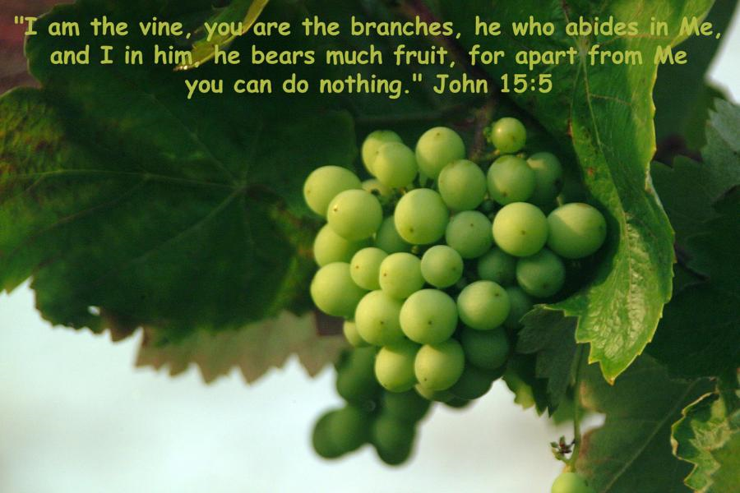
freefoto.com

Slide 46
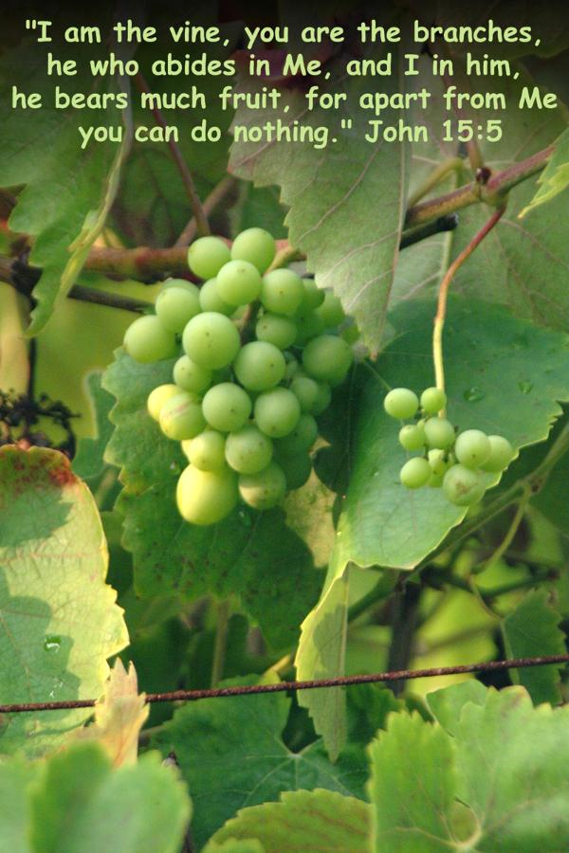

Slide 47
Ellen White
No man can empty himself of self. We can only consent for Christ to accomplish the work.
Then the language of the soul will be, Lord, take my heart; for I cannot give it. It is Thy property. Keep it pure, for I cannot keep it for Thee. Save me in spite of myself, my weak, unchristlike self. Mold me, fashion me, raise me into a pure and holy atmosphere, where the rich current of Thy love can flow through my soul.
COL 159

