Slide 1
Increase Our Faith

Slide 2
Mueller In The Fog

Slide 3
Ellen White
“Prayer and faith are closely allied, and they need to be studied together. In the prayer of faith there is a divine science; it is a science that everyone who would make his lifework a success must understand.”
Ed 257
Notes:
Praying without faith is like trying to cut with a blunt knife—much labor expended to little purpose.

Slide 4
What does the Bible say about FAITH?

Slide 5
Ellen White
“Prayer and faith are closely allied, and they need to be studied together. In the prayer of faith there is a divine science; it is a science that everyone who would make his lifework a success must understand. …

Slide 6
Ellen White
“Christ says, ‘What things soever ye desire, when ye pray, believe that ye receive them, and ye shall have them.’ Mark 11:24. He makes it plain that our asking must be according to God's will; we must ask for the things that He has promised, and whatever we receive must be used in doing His will. The conditions met, the promise is unequivocal.”
Ed 257

Slide 7
Eileen Crossman
James Fraser:
“I have come to see that in past years I have wasted much time over praying (in a way) that was not effective prayer at all. Praying without faith is like trying to cut with a blunt knife—much labor expended to little purpose. For the work accomplished by labor in prayer depends on our faith: ‘According to your faith,’ not labor, ‘be it unto you.’...
Mountain Rain
Notes:
James Fraser was a missionary who served with Hudson Taylor in China. Fraser did a wonderful work and achieved much through prayer.

Slide 8
Hebrews 11:6
“But without faith it is impossible to please Him, for he who comes to God must believe that He is, and that He is a rewarder of those who diligently seek Him.”

Slide 9
1 John 5:4
“For whatever is born of God overcomes the world. And this is the victory that has overcome the world — our faith.”

Slide 10
Romans 14:23
“…for whatever is not from faith is sin.”

Slide 11
Hebrews 4:2
“For indeed the gospel was preached to us as well as to them; but the word which they heard did not profit them, not being mixed with faith in those who heard it.”

Slide 12
Luke 18:8
“When the Son of Man comes, will He really find faith on the earth?”

Slide 13
Hannah Whitall Smith
“Our Lord asked the pathetic question, ‘When the Son of Man cometh, shall he find faith on the earth?’ He will find plenty of activity, a great deal of earnestness, and doubtless many consecrated hearts; but shall he find faith, the one thing He values more than all the rest? It is a solemn question, and I would that every Christian heart would ponder it well.”
  The Christian's Secret of a Happy Life, p. 50
Notes:
The Christian's Secret of a Happy Life p. 50

Slide 14
James 1:5-8
“If any of you lacks wisdom, let him ask of God, who gives to all liberally and without reproach, and it will be given to him. But let him ask in faith, with no doubting, for he who doubts is like a wave of the sea driven and tossed by the wind. For let not that man suppose that he will receive anything from the Lord; he is a double-minded man, unstable in all his ways.”

Slide 15
Ellen White
“We may expect large things, even the deep movings of the Spirit of God, if we have faith in His promises. …
“Our greatest sin is unbelief in God.”
Letter 92, 1896, p. 2.
Notes:
Letter 92, 1896, p. 2. (To "Dear Brother A. T. Robinson," September 2, 1896.) {4MR 395.1}

Slide 16
Matthew 13:58
“Now He did not do many mighty works there because of their unbelief.”

Slide 17
Ellen White
“Every failure on the part of the children of God is due to their lack of faith.”
PP 657

Slide 18
WHAT IS FAITH?

Slide 19
FAITH
Forsaking
All
I
Take
Him

Slide 20
Proverbs 3:5-6
“Trust in the LORD with all your heart,
And lean not on your own understanding;
In all your ways acknowledge Him,
And He shall direct your paths.”

Slide 21
FAITH
Fantastic
Adventures
In
Trusting
Him

Slide 22
Psalm 34:8
“Oh, taste and see that the LORD is good;
Blessed is the man who trusts in Him!”

Slide 23
Ellen White
“Faith is trusting God--believing that He loves us and knows best what is for our good. Thus, instead of our own, it leads us to choose His way.” Ed 253

Slide 24
George Muller
“In the simplest manner in which I am able to express it, I answer: Faith is the assurance that the thing which God has said in His Word is true, and that God will act according to what He has said in His Word. This assurance, this reliance on God's Word, this confidence is FAITH.…

Slide 25
George Muller
“No impressions are to be taken in connection with faith. Impressions have neither one thing nor the other to do with faith. Faith has to do with the Word of God. …

Slide 26
George Muller
“Probabilities are not to be taken into account. Many people are willing to believe regarding those things that seem probable to them. Faith has nothing to do with probabilities. The province of FAITH begins where probabilities cease and sight and sense fail.

Slide 27
George Muller
“Appearances are not to be taken into account. The question is - whether God has spoken it in His Word.
Notes:
are you coming to Arme Bible camp
Friend: haha..
me: haha
Friend: I can't be spending money like that with no job

Slide 28
2 Corinthians 5:7
“For we walk by faith, not by sight.”
Notes:
Faith is not sight and sight is not faith.
If faith were sight, it would not be faith, it would be sight.

Slide 29
Matthew 8:10
When Jesus heard it, He marveled, and said to those who followed, “Assuredly, I say to you, I have not found such great faith, not even in Israel!”

Slide 30
Matthew 8:5-9
5 Now when Jesus had entered Capernaum, a centurion came to Him, pleading with Him, 6 saying, "Lord, my servant is lying at home paralyzed, dreadfully tormented."
7 And Jesus said to him, "I will come and heal him."
8 The centurion answered and said, "Lord, I am not worthy that You should come under my roof. But only speak a word, and my servant will be healed. 9 For I also am a man under authority, having soldiers under me. And I say to this one, 'Go,' and he goes; and to another, 'Come,' and he comes; and to my servant, 'Do this,' and he does it.“

Slide 31
Luke 5:4-8
4 When He had stopped speaking, He said to Simon, "Launch out into the deep and let down your nets for a catch."
5 But Simon answered and said to Him, "Master, we have toiled all night and caught nothing; nevertheless at Your word I will let down the net."
6 And when they had done this, they caught a great number of fish, and their net was breaking. 7 So they signaled to their partners in the other boat to come and help them. And they came and filled both the boats, so that they began to sink.

Slide 32
George Muller
“Faith is the assurance that the thing which God has said in His Word is true, and that God will act according to what He has said in His Word. This assurance, this reliance on God's Word, this confidence is FAITH.”

Slide 33
Luke 17:5
And the apostles said to the Lord, “Increase our faith.”

Slide 34
Matthew 17:20
“For assuredly, I say to you, if you have faith as a mustard seed , you will say to this mountain, 'Move from here to there,' and it will move; and nothing will be impossible for you.”

Slide 35
Mark 16:14-15
14 Later He appeared to the eleven as they sat at the table; and He rebuked their unbelief and hardness of heart, because they did not believe those who had seen Him after He had risen.
15 And He said to them, "Go into all the world and preach the gospel to every creature.

Slide 36
Romans 10:17
“So then faith comes by hearing, and hearing by the word of God.”
Notes:
Faith is nurtured by the word of God.

Slide 37
Ellen White
“If you want faith, talk faith; talk hopefully, cheerfully.”
1T 699

Slide 38
C.T. Studd
“Funds are low again, hallelujah! That means God trusts us and is willing to leave His reputation in our hands.”

Slide 39
Ellen White
“Let us take heed to our words. Let us talk faith, and we shall have faith. Never give place to a thought of discouragement in the work of God. Never utter a word of doubt. It is as seed sown in the heart of both speaker and hearers, to produce a harvest of discouragement and unbelief.”
Ev 633
Notes:
If you talk doubt, it will grow. It is very contagious. It will die, if you don’t mention it.

Slide 40
Ellen White
“Take the word of Christ as your assurance. Has He not invited you to come unto Him? Never allow yourself to talk in a hopeless, discouraged way. If you do you will lose much. …

Slide 41
Ellen White
“By looking at appearances and complaining when difficulties and pressure come, you give evidence of a sickly, enfeebled faith. Talk and act as if your faith was invincible. The Lord is rich in resources; He owns the world. Look heavenward in faith. Look to Him who has light and power and efficiency.”
COL 146

Slide 42
Matthew 9:29
Then He touched their eyes, saying, "According to your faith let it be to you."
Notes:
Matt 9:27-30
When Jesus departed from there, two blind men followed Him, crying out and saying,"Son of David, have mercy on us!"
28 And when He had come into the house, the blind men came to Him. And Jesus said to them, "Do you believe that I am able to do this?"
They said to Him, "Yes, Lord."
29 Then He touched their eyes, saying, "According to your faith let it be to you."
NKJV

Slide 43
Great faith, great blessing;
Little faith, little blessing;
No faith, no blessing”

Slide 44
Numbers 13:30-31
30 Then Caleb quieted the people before Moses, and said, "Let us go up at once and take possession, for we are well able to overcome it."
31 But the men who had gone up with him said, "We are not able to go up against the people, for they are stronger than we."

Slide 45
Numbers 14:28-30
28 Say to them, 'As I live,' says the LORD, 'just as you have spoken in My hearing, so I will do to you: 29 The carcasses of you who have complained against Me shall fall in this wilderness, all of you who were numbered, according to your entire number, from twenty years old and above. 30 Except for Caleb the son of Jephunneh and Joshua the son of Nun, you shall by no means enter the land which I swore I would make you dwell in.

Slide 46
1 Samuel 17:45-47
45 Then David said to the Philistine, "You come to me with a sword, with a spear, and with a javelin. But I come to you in the name of the LORD of hosts, the God of the armies of Israel, whom you have defied.

Slide 47
1 Samuel 17:45-47
46 This day the LORD will deliver you into my hand, and I will strike you and take your head from you. And this day I will give the carcasses of the camp of the Philistines to the birds of the air and the wild beasts of the earth, that all the earth may know that there is a God in Israel.

Slide 48
1 Samuel 17:45-47
47 Then all this assembly shall know that the LORD does not save with sword and spear; for the battle is the LORD's, and He will give you into our hands."

Slide 49
Hebrews 11:6
“But without faith it is impossible to please Him, for he who comes to God must believe that He is, and that He is a rewarder of those who diligently seek Him.”

Slide 50
Alexander the Great

Slide 51
Ellen White
“He is well pleased when they make the very highest demands upon Him, that they may glorify His name. They may expect large things if they have faith in His promises.”
DA 668

Slide 52


Slide 53
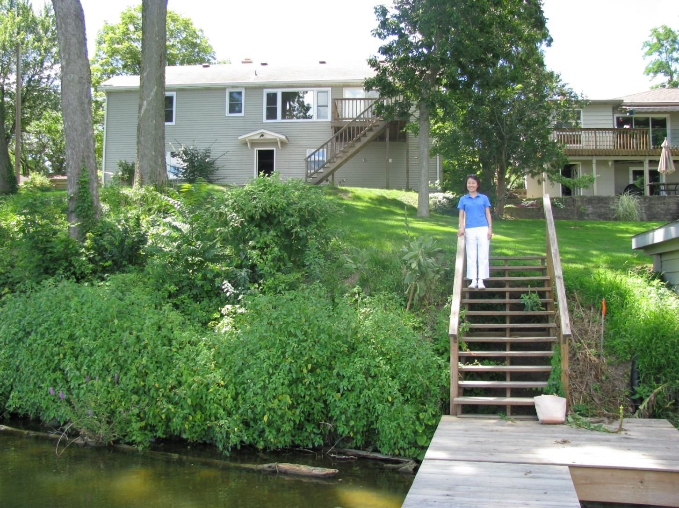

Slide 54


Slide 55


Slide 56
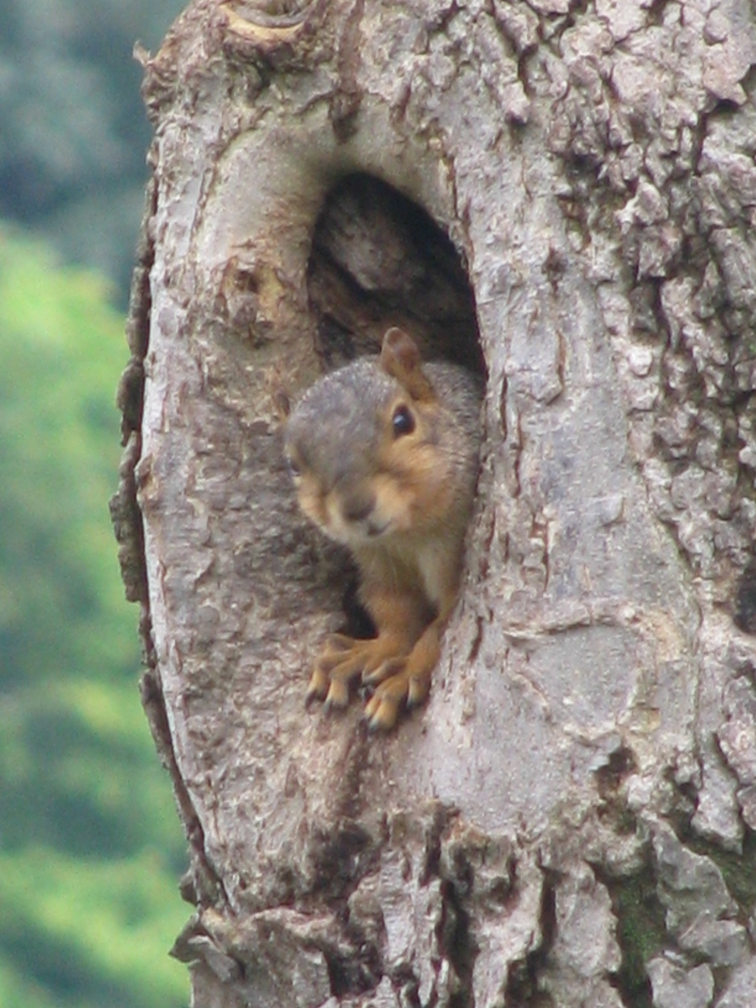

Slide 57
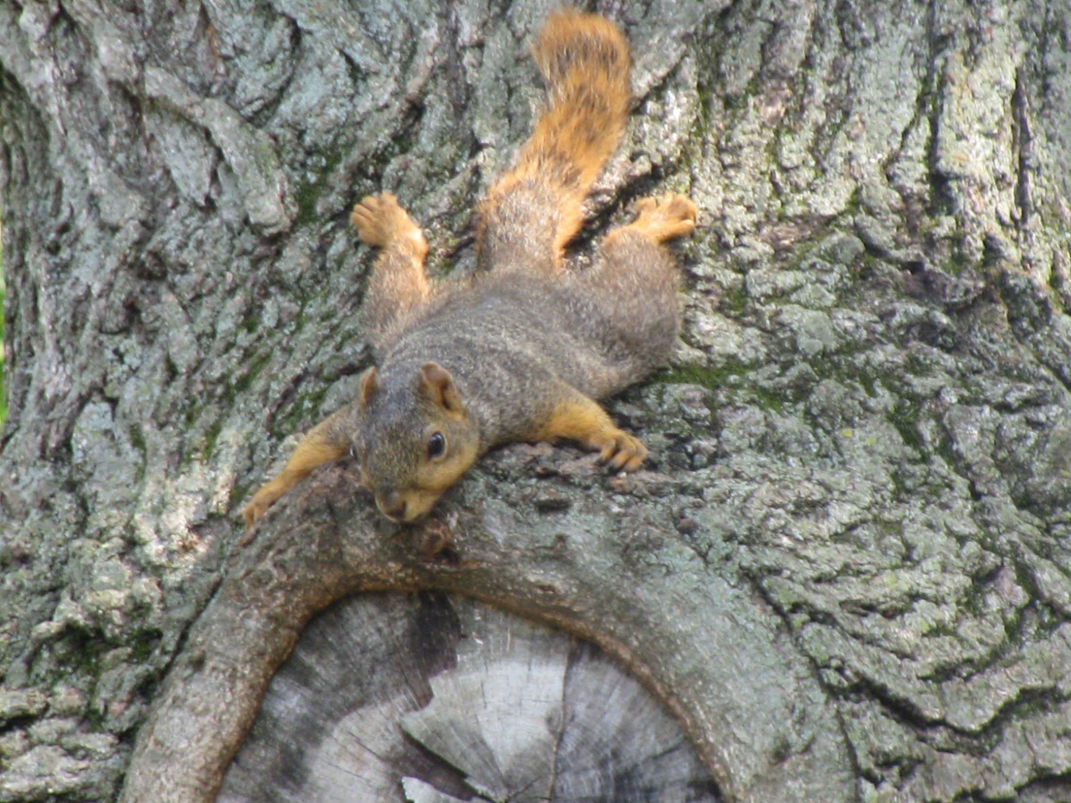

Slide 58
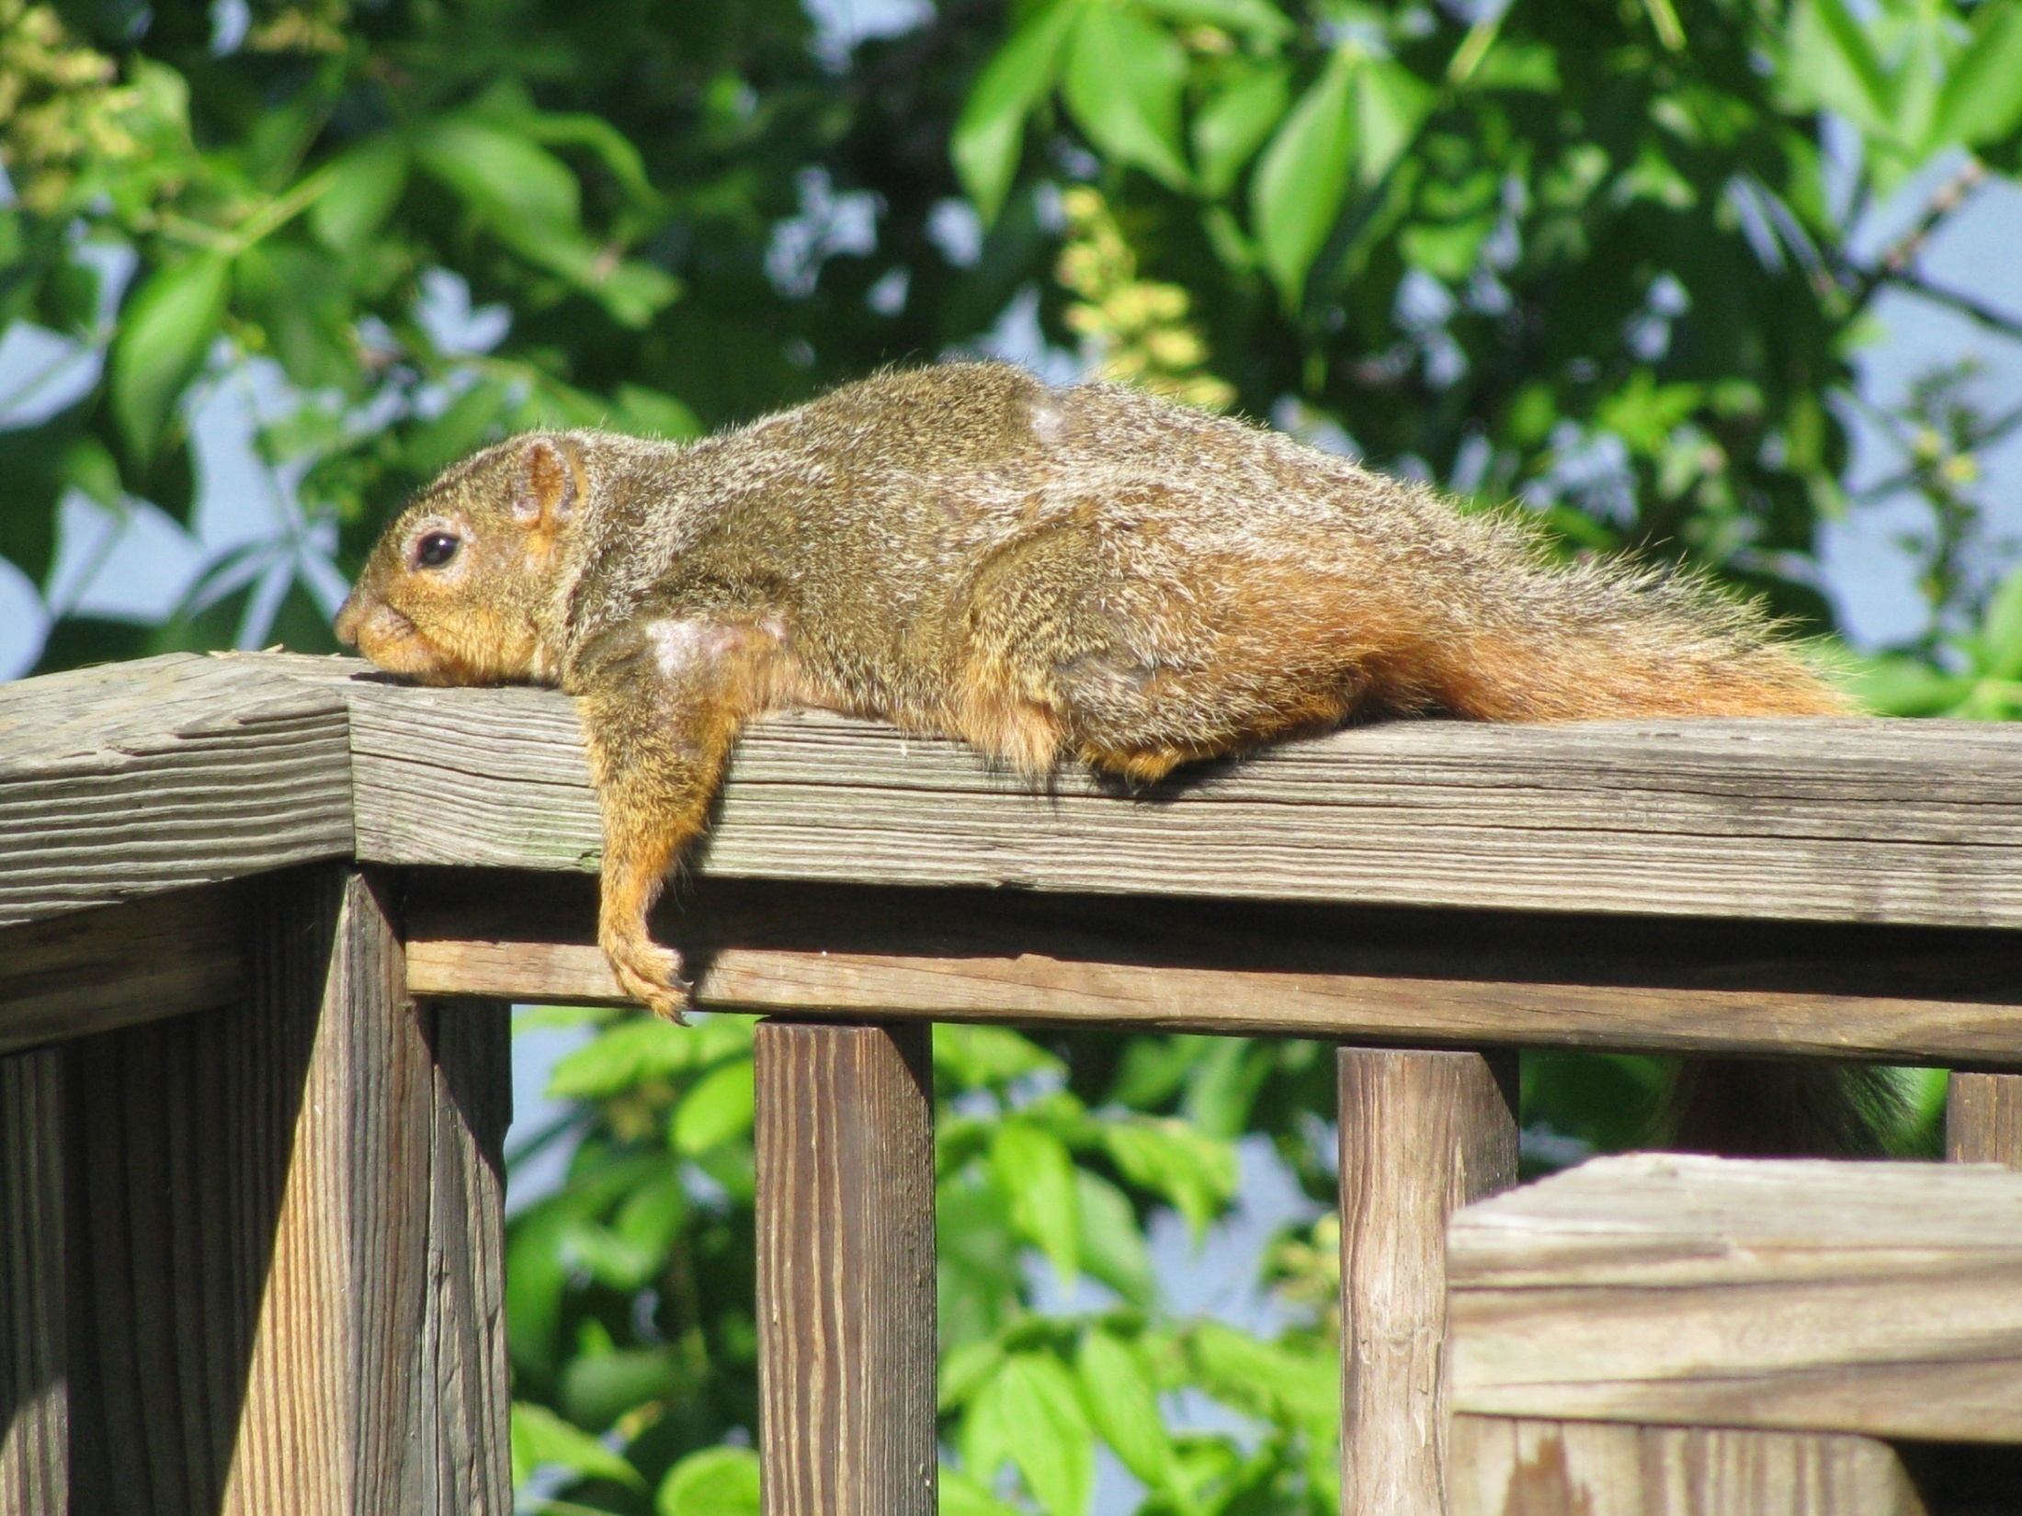

Slide 59
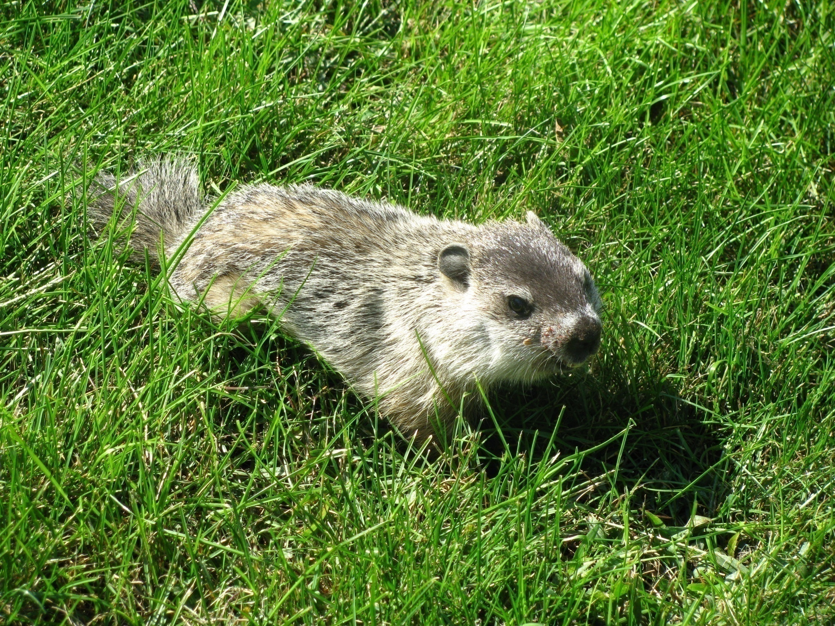

Slide 60
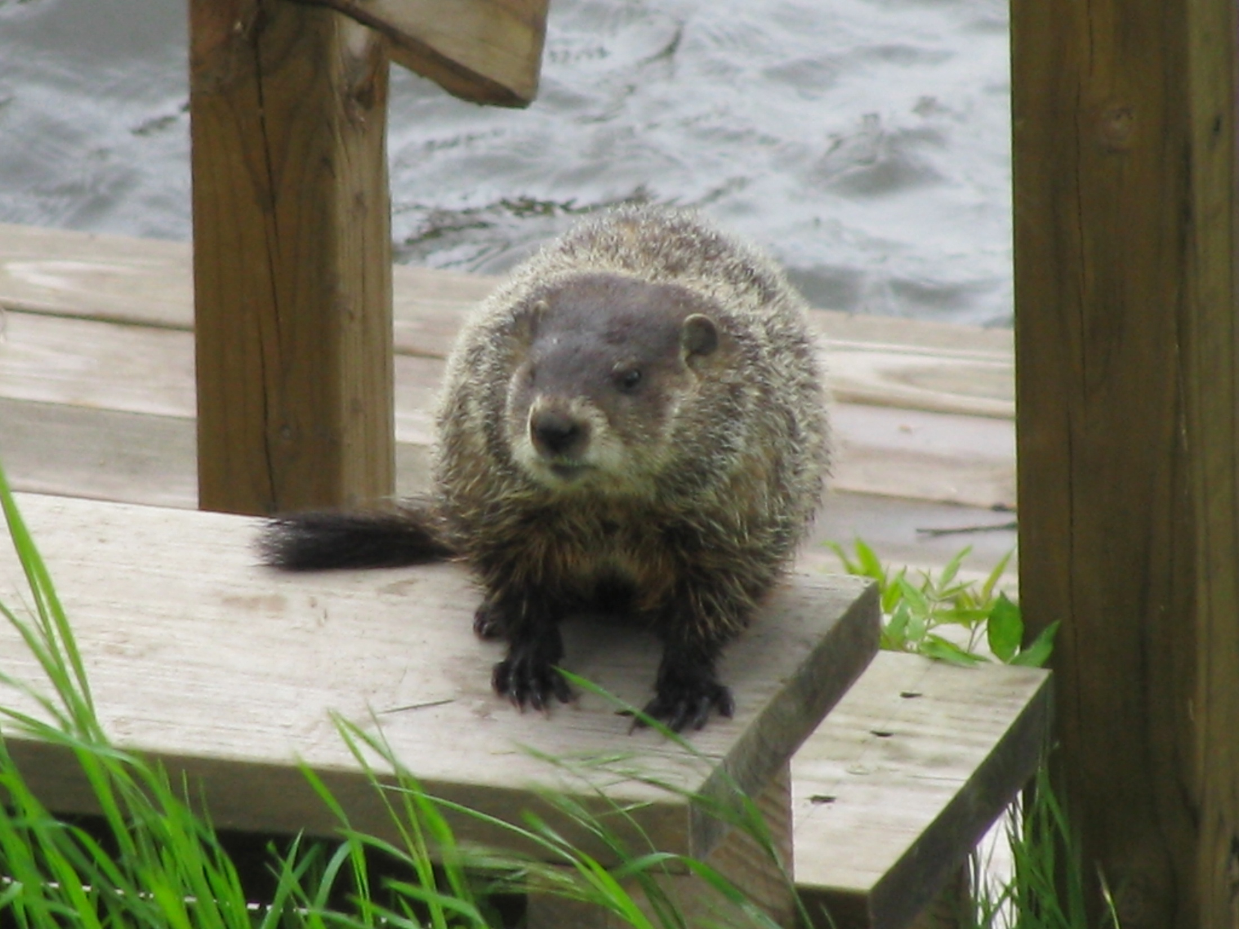

Slide 61
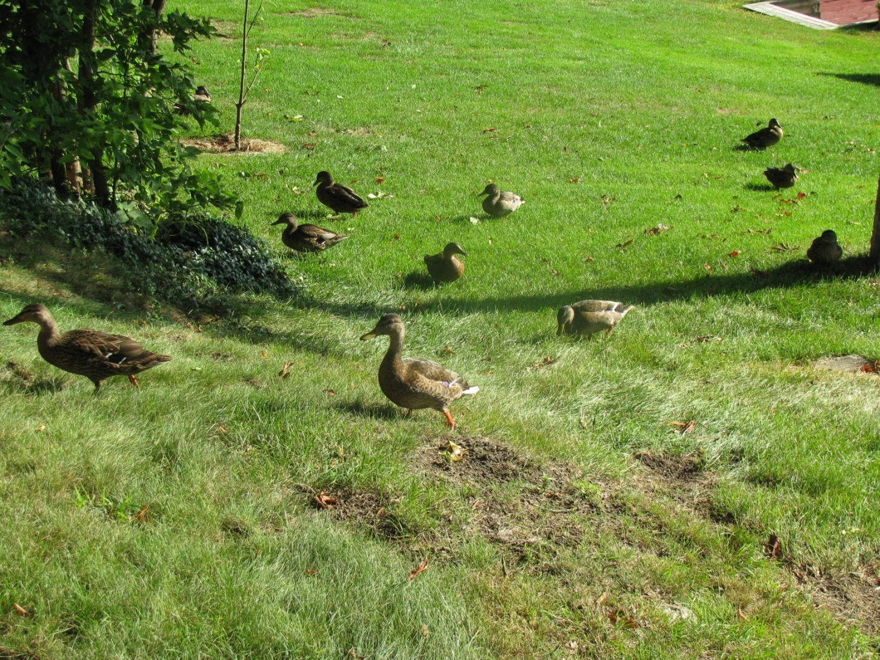

Slide 62
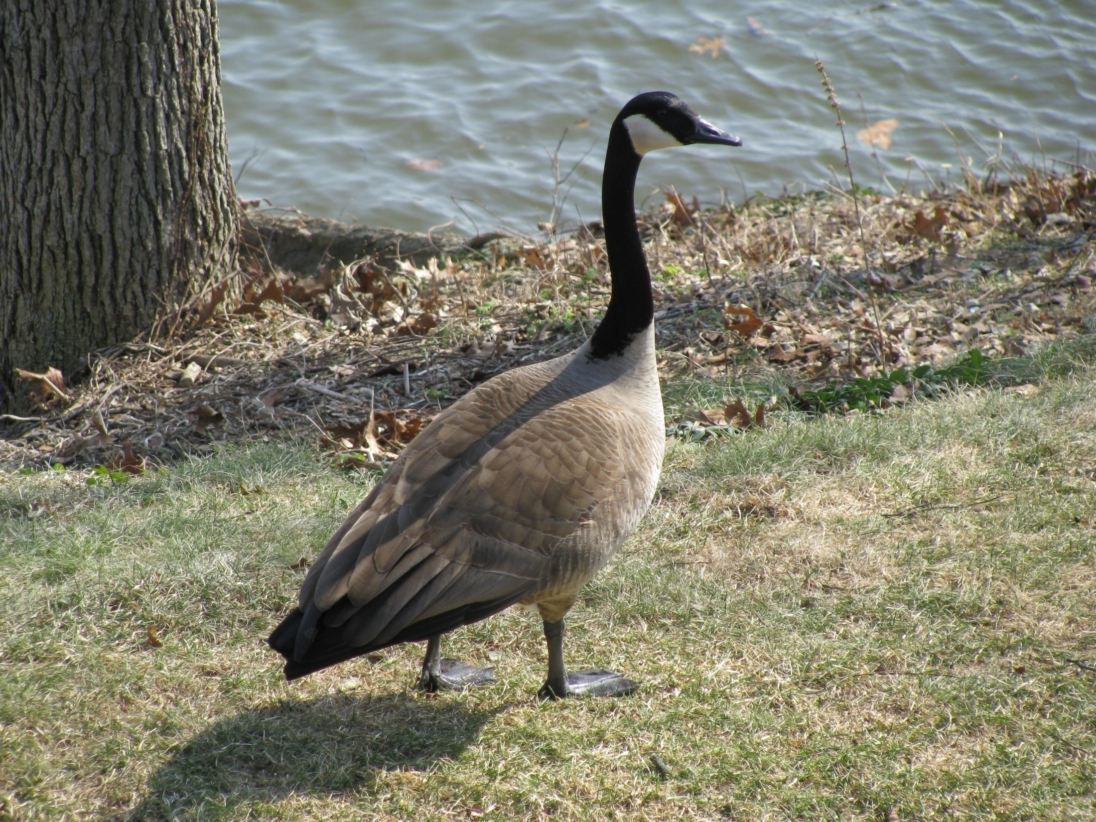

Slide 63
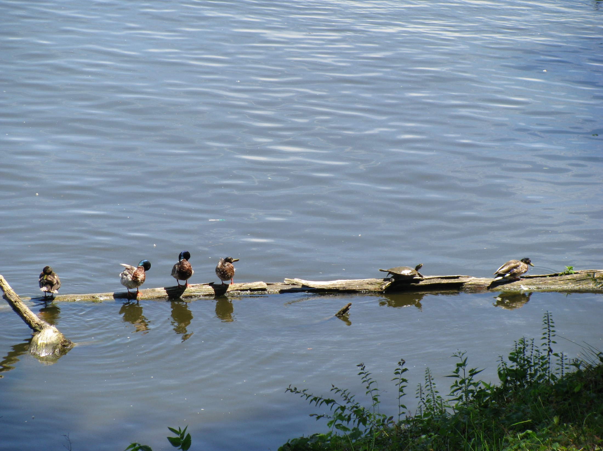

Slide 64
