Slide 1
bārā, ברא
Kalam Cosmological Argument

Slide 2
Apologetics
1 Pet 3:15
Apologia – “speaking in defense”
a field of Christian theology that aims to present a rational basis for the Christian faith, defend the faith against objections, and expose the perceived flaws of other world views

Slide 3
The role of evidence
“Many, especially those who are young in the Christian life, are at times troubled with the suggestions of skepticism...how can I be freed from these doubts and perplexities?"
God never asks us to believe, without giving sufficient evidence upon which to base our faith…Yet God has never removed the possibility of doubt. Our faith must rest upon evidence, not demonstration. Those who wish to doubt will have opportunity; while those who really desire to know the truth will find plenty of evidence on which to rest their faith…

Slide 4
Kalam Cosmological Argument
1. Whatever begins to exist has a cause.
2. The Universe began to exist.
3. Therefore, the universe has a cause.

Slide 5
1. Whatever begins to exist has a cause
3 reasons to support this first premise
Something can not come from nothing
If something can come into being uncaused out of nothing, then it becomes inexplicable why just anything and everything does not come into existence uncaused from nothing
Common experience and scientific evidence constantly confirm it

Slide 6
Objection to 1st Premise
Well then, what caused God?
“The Cosmological argument, which in its simplest form states that since everything must have a cause the universe must have a cause…What caused God?”
-Daniel Dennet, Breaking the Spell: Religion as a Natural Phenomenon

Slide 7
Kalam Cosmological Argument
1. Whatever begins to exist has a cause.
2. The Universe began to exist.
3. Therefore, the universe has a cause.

Slide 8
2. The Universe Began to Exist
2 Philosophical arguments along with 2 scientific confirmations of these on empiric basis

Slide 9
1. Impossibility of the existence of an actual infinite number of “things”
1.1) An actually infinite number of things cannot exist.
1.2) A beginningless series of events in time entails an actually infinite number of things.
1.3) Therefore, a beginningless series of events in time cannot exist.

Slide 10
1. Impossibility of the existence of an actual infinite number of “things”
Actual infinite vs potential infinite
Illustration:
Hillbert’s Hotel, German mathematician
Marbles
Objection to 2nd premise
How then can God be infinite?

Slide 11
“The infinite is nowhere to be found in reality. It neither exists in nature nor provides a legitimate basis for rational thought…The role that remains for the infinite to play is solely that of an idea.”
- David Hillbert, “On the Infinite”

Slide 12
Kalam Cosmological Argument
1. Whatever begins to exist has a cause.
2. The Universe began to exist.
3. Therefore, the universe has a cause.

Slide 13
2. Impossibility of forming an actually infinite collection of things by adding one member after another
2.1) The series of events in time is a collection formed by adding one member after another.
2.2) A collection formed by adding one member after another cannot be actually infinite.
2.3) Therefore, the series of events in time cannot be actually infinite.

Slide 14
2. Impossibility of forming an actually infinite collection of things by adding one member after another
Distinct and separate from prior argument
Sometimes referred to as the impossibility of traversing the infinite.

Slide 15
Scientific confirmations
2 remarkable scientific confirmations of the conclusion reached by philosophical reasoning
The expansion of the Universe
The thermodynamic properties of the Universe

Slide 16
1. The Expansion of the Universe
Prior to 1920’s: universe assumed to be stationary and eternal
1917: Einstein’s General Theory of Relativity
1920’s: Russian Mathematician Alexander Friedman and Belgian astronomer Georges Lemaitre
The magnitude: “was absolutely beyond comprehension. Throughout all of human history the universe was regarded as fixed and immutable and the idea that it might actually be changing was inconceivable.” –Cambridge Press

Slide 17
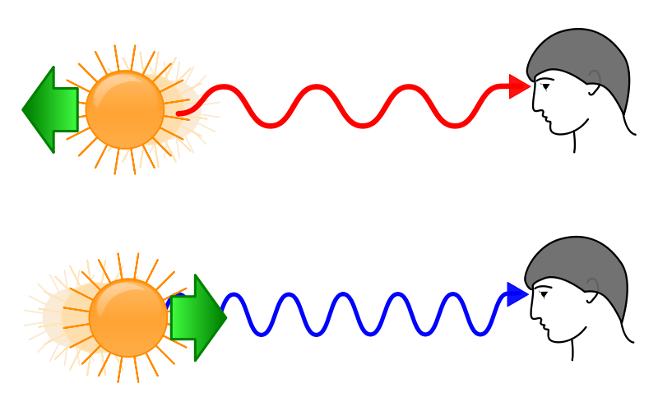
1. The Expansion of the Universe
1929: American astronomer Edwin Hubble
“the Red Shift”
“Of all the great predictions that science has ever made over the centuries, was there ever one greater than this, to predict, and predict correctly, and predict against all expectation a phenomenon so fantastic as the expansion of the universe?” – John Wheeler

Slide 18
Implications of an expanding universe
“If we extrapolate this prediction to its extreme, we reach a point when all distances in the universe have shrunk to zero. An initial cosmological singularity therefore forms a past temporal extremity to the universe. We cannot continue physical reasoning, or even the concept of spacetime, through such an extremity. For this reason most cosmologists think of the initial singularity as the beginning of the universe. On this view the big bang represents the creation event; the creation not only of all the matter and energy in the universe, but also of spacetime itself.”
-P.C.W. Davies, Spacetime and Singularities: An introduction

Slide 19
1. The Expansion of the Universe
“At this singularity, space and time came into existence; literally nothing existed before the singularity, so, if the Universe originated at such a singularity, we would truly have creation ex nihilo.”
-physicists John Barrow and Frank Tripler
“Almost everyone now believes that the universe and time itself had a beginning at the Big Bang.”
-Stephen Hawking
“The beginning seems to present insuperable difficulties unless we agree to look on it as frankly supernatural”
-Sir Arthur Eddington

Slide 20
1. The Expansion of the Universe
Further corroboration
Background Radiation
Arno Penzias, Nobel Prize
“The best data we have are exactly what I would have predicted had I nothing to go on but the five books of Moses, the Psalms, and the Bible as a whole”
-Arno Penzias, New York Times, March 12, 1978

Slide 21
“There is nonetheless a striking point at which Big Bang cosmology and traditional theological claims intersect. The universe has not proceeded from the everlasting to the everlasting. The cosmological beginning may be obscure, but the universe is finite in time. This is something that until the twentieth century was not known. When it became known, it astonished the community of physicists--and everyone else... The hypothesis of God’s existence and the facts of contemporary cosmology are consistent.” -David Berlinski, The Devil’s Delusion

Slide 22
2. The thermodynamic properties of the Universe
2nd Law of Thermodynamics:
Processes taking place in a closed system always tend toward a state of equilibrium
In other words, unless energy is constantly being fed into a system the processes will eventually run down and quit
Examples: gas within a vacuum, water in bath-tub, etc
Implications when applied to Universe = “heat death”

Slide 23
Let’s remember that the Old Testament was written more than 2,500 years ago by people that essentially contended that God told them what He did. Gerald Schroeder notes, “These commentaries were not composed in response to cosmological discoveries as an attempt to force an agreement between theology and cosmology... Theology represents a fixed view of the universe. Science, through its progressively improved understanding of the world, has come to agree with theology.” - What’s So Great About Christianity, p.124

Slide 24
“For the scientist who has lived by his faith in the power of reason, the story ends like a bad dream. He has scaled the mountains of ignorance; he is about the conquer the highest peak. As he pulls himself over the final rock, he is greeted by a band of theologians who have been sitting there for centuries.” -God and the Astronomers, p.107

Slide 25
The Nature of the First Cause
“It therefore follows that the universe has an EXTERNAL cause. Conceptual analysis enables us to recover a number of striking properties which must be possessed by such an ultra-mundane being. For as the cause of space and time, this entity must TRANSCEND space and time and therefore exist atemporally and non-spatially (at least without the universe). This transcendent cause must therefore be CHANGELESS and IMMATERIAL, since timelessness entails changelessness, and changelessness implies immateriality. Such a cause must be BEGINNINGLESS and UNCAUSED, at least in the sense of lacking any antecedent causal conditions, since there cannot be an infinite regress of causes... This entity must be UNIMAGINABLY POWERFUL, since it created the universe without any material cause.”
-William Lane Craig, Reasonable Faith; emphasis mine

Slide 26
Cause must be Personal
3 reasons to support this:
Two types of causal explanation
Scientific vs personal explanations
Implied by its timelessness and immateriality
Minds vs abstract objects (i.e numbers)
Implied by the fact of a temporal effect from a timeless cause
Example of water freezing

Slide 27
Recap
Deductive Argument
Whatever begins to exist has a cause.
The Universe began to exist.
Therefore, the Universe has a cause.
Inductive reasoning
Characteristics of first cause:
Transcendent, Changeless, Timeless, Immaterial, Beginningless, Uncaused, Exceedingly Powerful, and Personal

Slide 28
Objections to Kalam
“What does need its origin explained is the concrete Universe itself, and as Hume…long ago asked: Why not stop at the material world? It…does perform a version of the ultimate bootstrapping trick; it creates itself ex nihilo. Or at any rate out of something that is well-nigh indistinguishable from nothing at all.”
- Dennet, Breaking the Spell

Slide 29
Objections to Kalam
“Even if we allow the dubious luxury of arbitrarily conjuring up a terminator to an infinite regress and giving it a name, simply because we need one, there is absolutely no reason to endow that terminator with any of the properties normally ascribed to God: omnipotence, omniscience, goodness, creativity of design, to say nothing of such human attributes as listening to prayers, forgiving sins and reading innermost thoughts.”
-Richard Dawkins, The God Delusion

Slide 30
More than just an Argument
There is an evidence that is open to all,--the most highly educated, and the most illiterate,--the evidence of experience. God invites us to prove for ourselves the reality of His word, the truth of His promises. He bids us "taste and see that the Lord is good.” Instead of depending upon the word of another, we are to taste for ourselves...

Slide 31
…He can testify, "I needed help, and I found it in Jesus. Every want was supplied, the hunger of my soul was satisfied; and now the Bible is to me the revelation of Jesus Christ. Do you ask why I believe in Jesus? Because He is to me a divine Saviour. Why do I believe the Bible? Because I have found it to be the voice of God to my soul." We may have the witness in ourselves that the Bible is true, that Christ is the Son of God. We know that we are not following cunningly devised fables.
- Ellen White, Steps to Christ

