Slide 1
Growing and Preserving Elderberries

Slide 2
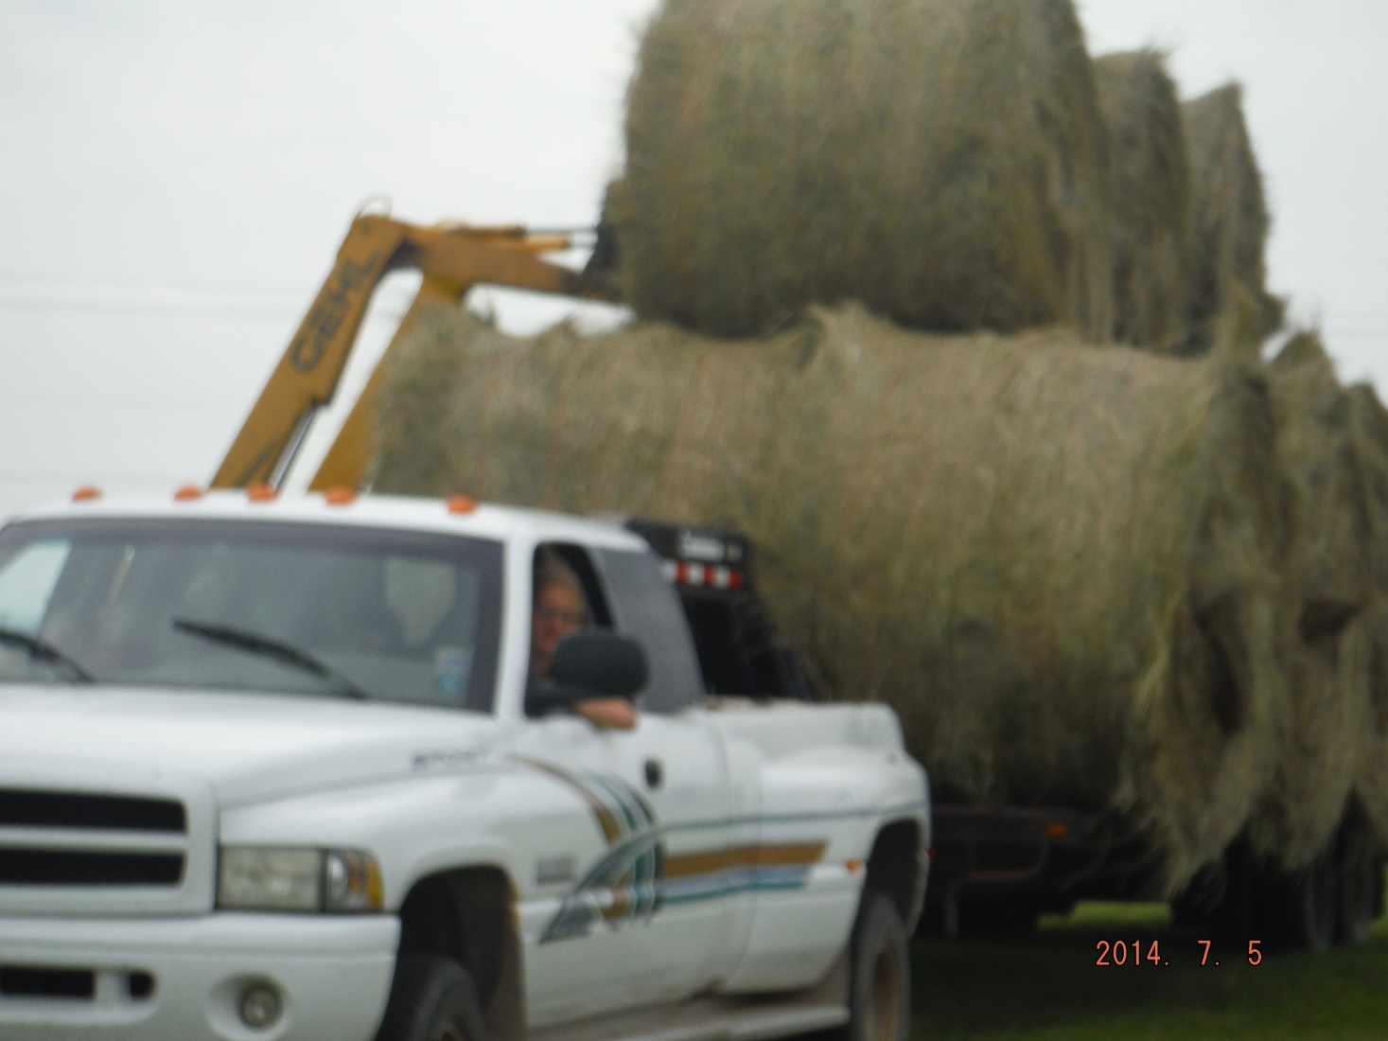
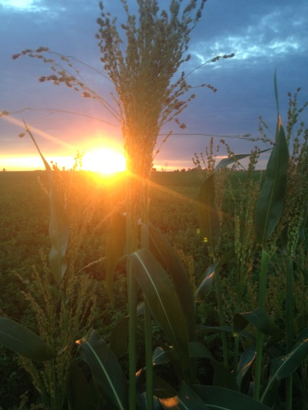
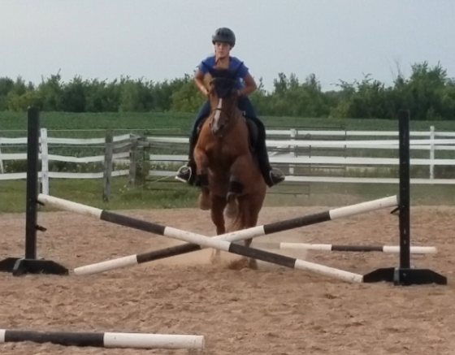
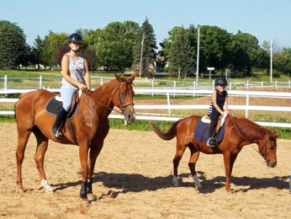
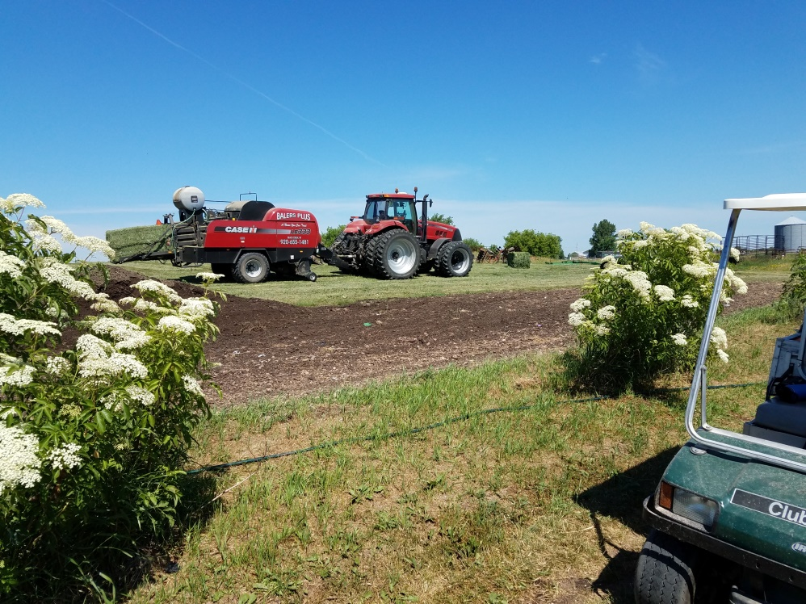
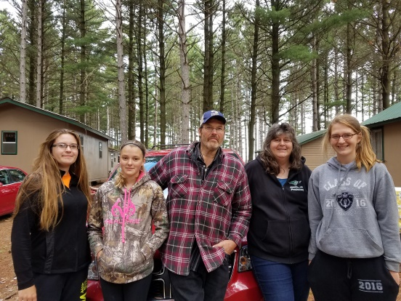
Our family farm

Slide 3
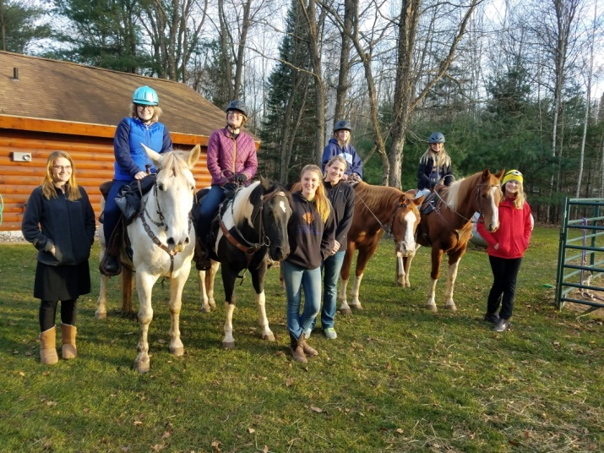
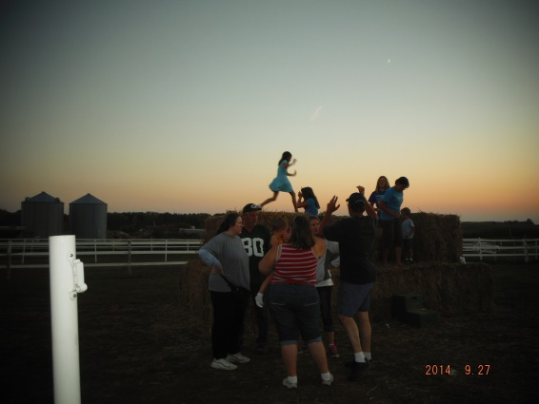
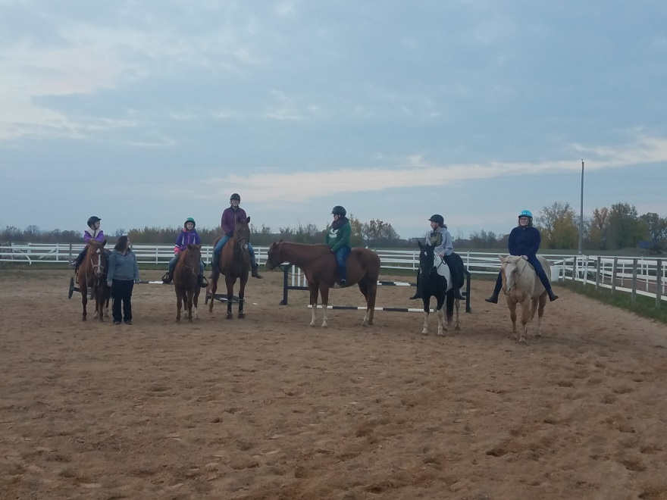
Visitors experience the country life. Sharing the message many ways

Slide 4
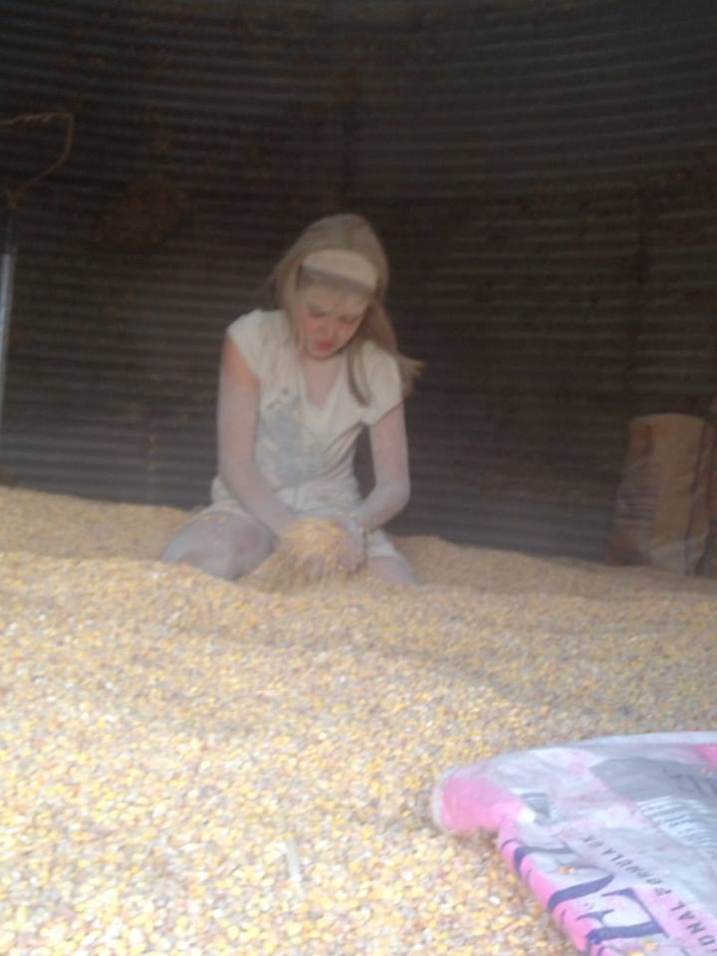
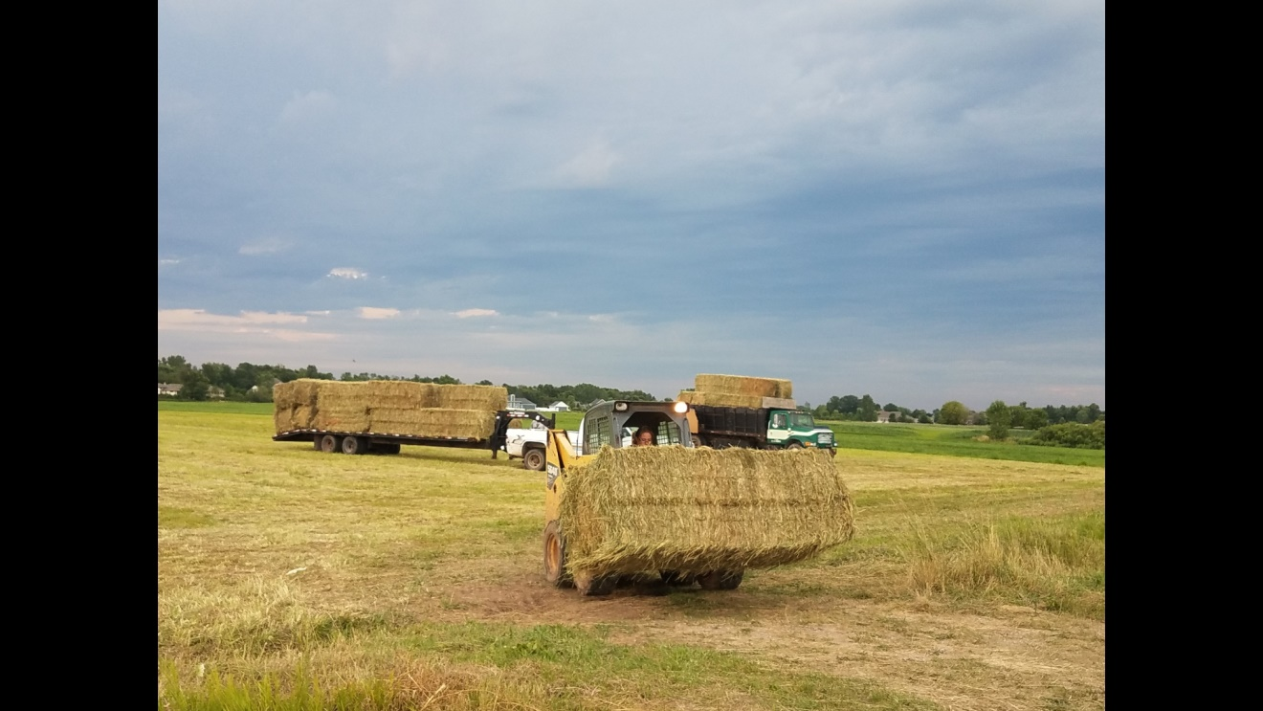
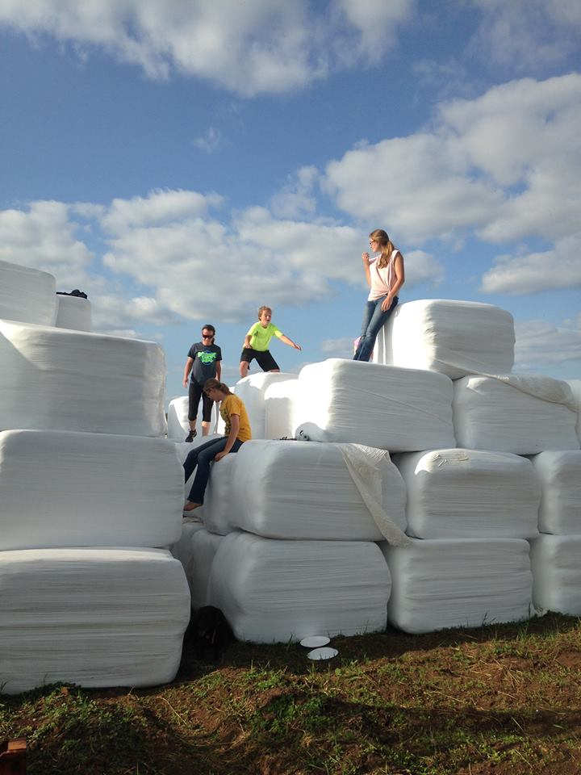
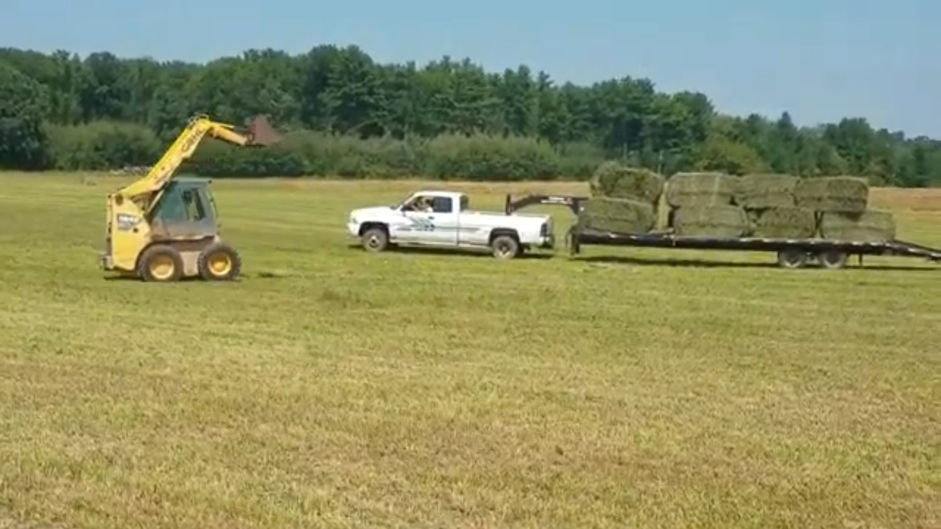
USDA Organic Farm

Slide 5
The why and how to grow elderberries
Health
Propagating
Cuttings
Rooting
Growing
Site selection
Planting
Harvesting
Preserving
Canning
Freezing

Slide 6
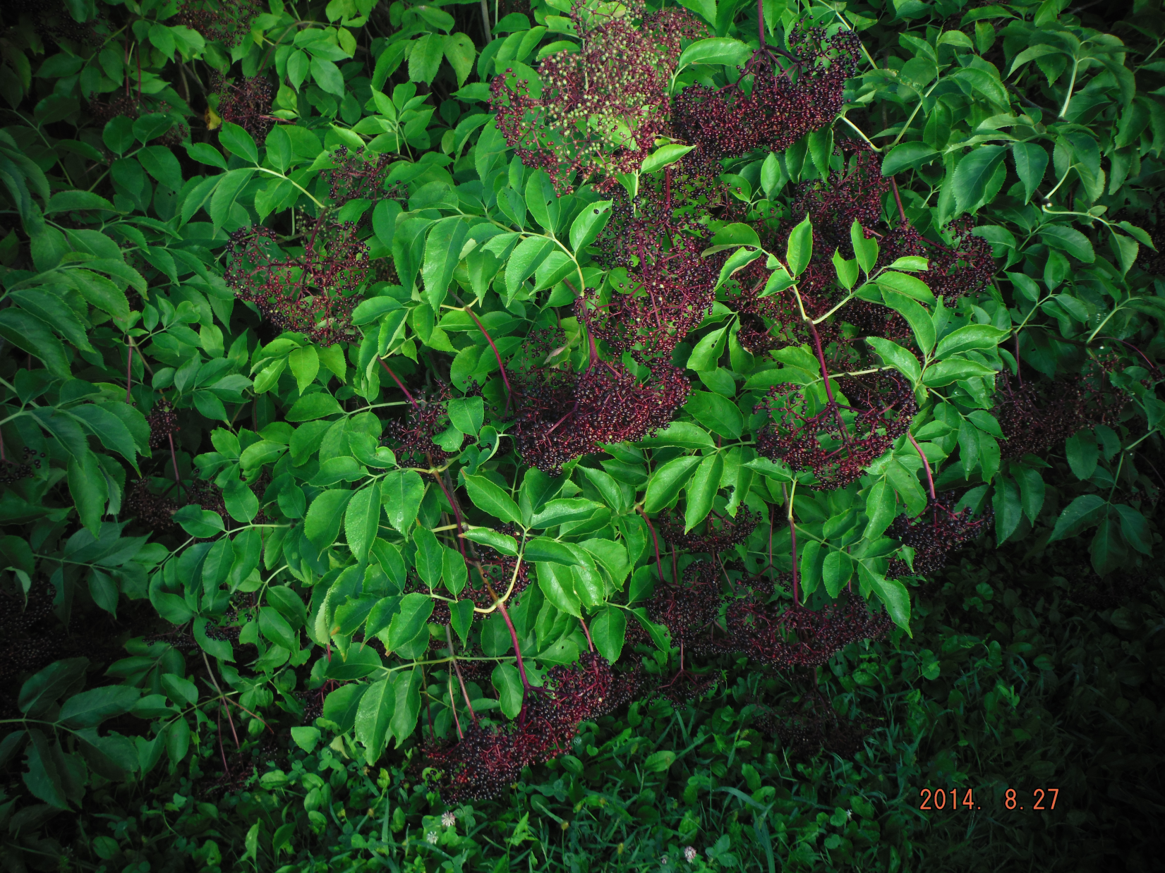
What are your goals?

Slide 7
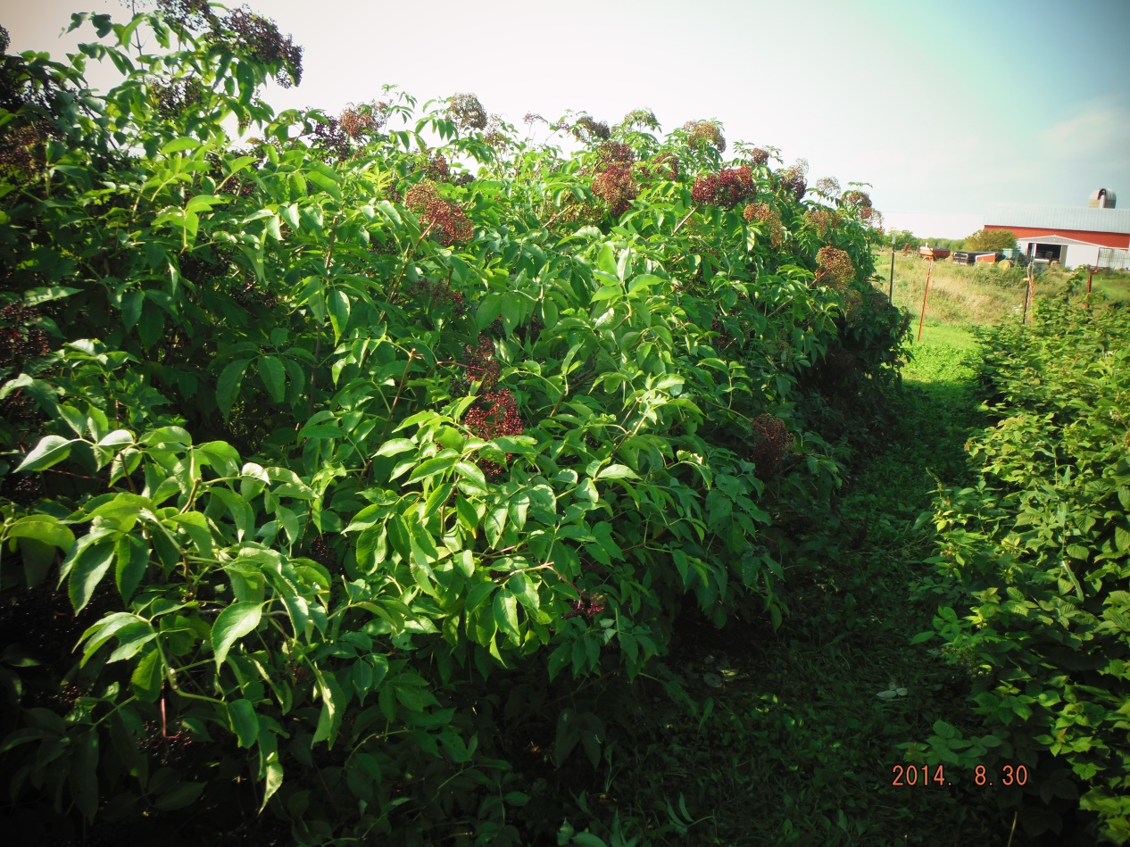
Site Selection
Too close
No air flow
Difficult to harvest

Slide 8
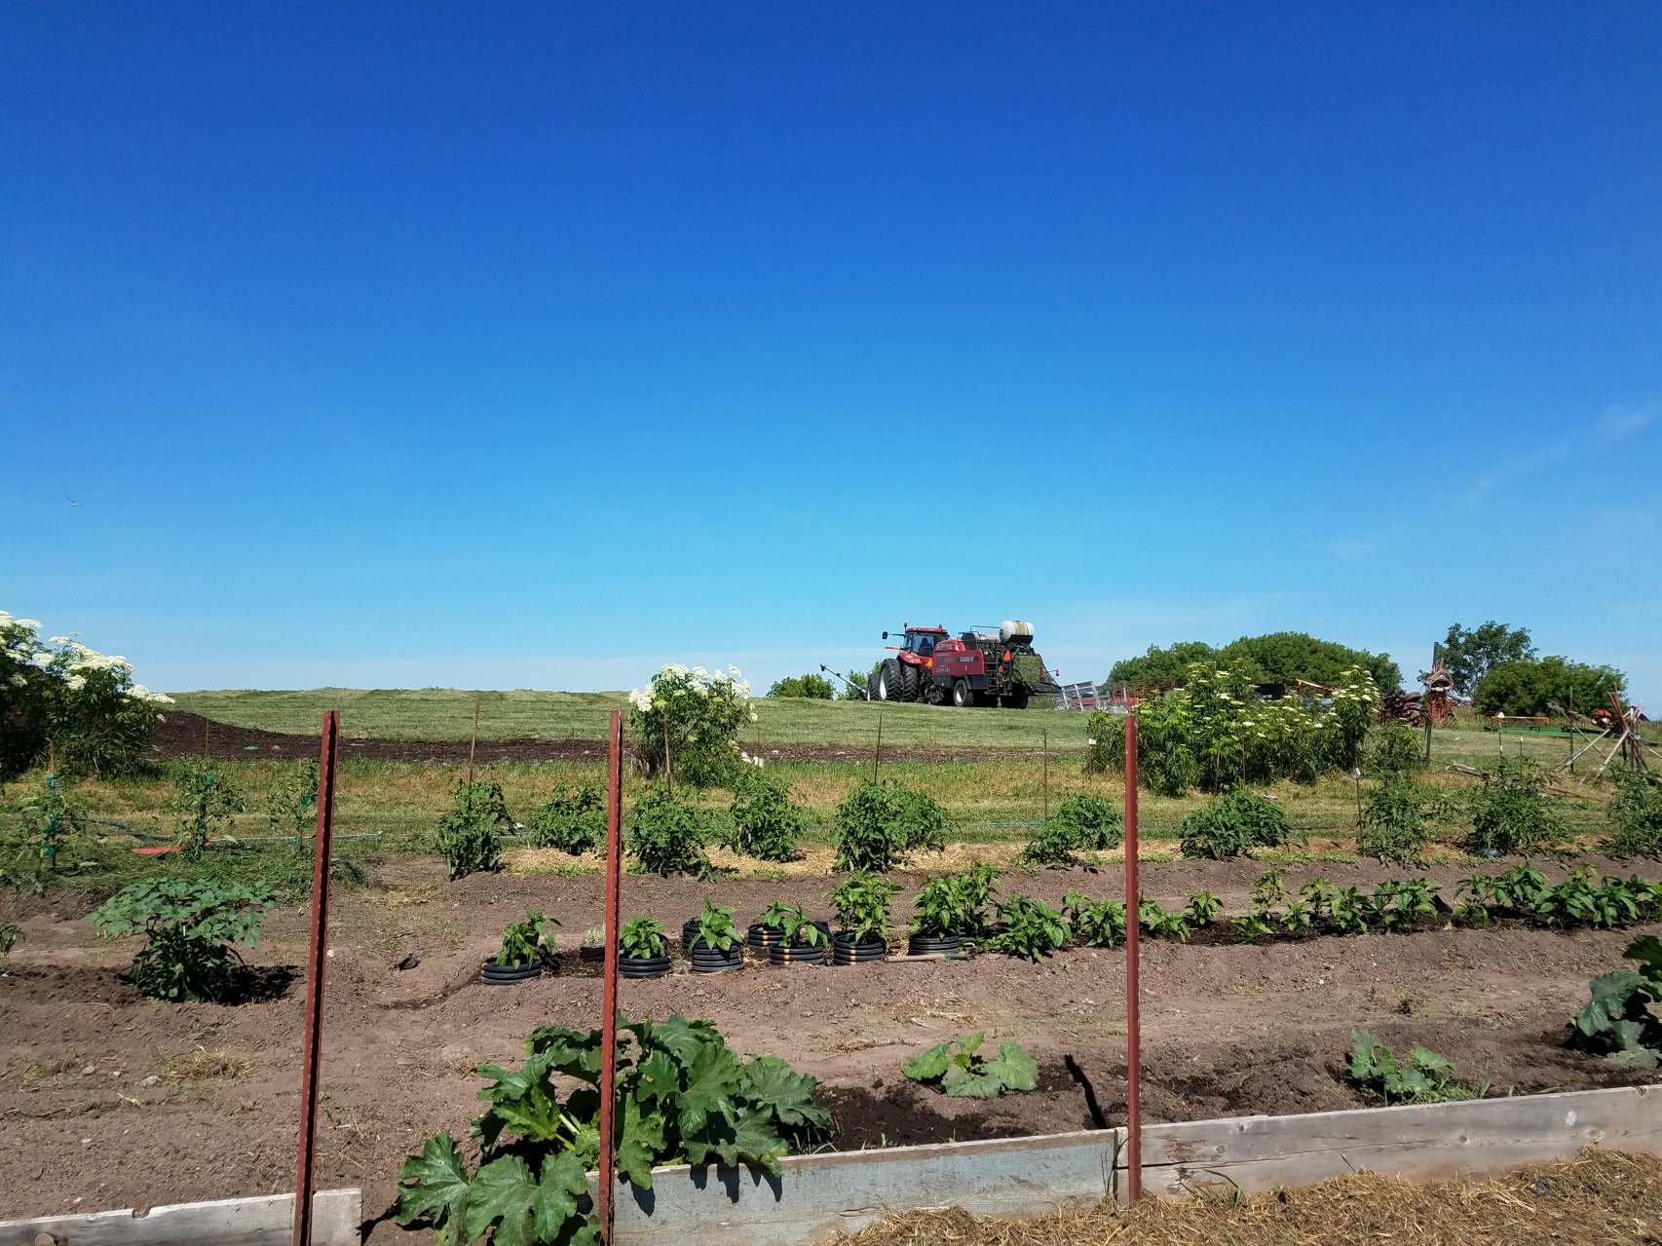
Site Selection
North
Too far apart
Too close to driveway
Don’t forget they get bigger!
Gardening on your knees

Slide 9
Good Spacing
Excellent permanent grove
Difficult to use farm land
Close to water

Slide 10
HARDWOOD CUTTINGS OR GREENWOOD CUTTINGS

Slide 11
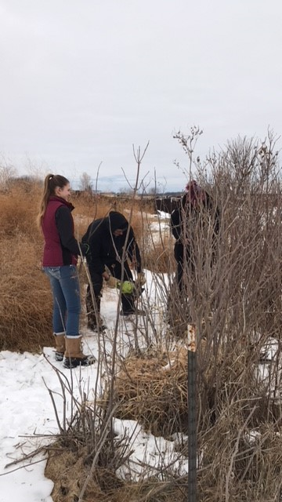
Start in January

Slide 12
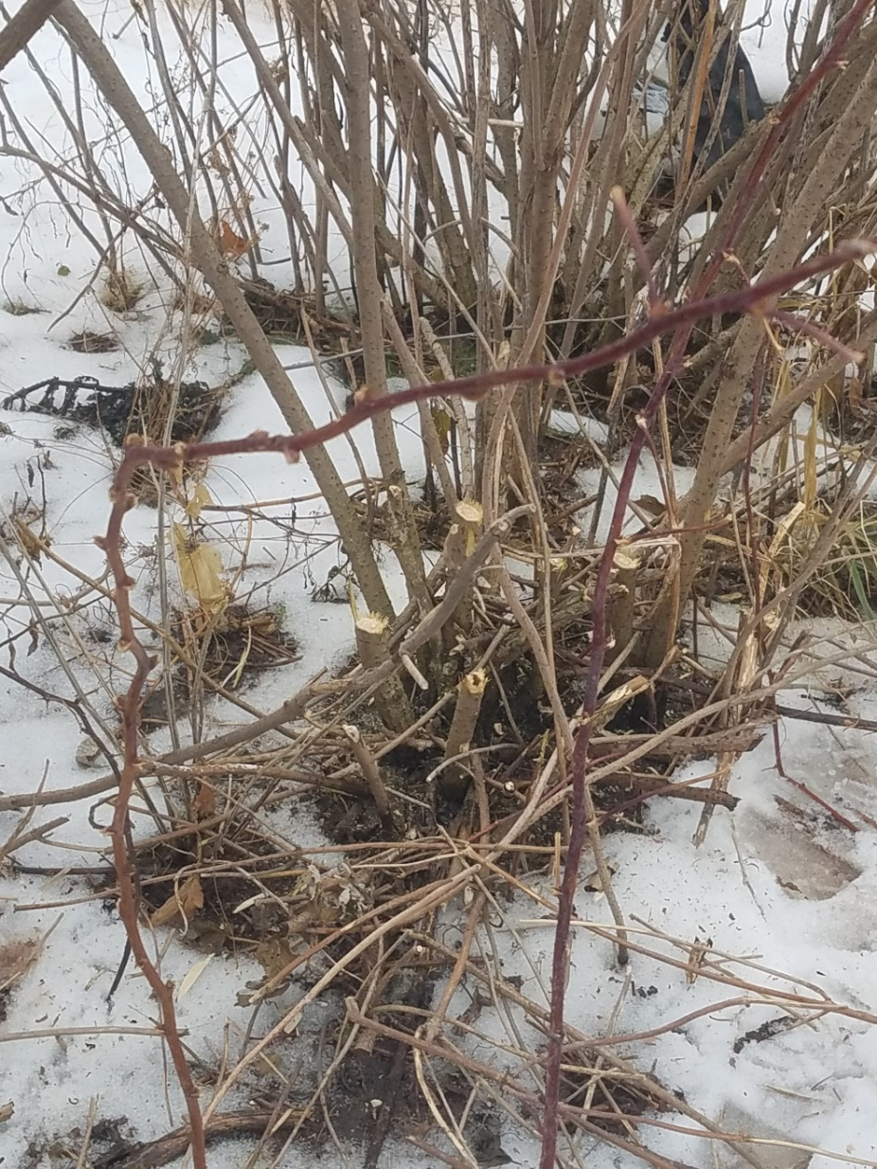
Double Duty: Pruning and Propagating

Slide 13
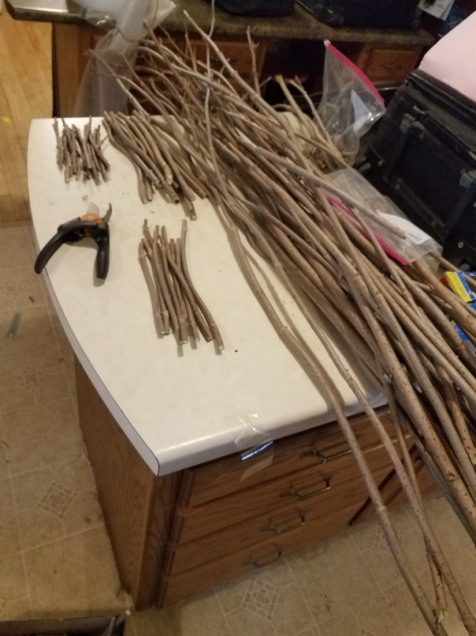
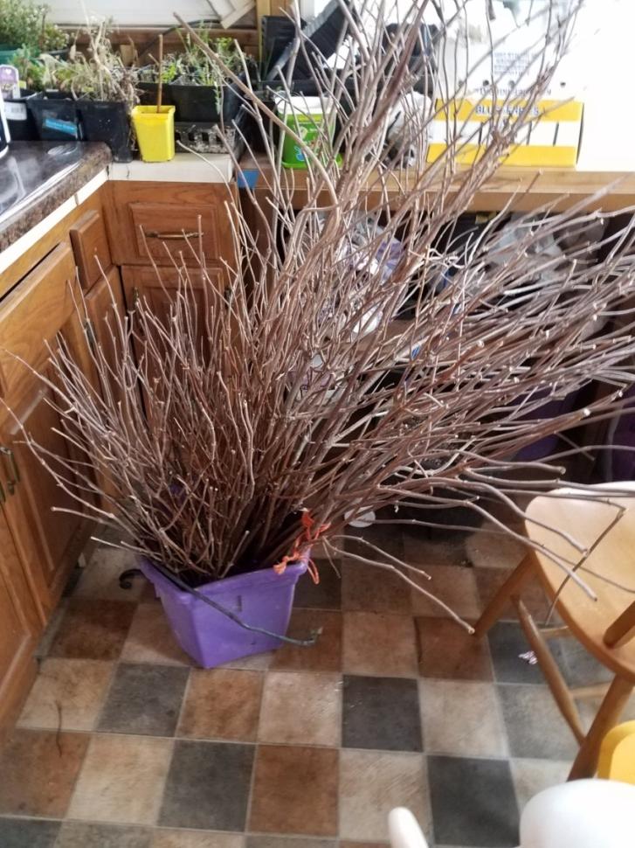
Choose your cuttings

Slide 14
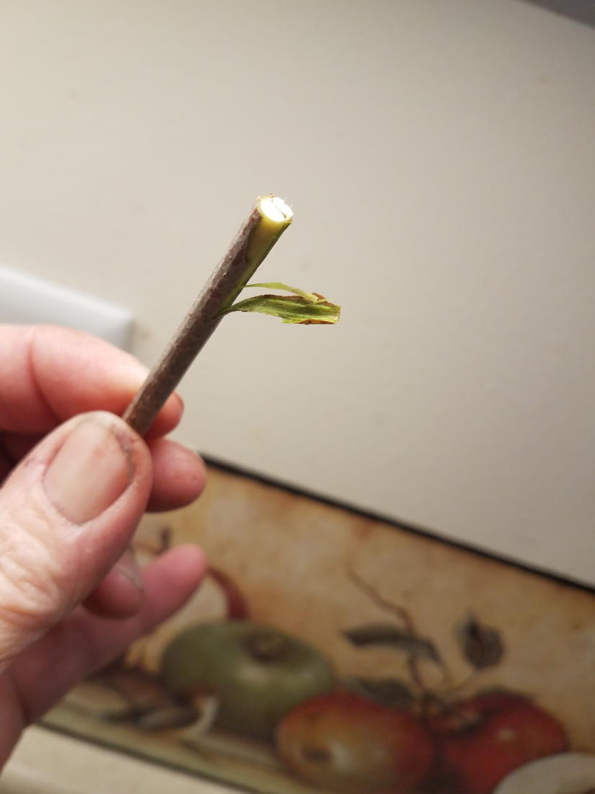
PROPAGATION
Don’t plant dead sticks!

Slide 15
This end up

Slide 16
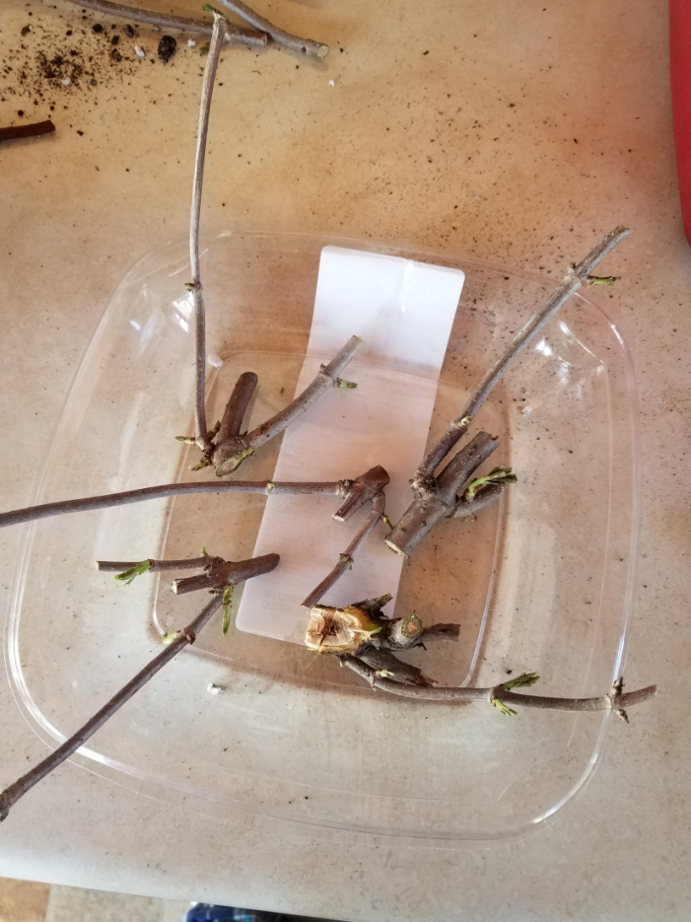
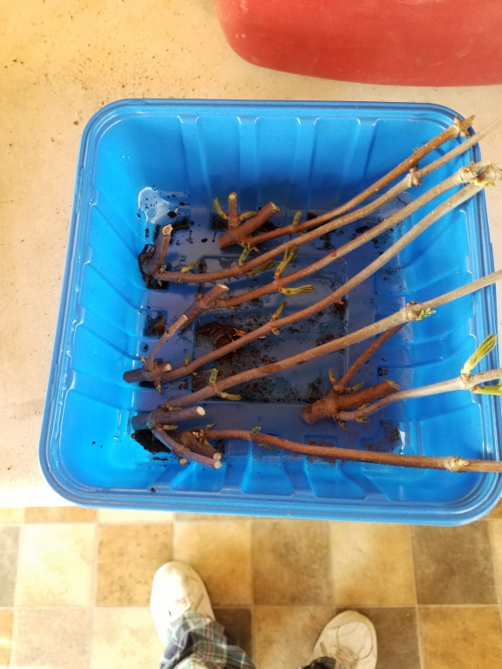
PROPAGATION

Slide 17
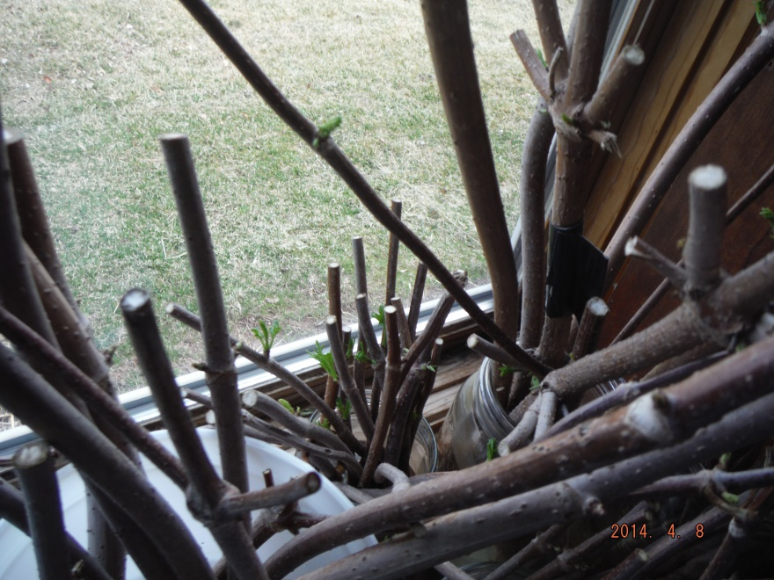
Water Rooting

Slide 18
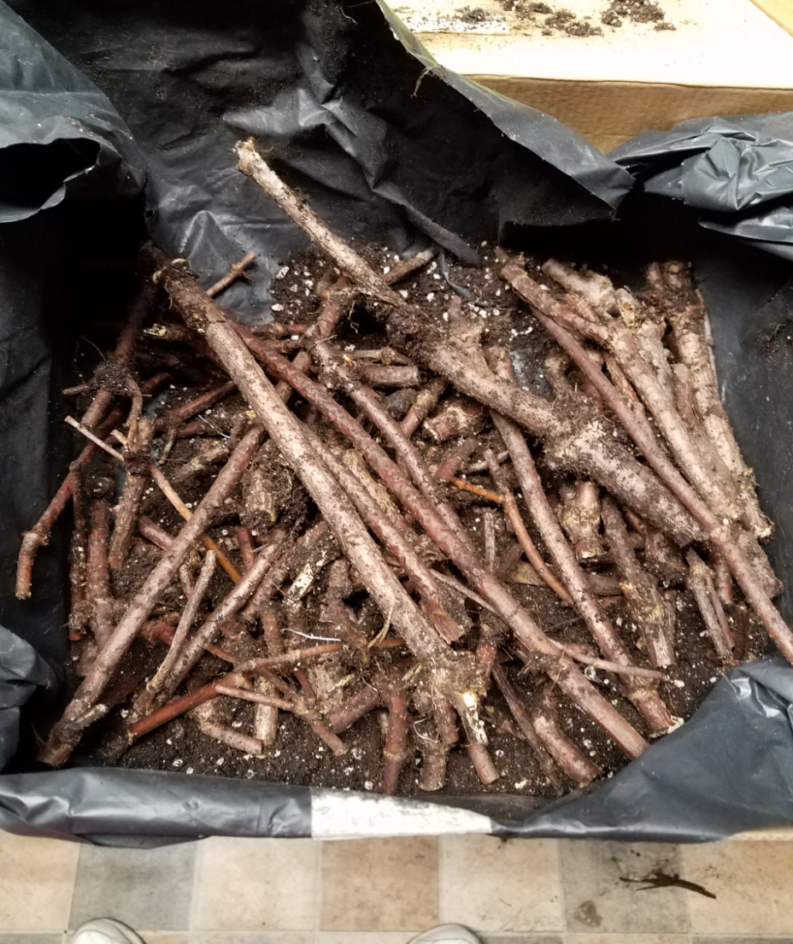
In a box

Slide 19
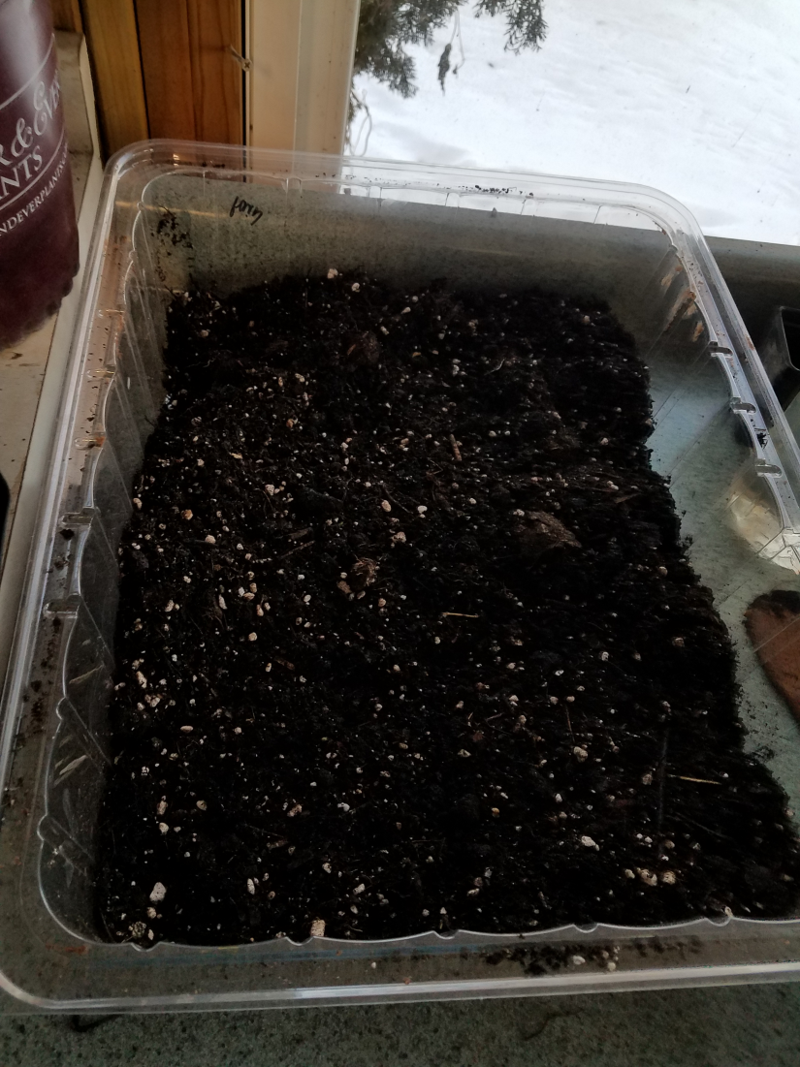
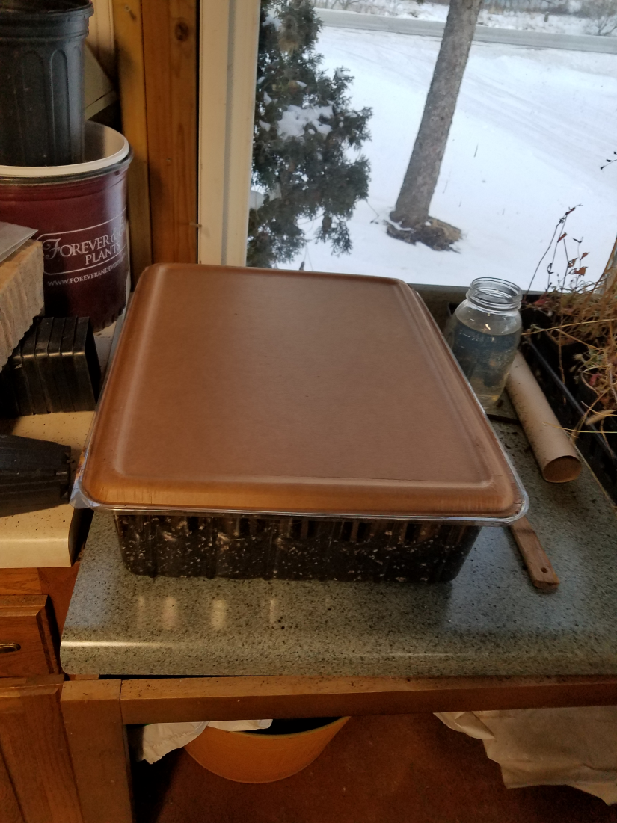
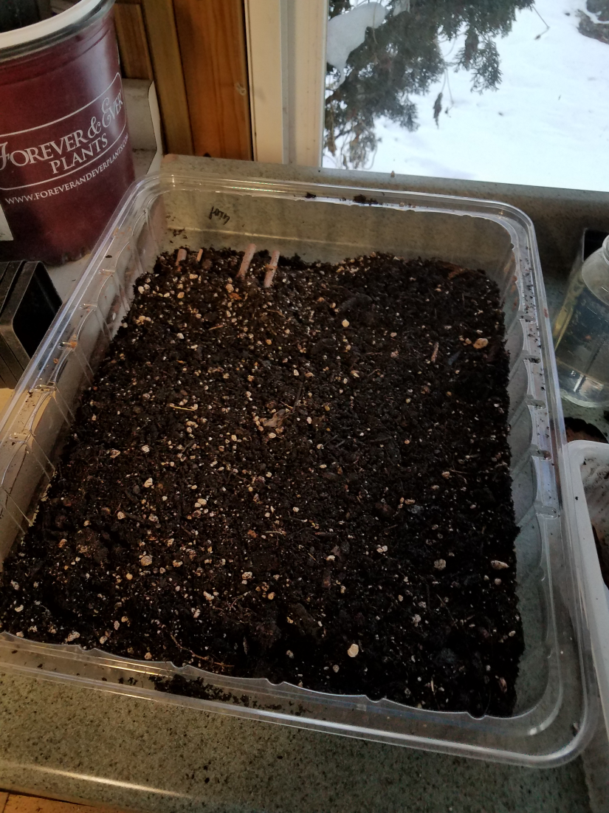
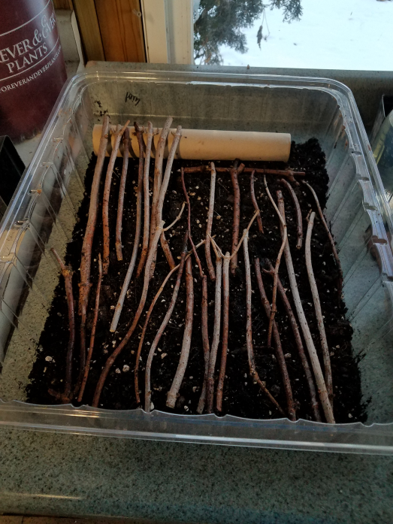
PROPAGATION

Slide 20
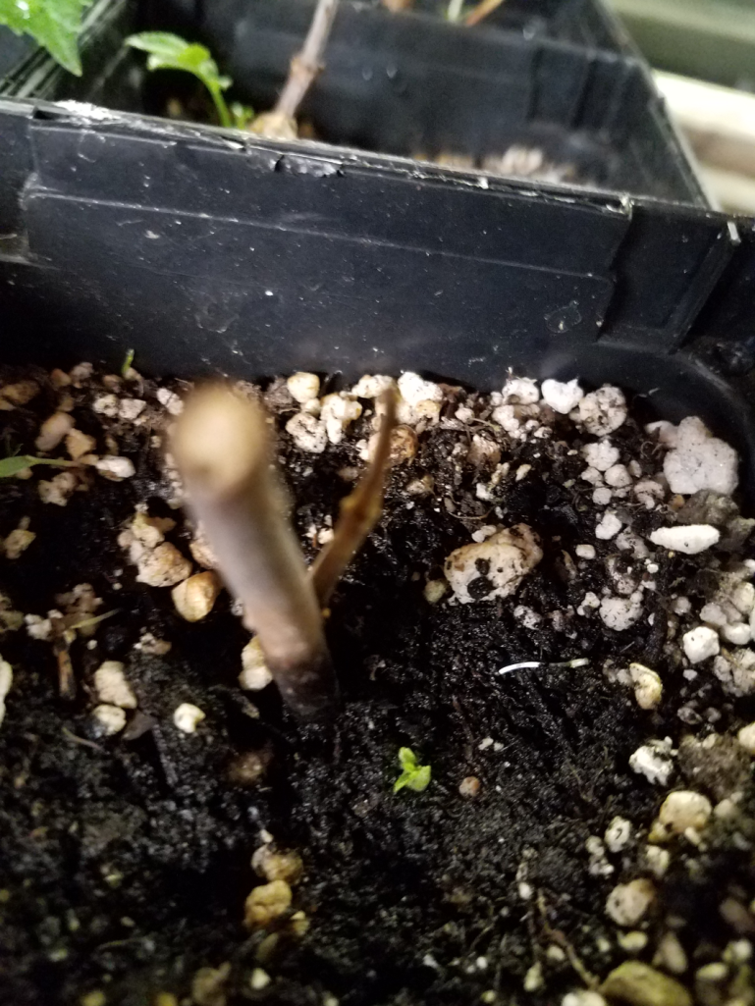
Don’t give up too soon ☺

Slide 21
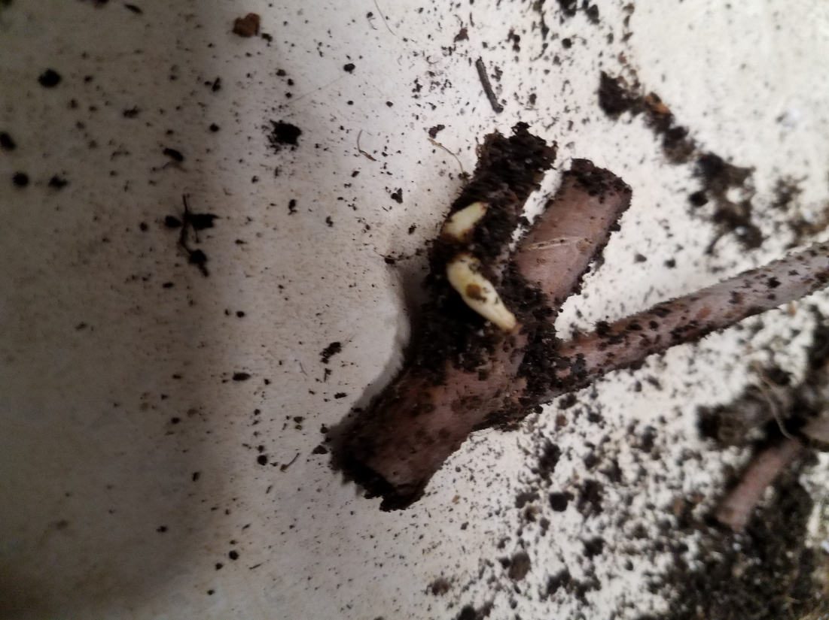
Sprouted

Slide 22
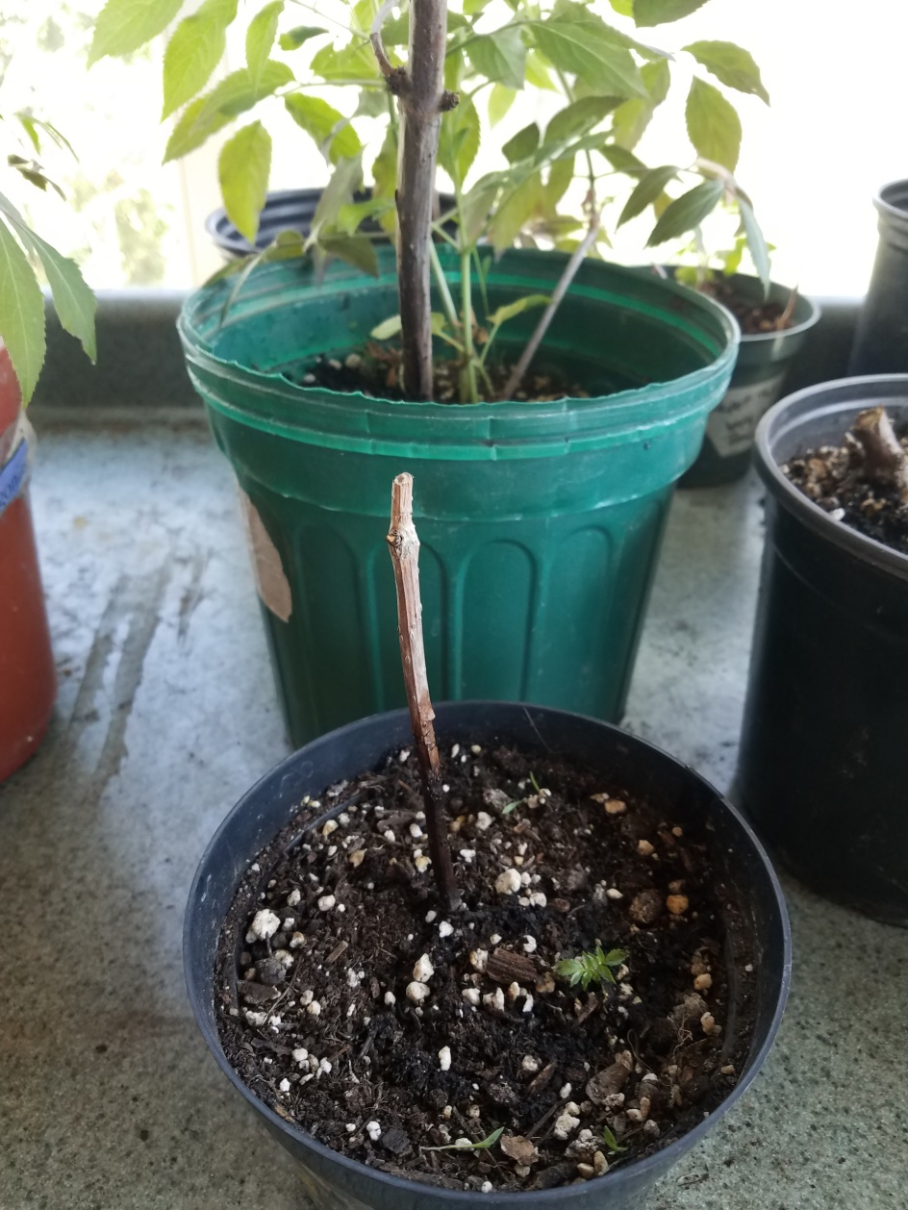
Pot them up

Slide 23
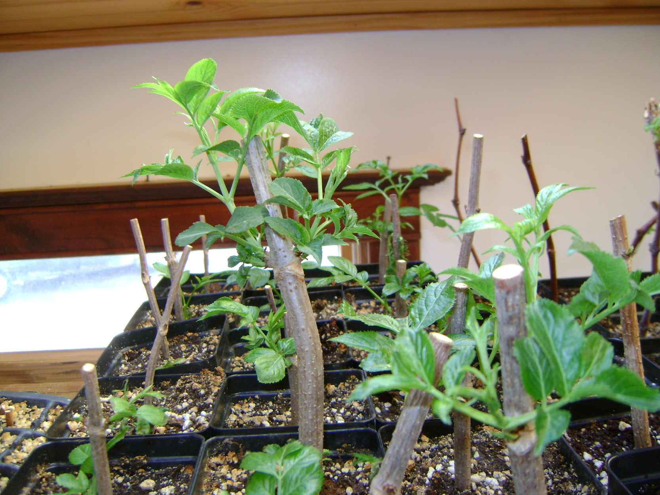
Green on top

Slide 24
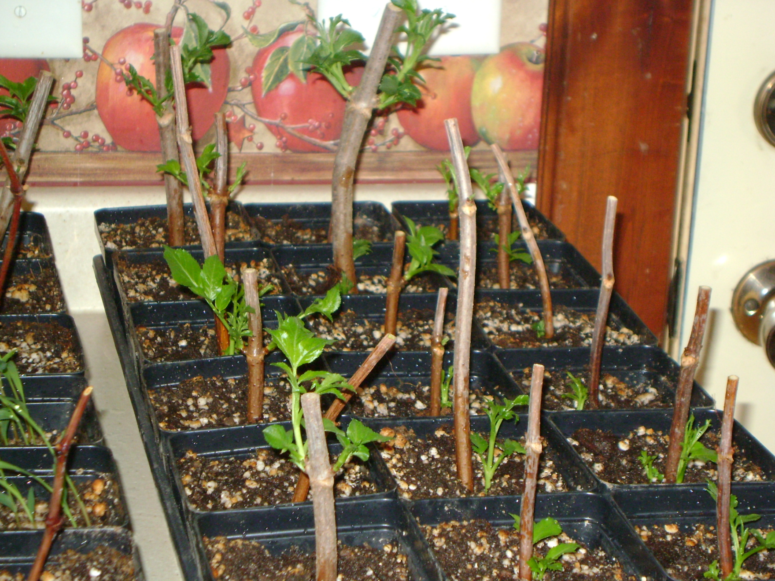
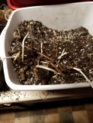
PROPAGATION

Slide 25
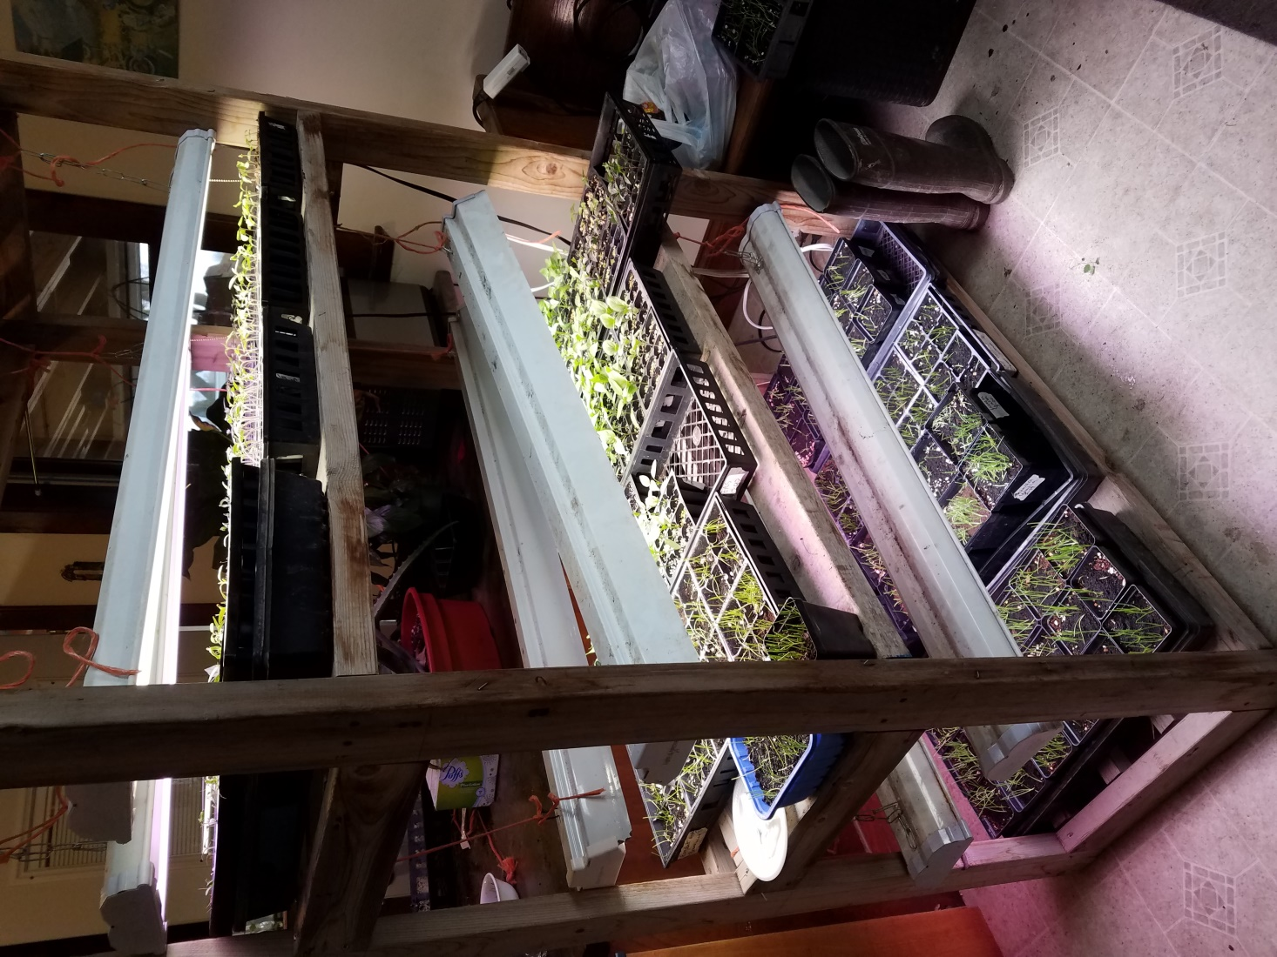
Good light and water

Slide 26
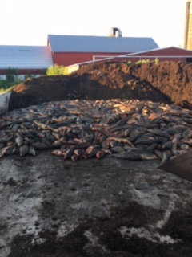
From pretty gross…

Slide 27
…to black gold

Slide 28
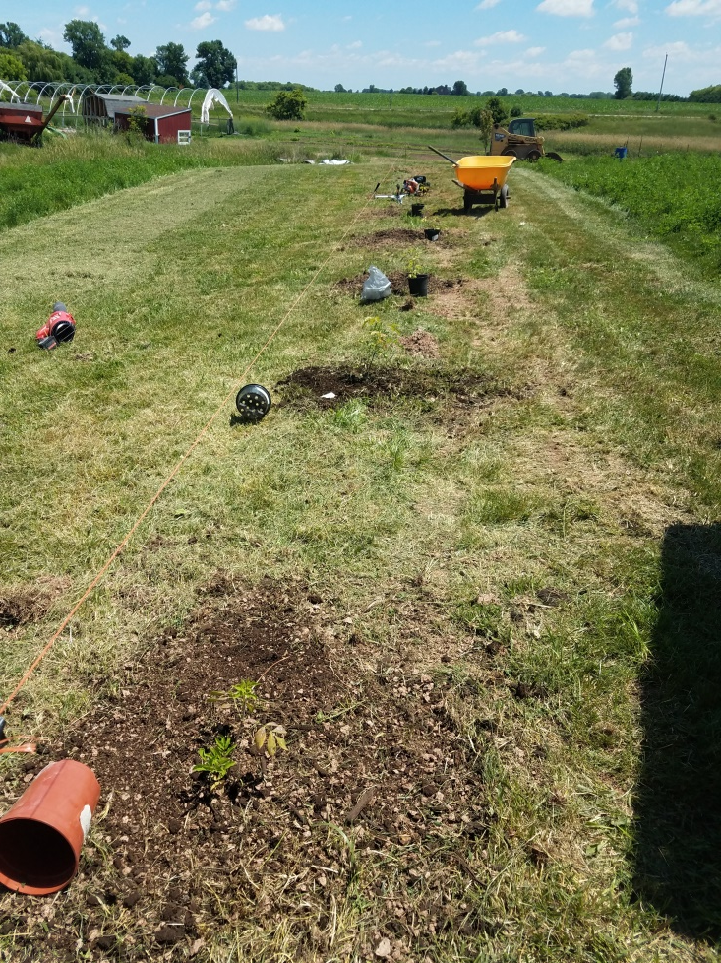
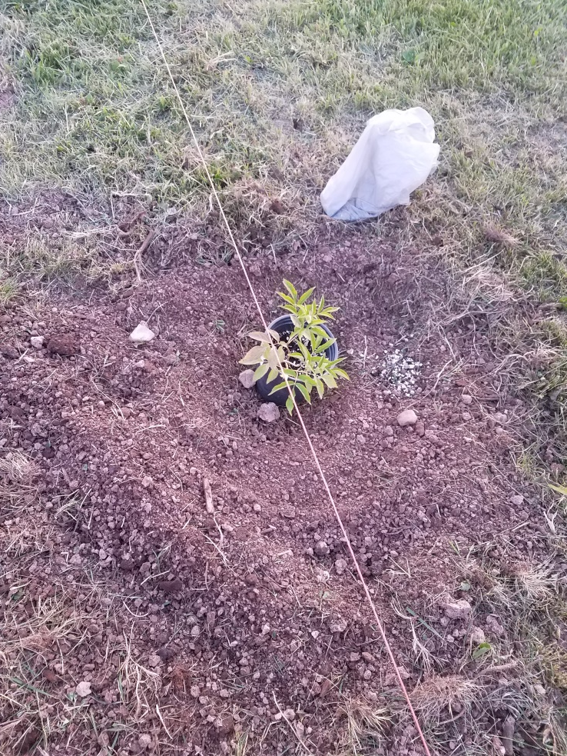
PLANTING

Slide 29
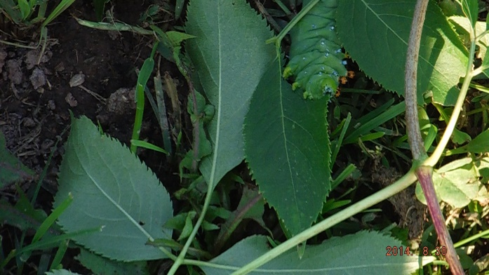
PESTS

Slide 31
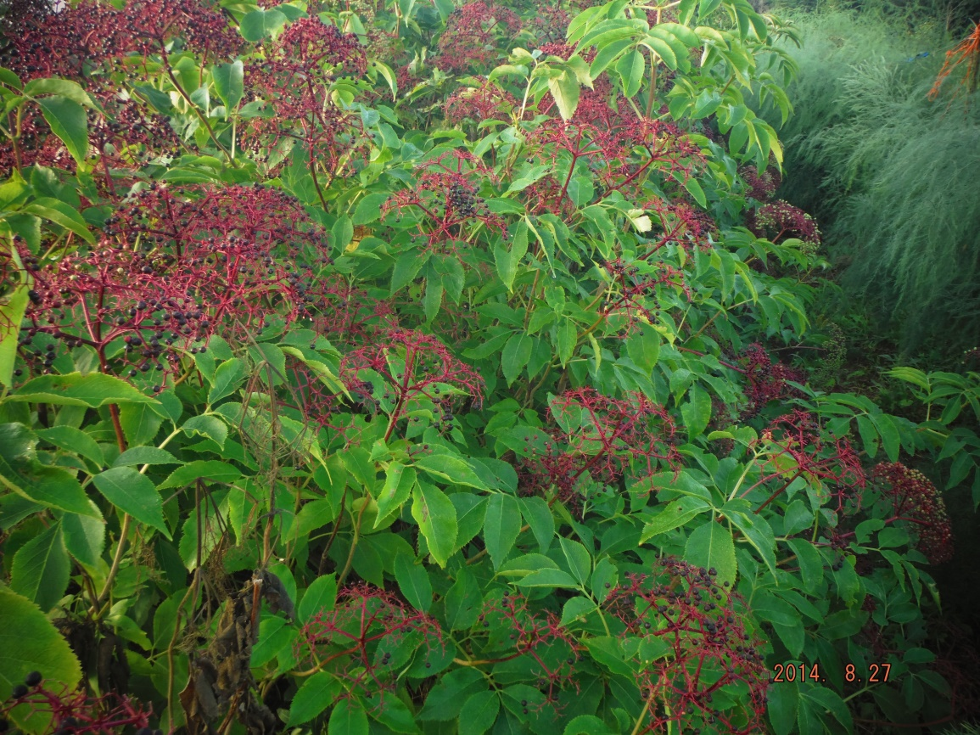
BIRDS

Slide 32
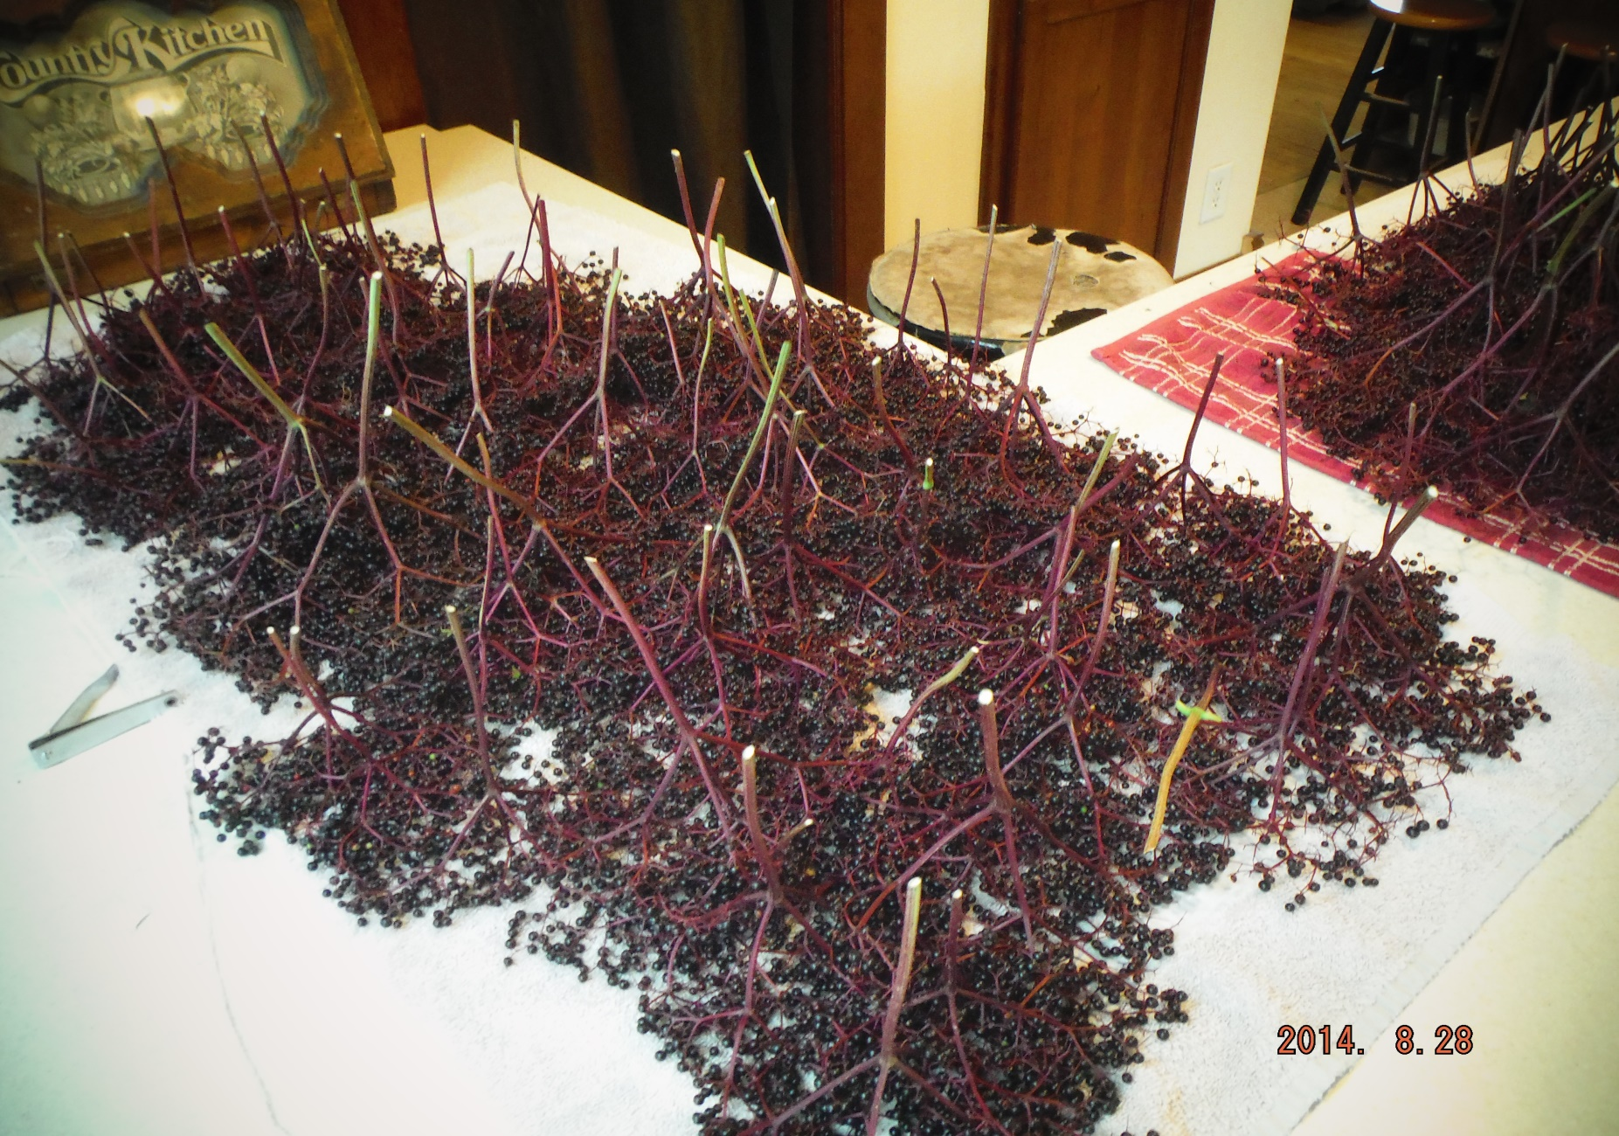
FREEZING

Slide 33
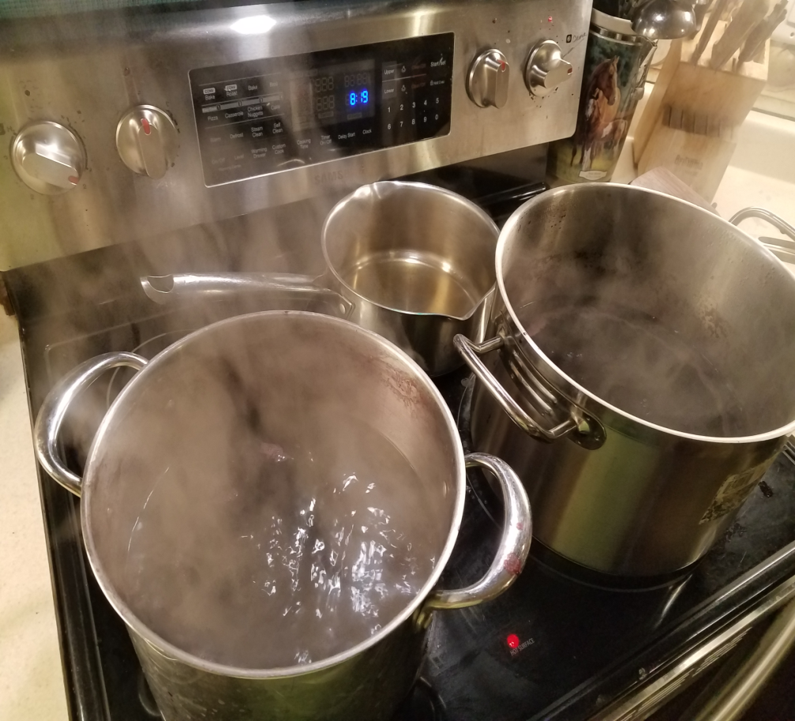
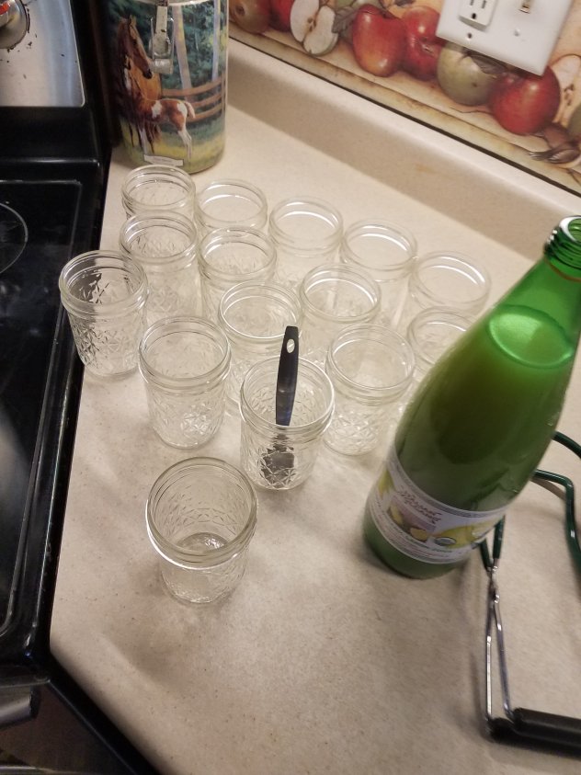
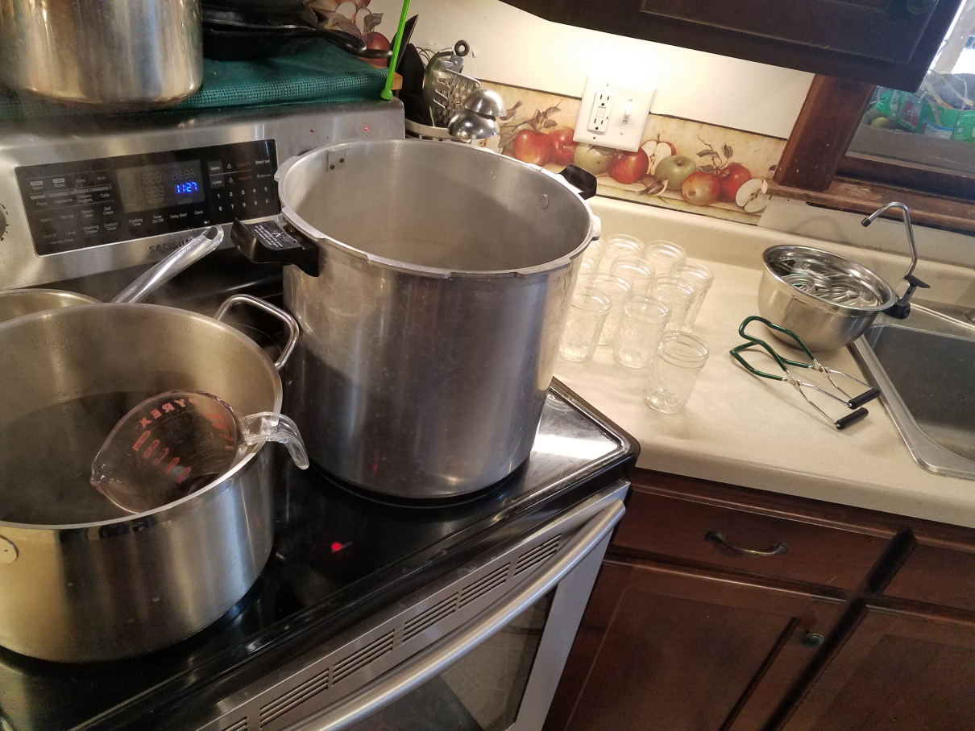
CANNING

Slide 34
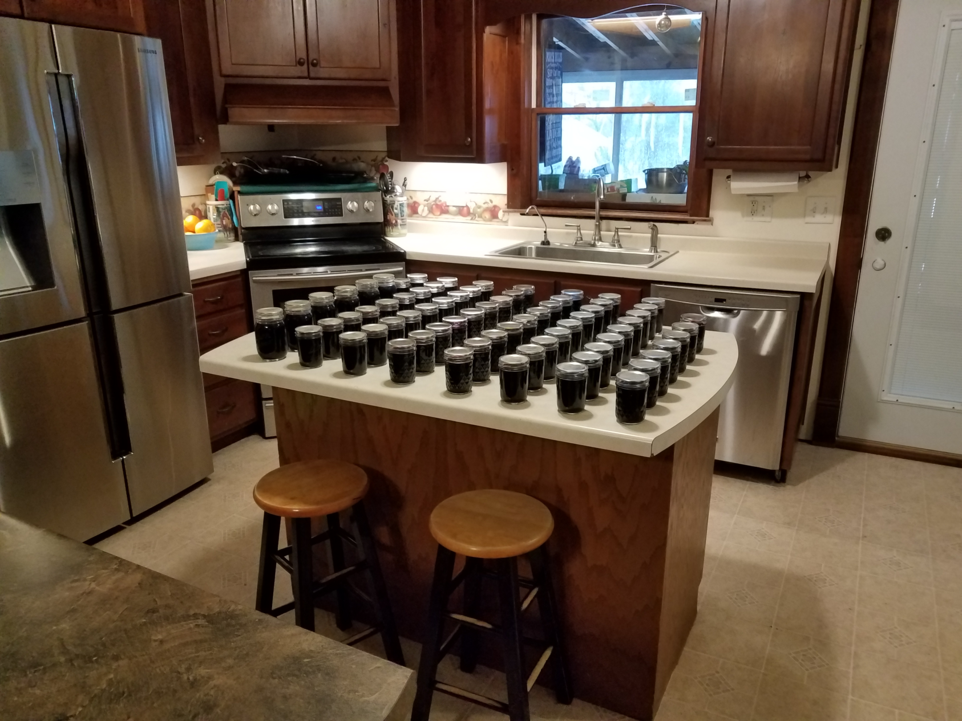
A productive day

Slide 35
The reality of canning…

Slide 36
Cold and Flu Syrup
2 cups elderberries
Enough water to cover
Add desired spices (optional)
Lemon
Cinnamon
Any mulling spices
Simmer 20 minutes stirring and mashing
Add more water as needed
Cool and add desired amount of honey
You can’t add too much
1 tsp. daily for maintenance, and 3-5 tsp. daily when you feel a cold coming on

Slide 37
HEALTH BENEFITS
Antioxidants
Flavonoids when cooked at low temp
Anti-Viral
Anti-Bacterial
Boosts immune system
Research the benefits for yourself.
Be careful if you have autoimmune disease.
Tending is spiritual

Slide 38
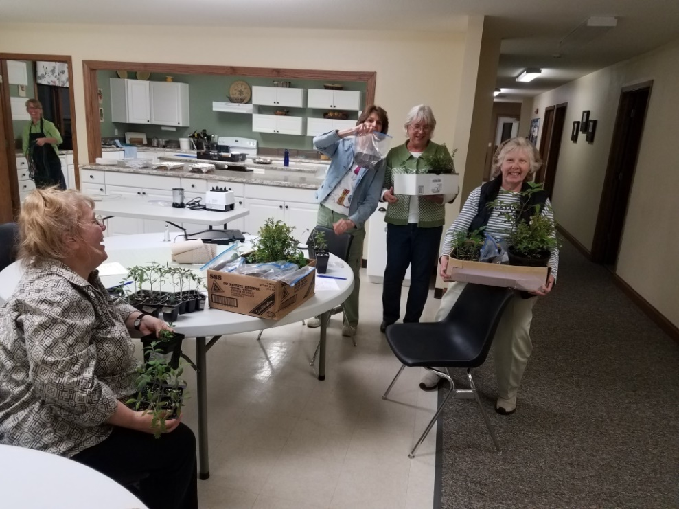
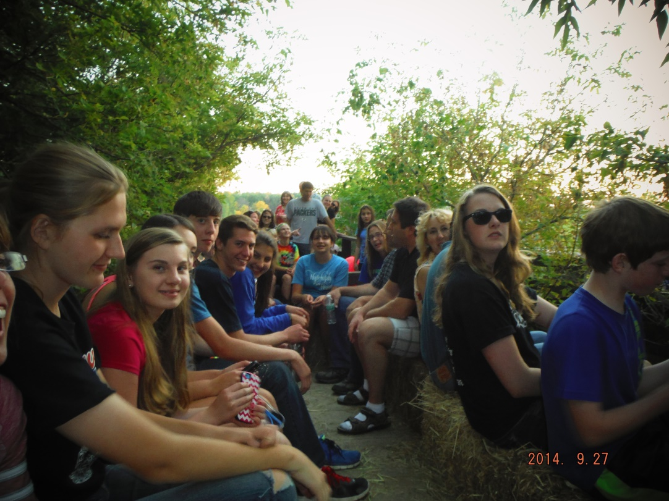
OUTREACH MISSION

Slide 39
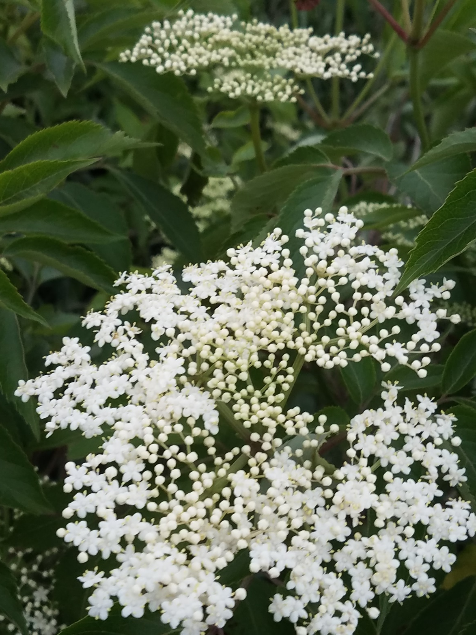
Thank you

