Slide 1
Minimum Till for Problem Solving and Sustainability
sus·tain·a·bil·i·ty noun
the ability to be maintained

Slide 2
The Creator is interested in us knowing the science of the soil.
Before I visited Cooranbong, the Lord gave me a dream. In my dream I was taken to the land that was for sale in Cooranbong. Several of our brethren had been solicited to visit the land, and I dreamed that I was walking upon the ground. I came to a neat-cut furrow that had been plowed one quarter of a yard deep and two yards in length. Two of the brethren who had been acquainted with the rich soil of Iowa were standing before this furrow and saying, “This is not good land; the soil is not favorable.” But One who has often spoken in counsel was present also, and He said, “False witness has been borne of this land.” Then He described the properties of the different layers of earth. He explained the science of the soil, and said that this land was adapted to the growth of fruit and vegetables, and that if well worked it would produce its treasures for the benefit of man. This dream I related to Brother and Sister Starr and my family. {16MR 153.1}
The next day we were on the cars, on our way to meet others who were investigating the land; and as I was afterward walking on the ground where the trees had been removed, lo, there was a furrow just as I had described it, and the men also who had criticized the appearance of the land. The words were spoken just as I had dreamed. {16MR 153.2}

Slide 3
Does it align with SOP?!
Plow “often and deep.” COL
That is how it is, and my mind has been greatly stirred in regard to the idea, “Why, Sister White has said so and so, and Sister White has said so and so; and therefore we are going right up to it.” {3SM 217.1}
God wants us all to have common sense, and he wants us to reason from common sense. Circumstances alter conditions. Circumstances change the relation of things. {3SM 217.2}
PRAY and STUDY for yourself. Understand context.
Most importantly seek and follow the Creator’s will for you, and leading on your heart.

Slide 4
What it is not
It is not turning over or inverting the natural layer of the soil.
It is not “no till” in it’s purest sense.
It is not the method popularly known as “Back to Eden” or the “chip method.”
It is not disregard to soil science.

Slide 5
Typical Production Problems
Retention of water in the soil (amount of water needed)
Weed pressure
Loss of organic content in soil (poor topsoil)
Amount of space needed to support scope of program
Plant health problems
Pest problems
Soil biology problems
Soil texture/quality problems

Slide 6
Other Problems
At one time top soils in the US had 6-10% Soil Organic Matter (SOM)
Now average agricultural lands have 1-3%
Worldwide, in the last century, roughly 2/3 of soil carbon (organic matter) has been depleted
Tillage tends to deplete carbon and nitrogen
Topsoil loss due to erosion is increased by tillage
Tillage decreases plant available water content in soil
Tillage is catastrophic to soil microorganism colonies that the plant depends on symbiotically

Slide 7
4 Principles for Soil Health
Disturb the soil layers as little as possible (maintain microorganism colonies)
Grow as many different plants as practical (different plants provide different system benefits)
Keep living plants in the soil as often as possible (keep photosynthesis happening and soil biology active, keep feeding the soil)
Keep the soil covered all the time. (keep soil life healthy and active, and weeds down)

Slide 8
Transplants vs. Direct Seed
Faster transition from crop to crop (more crops per year)
Less time in garden minimizes availability to pests
More predictable crop coverage
Larger plants out-compete weeds
Less water needed for establishing
Protection during most vulnerable stage

Slide 9
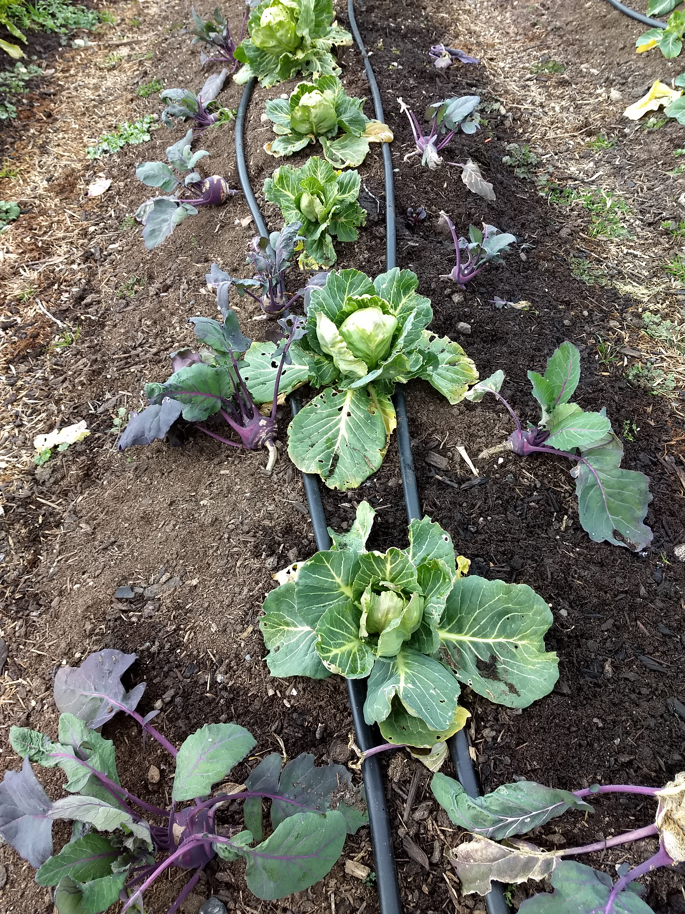
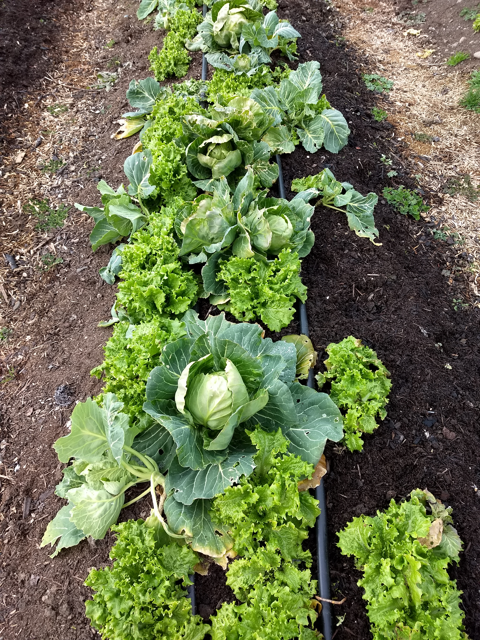
Intercropping

Slide 10
Intercropping Benefits
Soil covered more of the time—more photosynthesizing = more active biology and available nutrients
Short period crops help fill canopy until long period crops fill out = LESS WEED PRESSURE
Multiple crops on less space = more total production volume = more income potential
Less space needed = less infrastructure needed.
Possible companion plant benefits = less pest pressure or perhaps nitrogen fixation

Slide 16
Crop to Crop Turnaround
3-8 crops per year in one bed as opposed to 1-3 typical
Same day crop-out to crop-in (depending on bed size maybe 1hour)
Roots of previous crop STAY IN SOIL to feed next crop, add SOM, and retain mycorrhizal colonization

Slide 17
How?
Clip old crop below crown with loppers
Remove any weeds present (only pull if loping isn’t applicable)
Lay aside drip lines
Reshape bed if necessary with rake
Add amendments based on good soil test ONLY AS NEEDED
Broadfork (OFTEN AND DEEP)
Add layer of good quality and known content compost (1/2” to 1 ½” usually)
Lay drip lines back into position
Plant transplants & water in

Slide 19
Compost
Make your own with all crop stubble, weeds, tree leaves, and recycled food waste
Make sure it’s “finished”
Get it tested
Use nearby resources

Slide 20
Benefits
Soil biology maintained = plant health maintained
Significantly decreases water loss and water need due to increased retention
In practice, SOM is increased to 8-11%
Every crop becomes a cover crop and directly profitable
Weed pressure significantly decreased due to not exposing new seeds and more canopy
Labor inputs become primarily crop turnover/planting and harvesting (very little weeding)
Potential profit in practice >$100,000 per acre (proven)
Nutrient density
Non mechanized—anyone, anywhere; not dependent on fuel or expensive machinery
Will usually produce good results on unideal soil (rocky, clay, etc.)

Slide 21
Synergistic Systems
syn·er·gis·tic adjective
relating to the interaction or cooperation of two or more organizations, substances, or other agents to produce a combined effect greater than the sum of their separate effects.
Woody perennial hedgerows
Natives and fruiting species
Habitat for foraging predatory species
Temperature moderation effect– crop protection
Pollinator/beneficial insect feeder plantings
Bird houses
Collection ponds
Grassy strips
Ducks, goats

Slide 22
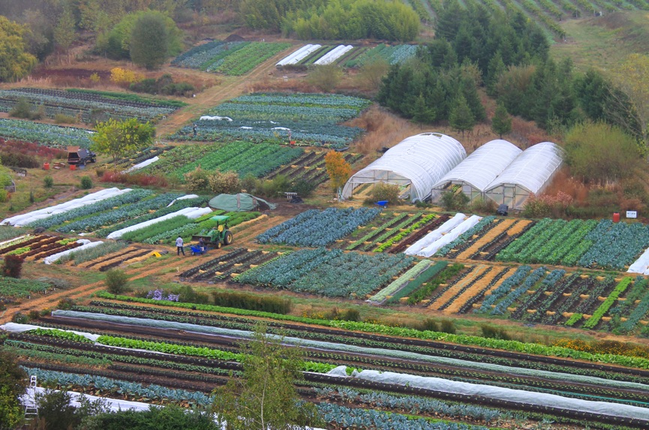

Slide 23
Nuts & Bolts
Beds: raised or not?
Bed spacing: approx. 30-32” wide, path 16”, = 4ft 9in center to center frequency
Allows for sufficient wheelbarrow access
Bed length: 75ft or 100ft
Some direct seeding necessary
Tools: wheelbarrow, broadfork, shovel, rake, stirrup hoe, harvest knife, long handled lopers
Supplies: Thule, floating row covers, woven landscape fabric, drip lines, greenhouse for starts
Most transplants ready 4 weeks after sowing
Pathway mulch treatments
No compost available? Woven row covers

Slide 24
Resources
Documentary: “Symphony of the Soil”
Book: Teeming With Microbes
Singing Frogs Farm
www.singingfrogsfarm.com
Paul and Elizabeth’s video lectures on YouTube
On farm workshops at the farm
Soil Consulting: Whitmar McConnell
Books by J.M. Fortier and Elliot Coleman

