Slide 1
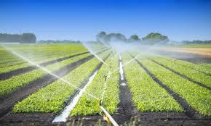
SMALL CSA OR FARM IRRIGATION
ADVENTIST AGRICULTURAL ASSOCIATION
JANUARY 2019
PRESENTED BY VICTOR SCHNEIDER

Slide 2
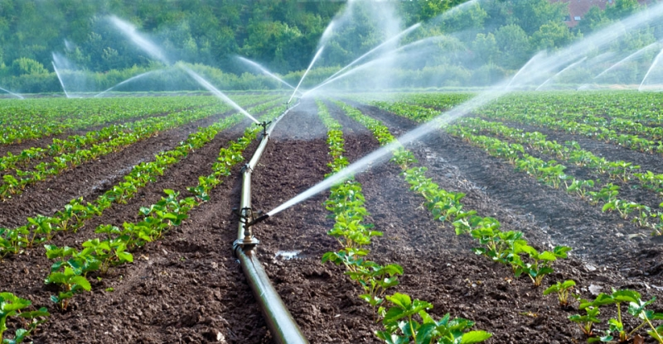
1. WATER SOURCE
A. WELL b. SURFACE WATER
C. STORAGE TANKS
2. CONSIDERATION FOR IRRIGATION
A. WATER QUALITY
B. CROP TO BE IRRIGATED
C. LENGTH OF SEASON
3. IRRIGATION TYPE
A. BIG GUN TRAVELER
B. LINEAR OR PIVOT
C. WHEEL LINES
D. HAND LINES
E. MICRO SPRINKLERS
F. DRIP TUBE OR TAPE
4. FILTRATION
A. SAND MEDIA
B. DISK
C. SCREEN
THINGS TO CONSIDER WHEN LOOKING TO IRRIGATE

Slide 3

Soil water holding capacity
The total water held by soil is called water holding capacity
  Available water capacity (AWC)
    The amount of water held in a soil available for use by most plants.
  Soil-Water potential
    Field capacity
    Permanent wilting point
    Management Allowed Depletion M.A.D.
soil water
soil
air space
Notes:
Total water held by a soil is called water holding capacity. However, not all soil-water is available for extraction by plant roots. The volume of water available to plants that s soil can store is referred to as available water capacity.
Available water capacity (AWC) is the amount of water held in the soil available for use by most plants. It is dependent of crop rooting depth and several soil characteristics. In fine textured soils and soils affected by salinity, sodicity, or other chemicals, a considerable volume of soil water may not be available for plant use.
Soil-water potential is a more correct way to define water available to plants. It is the amount of work required per unit quantity of water to transport water in soil. In the soil, water moves continuously in the direction of decreasing potential energy or from higher water content to lower water content. The concept of soil-water potential replaces arbitrary gravitational, capillary and hygroscopic terms.
Field capacity is the amount of water a well-drained soil holds after free water has drained because of gravity. For coarse textured soils drainage occurs soon after irrigation due to large particle and low soil particle surface tension. In fine textured soils, drainage takes much longer because of smaller pores and their horizontal shape.
Permanent wilting point is the soil water content at which most plants cannot extract enough moisture to prevent permanent tissue damage.
AWC = FC - PWP

Slide 4
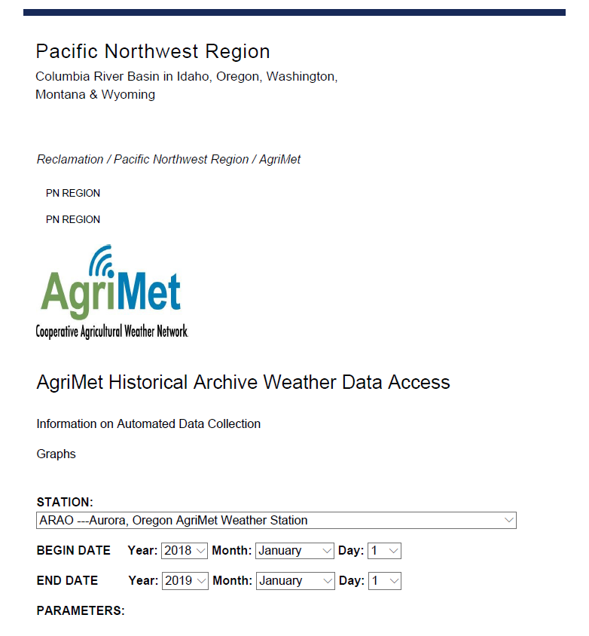

Slide 6
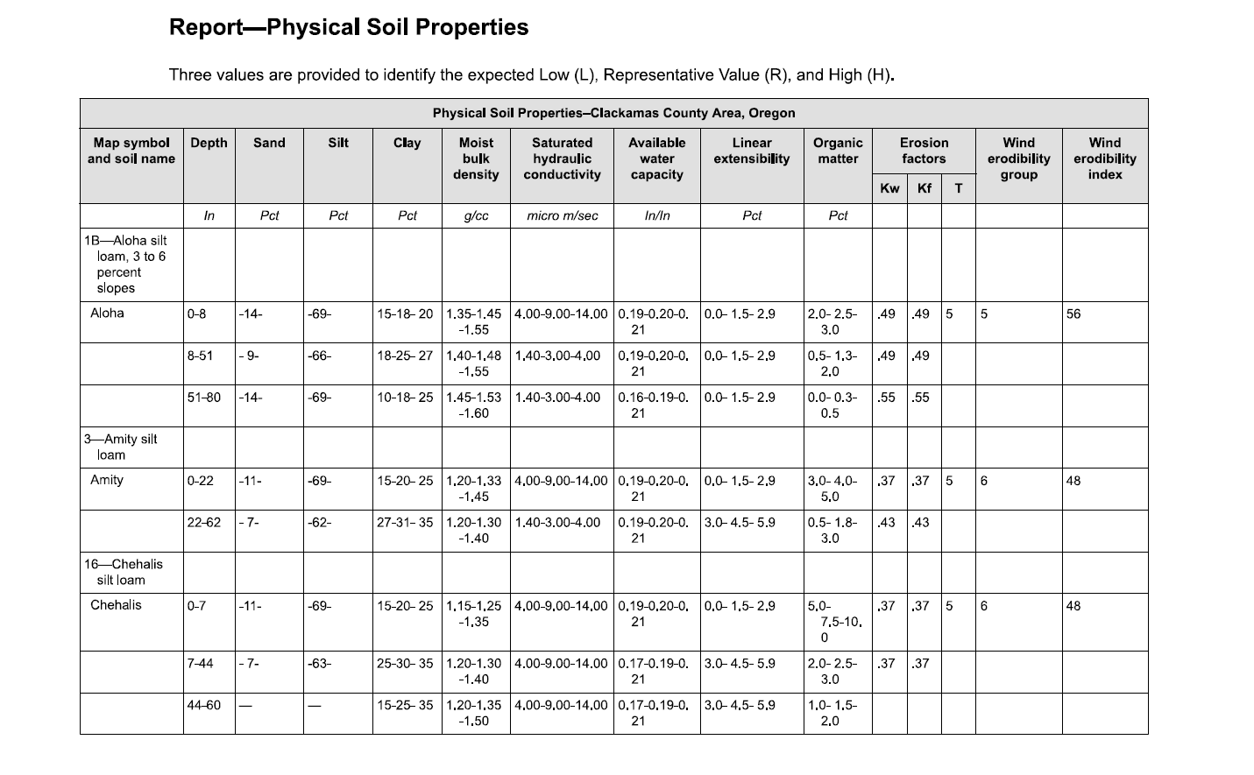

Slide 7
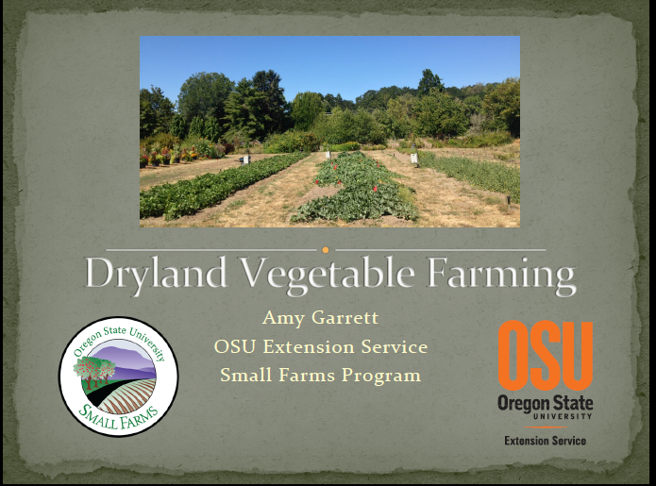

Slide 8
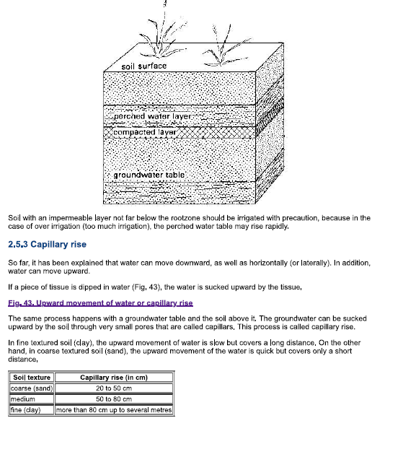

Slide 9
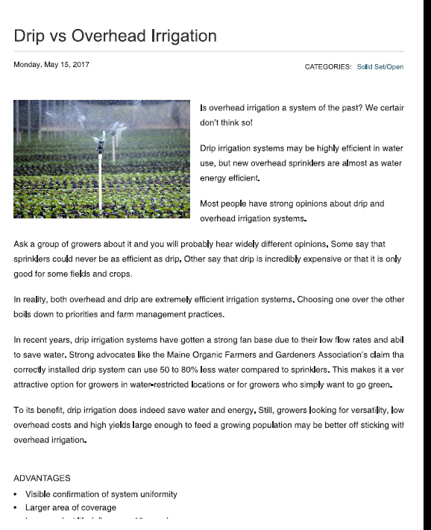

Slide 10
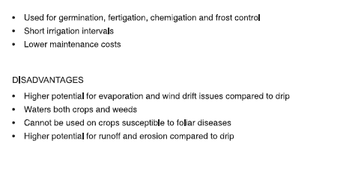

Slide 11
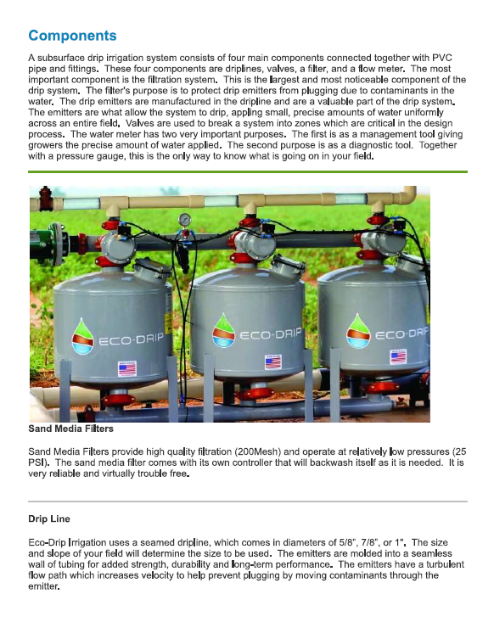

Slide 12
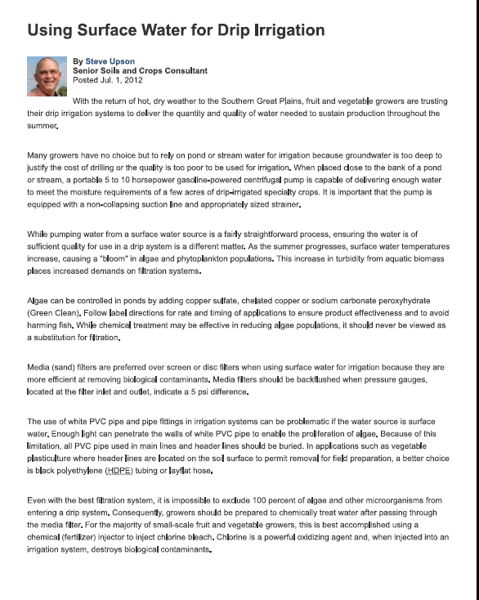

Slide 13
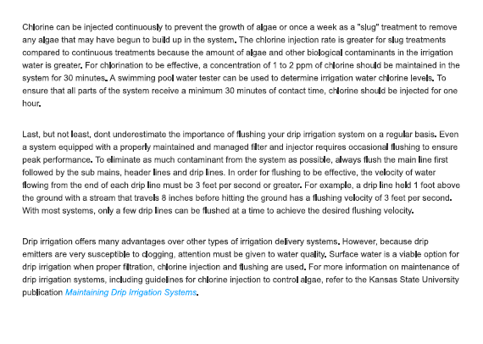

Slide 14
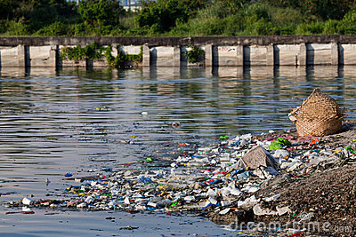
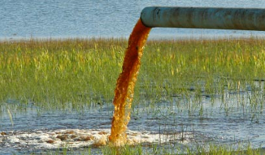
Global Water Quality & Drip
Facts & Thoughts
Continuing deterioration in water quality worldwide is caused by: population growth, industrial & man-made pollutions and global warming effects.
The Netafim substantial cost and agronomical advantages of low flow drippers, is increasing system clogging vulnerability.
Drip irrigation system maintenance/plugging “issues” are a major hindering block in the drip technology growth and Mass Adoption acceptance.

Slide 15
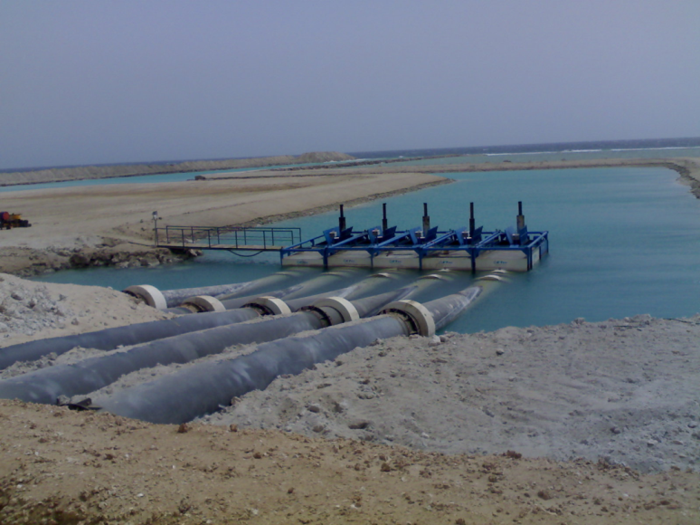
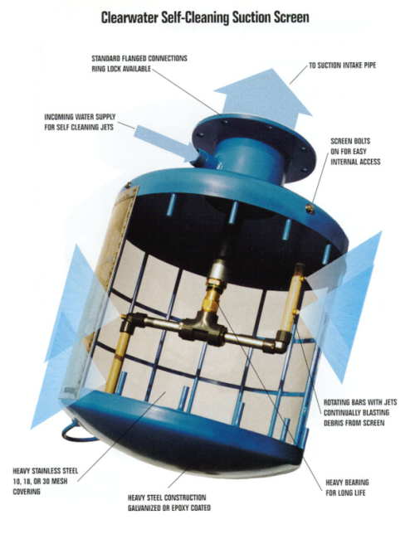
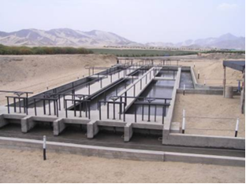
The Art of Protecting Drip Systems
Water Source
Pump Intake, Straining, Settling & Water Treatment
Pump Intake
Straining
Settling & Water Treatment

Slide 16
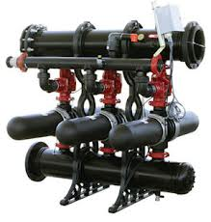
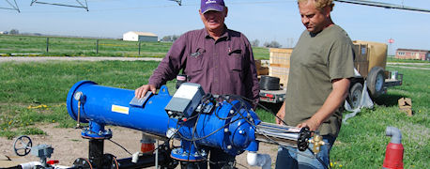
The Art of Protecting Drip Systems
Filtration & Separation:
Disc Filters
Sand Separator
Media Filters
Screen Filters

Slide 17
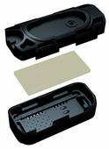
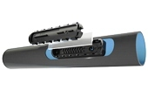
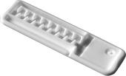
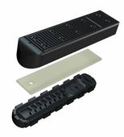
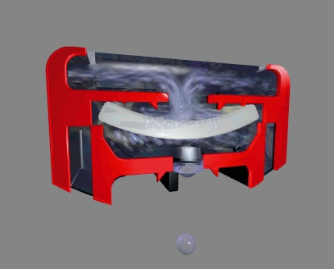
The Art of Protecting Drip Systems
Drippers:

Slide 18
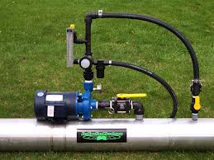
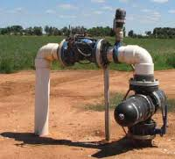
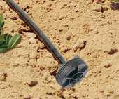
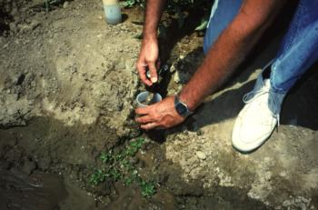
The Art of Protecting Drip Systems
System Maintenance:
Water Treatment
Secondary Filtration
Manual or Automatic Lateral Flushing

Slide 19
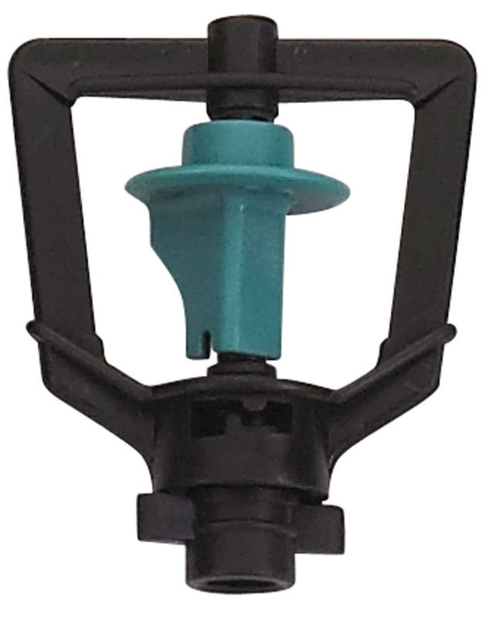
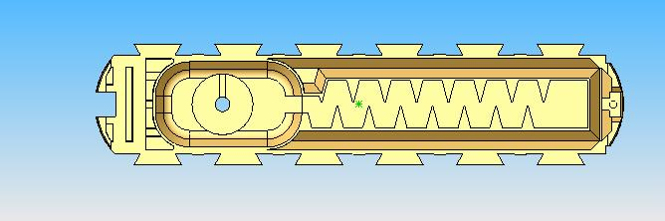
The Task – Clogging Protection
Filtration protection ratio between 1:2 to 1:10 will depend on the velocity in the orifice to be protected.
Sprinklers & Jet’s
High Velocity Orifice Water passage 1:2 to 1:3
Drippers – Low Velocity water passage 1:8 to 1:10

Slide 20
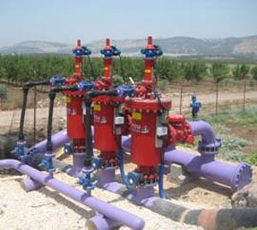
The Challenges and the Risks
Two Filter System Basic Facts:
Filters are the only irrigation system component that if it fails or compromised – can severely damage the drip system and possibly the yields.
Farmers/Operators will not know that the filters are compromised until it’s too late!!!

Slide 21
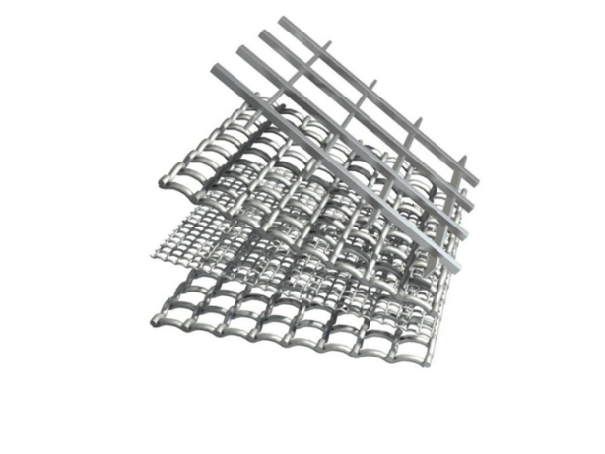
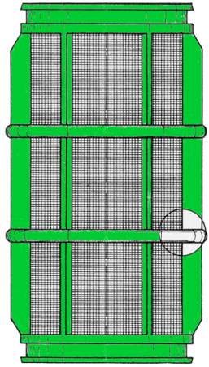

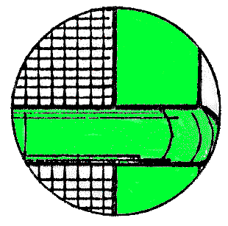
Filtration Technology
Terminology:
Mesh - The number of wires in a linear inch of a screen.
Micron - One millionth of a meter; known as a micrometer (�m).
TSS - Total suspended solids – Typically presented in PPM or mg/L.
TDS - Total dissolved solids
PSD - Particle size distribution.
NTU - Measurement of water turbidity.
Filter area, Effective area ,Open area and filtration ratio.

Slide 22
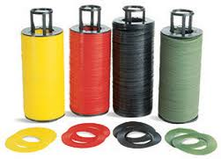
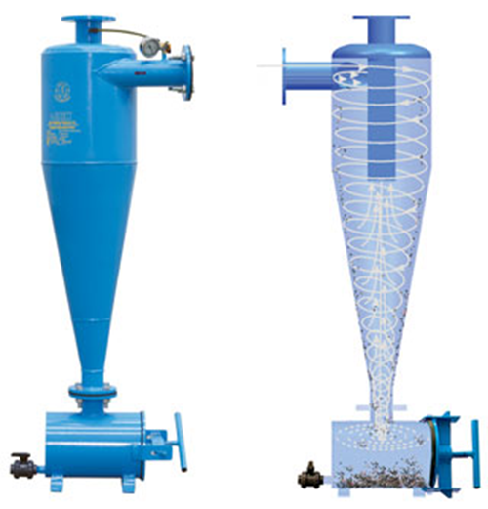
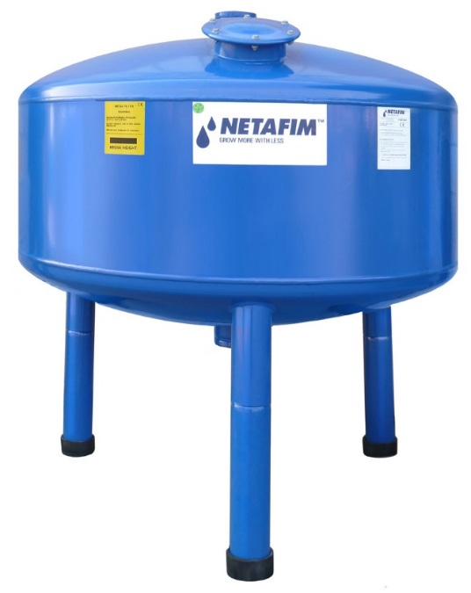
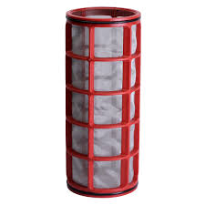
The Secret to Success
Use for your application the correct filter medium or separation technology to address the specific contamination type and potential TSS levels.

Slide 23
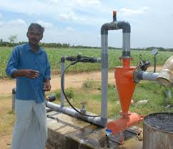
When Evaluating a Filter
What is the Grower Looking for:
The Lowest Price
The Best Protection for my Drip System and my Crop
No Headaches:
  Minimum Manual Labor
  Minimum Flush Water
  Product/System Reliability
  and Longevity.

Slide 24
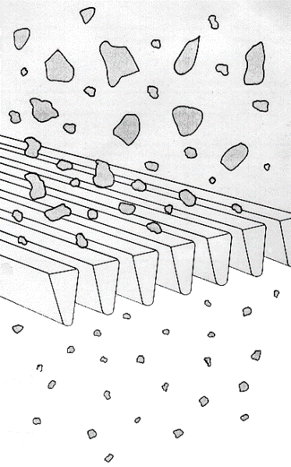
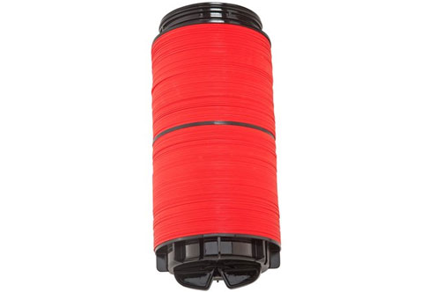

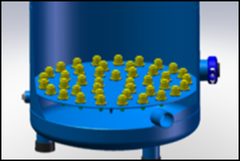
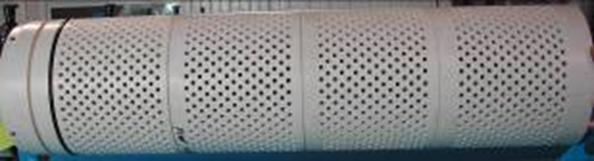
When Evaluating Filter Medium
Strength of the support structure.
Strength of the actual medium.
The Effective and Open filter areas

Slide 25
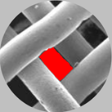
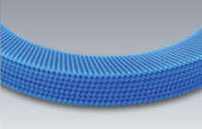
Open Area
Screen
Disc
120 Mesh = 11%
120 Mesh = 32%

Slide 26
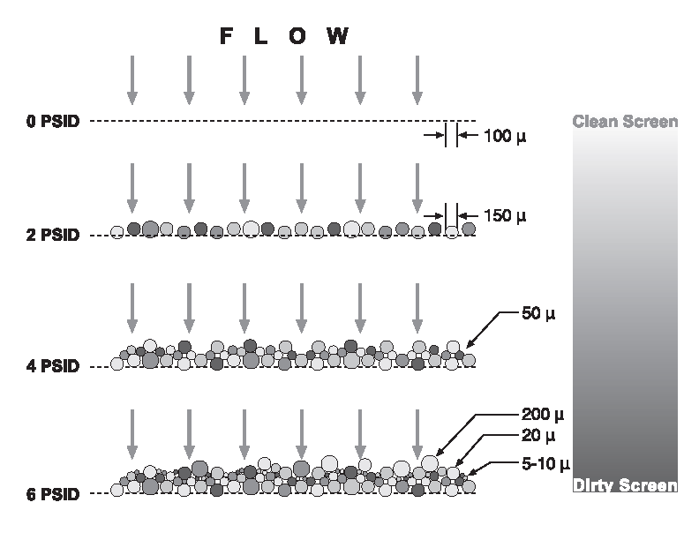
Filter Cake Effect
Is it Real?

Slide 27

Sand Filter – Flushing Process
open
close
close
open
close
open
open
close
Filtration mode
Flushing mode
Notes:
27

Slide 28
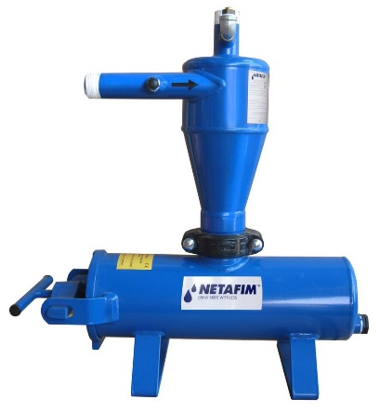

Filtration Technology
Sand Separator (Hydro cyclone)
Pros:
Very simple operation – No filter barrier.
Low Cost - due to the unit simplicity.
Cons:
Ability to operate only with particle's that are heavier
than the water.
Inability to work in changing flow rate.
Limited lifespan due to the constant “sand-blasting”

Slide 29
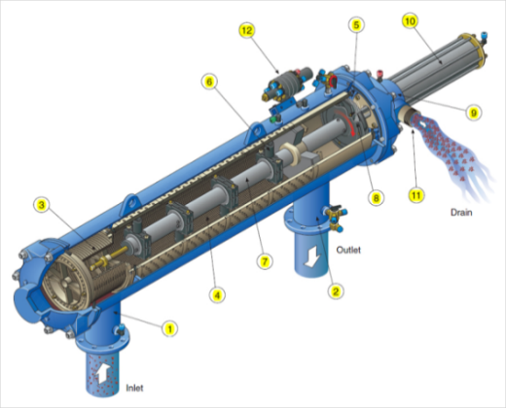
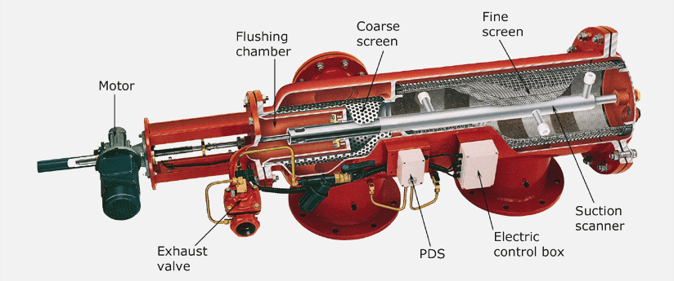
Filtration Technology
Screen Filtration in Irrigation
Pros:
The best solution for well water applications behind a cyclone or not.
A very effective unit for 50 to 80 mesh protection or 120 mesh for high flow drippers.
Very effective flushing mechanism that save waste and does not influence the irrigation cycle with low flushing flow rate.
Very small foot print for installation.
Cons:
Not very effective and efficient with organic
material as well as silt and clay removal.
Due to relatively small filter area, the
technology has limited ability to work with “dirty” water.
Moving parts in a dirty environment.
Minimum pressure for flushing.
The ability to work with coarse sand.

Slide 30
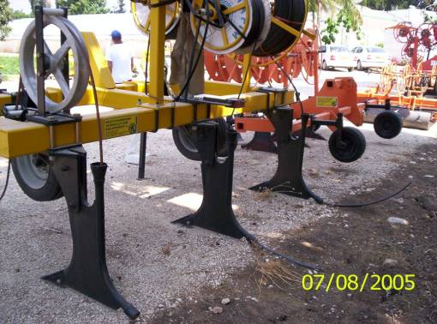
Surface to deep burial shank
For HWD
  Year 1 – On the surface
  Year 2+ - from surface to buried
Notes:
The shank on the left of the installation bar pictured above, allows for buring of surface applied drip line in 2nd year of permanent crops. This allows for establishment of young trees with surface application of water when trees have immature root system and then moved out from the young trunks and buried, after the first growing season.

Slide 31
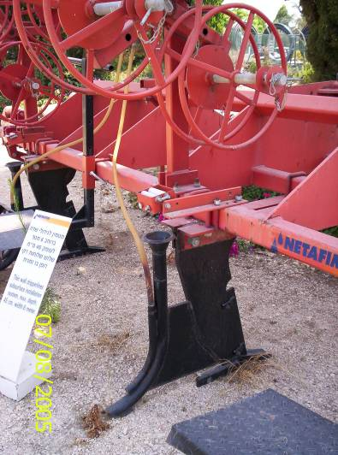
Review-
Transport & Storage
Belly Wrap
Reel Dimensions
Reel Support
Reel Alignment
Idler Assembly
Flared entry
Seamless tube
Notes:
In review, we have discussed how to store and transport TWD. 2 pallets high for storage and one for in-field transport.
The stretch wrap provides moderate protection and should be left on pallet and coils until needed for installation. Reels and pallets with stretch-wrap left intact, will not provide protection from the rain and should be undercover, if the potential for rain exists.
The cardboard belly wrap should be left on the reel until mounted on the installation shaft. This will protect the dripper line from an occasional drop of the reel during loading.
We discussed the various reel dimensions and drip line Feeding and Support Systems
We discussed the importance of spot checking alignment of reel support and mouth of shoe or feeding system, both front to back and right to left.
We discussed the height of the mounted reel over the mouth of the shoe should be between 24” and 28”
We discussed the importance of an idler assembly mounted between the bottom of the reel and the flared mouth of the installation shank (shoe).
All steel tubes where the drip comes into contact should be made of seamless tubing and bent into a gradual as possible radius. This spreads the heat out along the length and does not let it build up in one ‘hot point” of tension

Slide 32

Vertebrate Pest Management
Rodents
    Mice, Rats, Gophers, Squirrels
  Start with clean field
  Pack new installation
  Control perimeters
  Concerted effort to control
  Consult your local pest control agency for injectable materials.
Notes:
These are the usual suspects and if they are in your area they need to be considered.
Start with clean fields, if you know you have a problem treat before you do the installation.
Burrowing animals are the expected pest but also during installation mice can follow the space left by the insertion machine and might nest and chew on the flat drip line.
So running a packing wheel right after installation if not during is very important.
Control the perimeters of your fields once you have the fields under control to prevent a re-infestation.
Pest management is a concerted effort and you should use everything at your disposal to be proactive. A little effort up front will save many man hours and crop production dollars later. Utilize everything in your arsenal – Baits, Traps and Owl boxes.

Slide 33

Soil water movement with drip
Notes:
Before and irrigation with drip, saturation level, denoted in black, covers a very small area. ( no gravitational or capillary forces exist During irrigation gravitational and capillary forces pull the water down and out respectively, from the emission point. When an irrigation stops, gravitational forces continue for a short time in a sandy soil but can last up to two days in a fine clay soil. Capillary activity continues until equilibrium as been reached, as redistribution of the moisture from high moisture content to low moisture content

Slide 34


Slide 35



Slide 36


Slide 37
RESOURCES TO CONSIDER:
NRCS OFFICE
SOIL AND WATER CONSERVATION OFFICE
ENERGY TRUST OR LOCAL PUD
THINGS THEY HELP WITH:
COST SHARE ON IRRIGATION IMPROVMENTS
HIGH TUNNELS FOR YEAR ROUND PRODUCTION

Slide 38


Slide 39


Slide 40


Slide 41


Slide 42

QUESTIONS?

