Slide 1
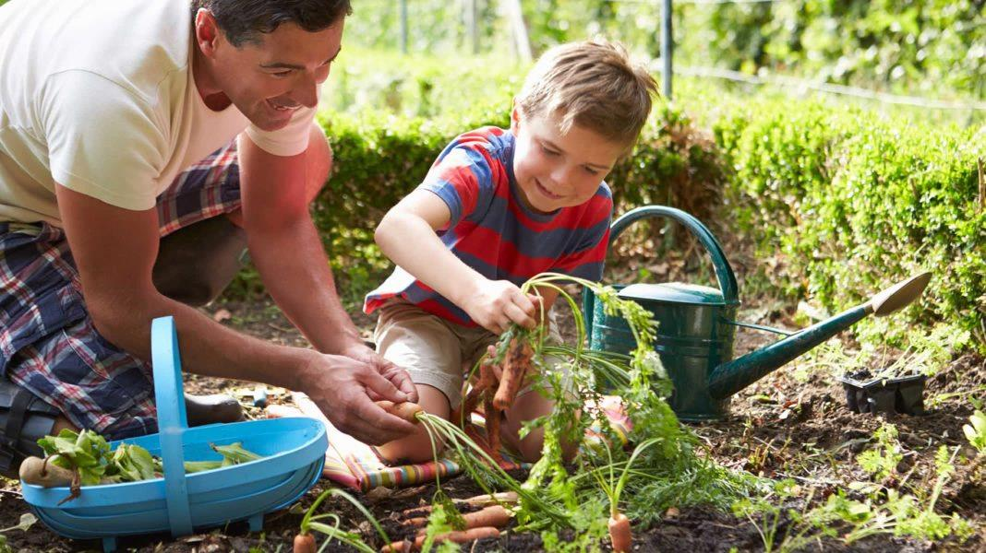
IRRIGATION FOR THE HOME GARDEN
ADVENTIST AGRICULTURAL ASSOCIATION
JANUARY 2019
PRESENTER VICTOR SCHNEIDER

Slide 2
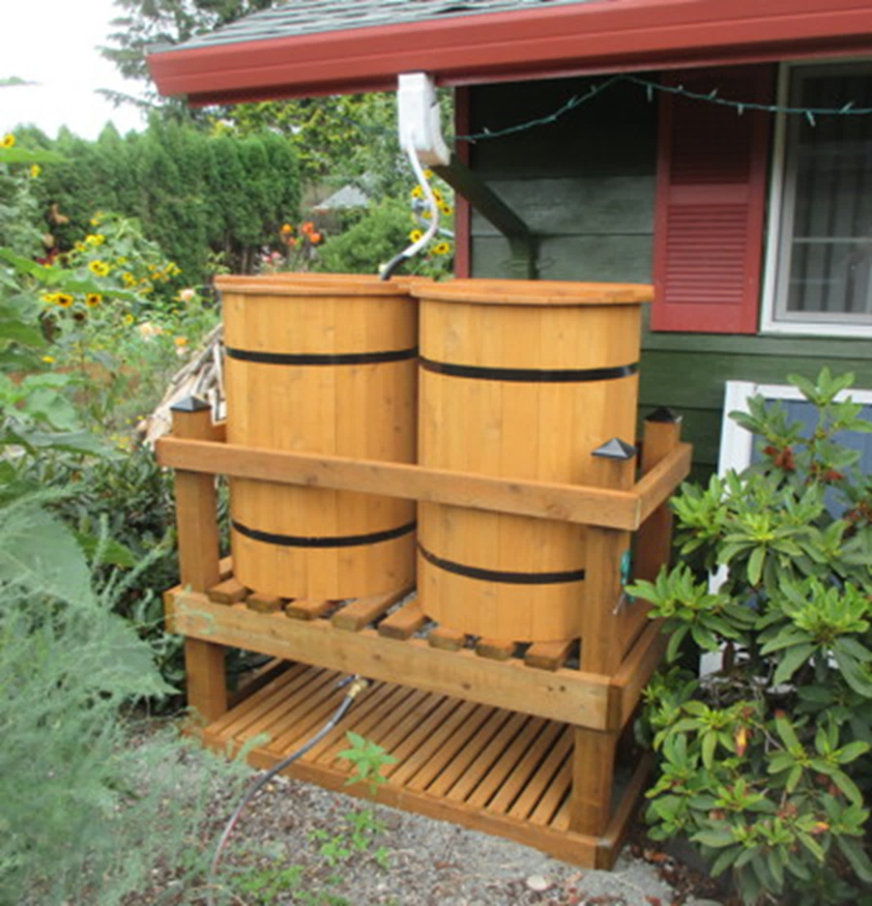
THINGS TO CONSIDER
WATER SOURCE
WELL, POND, STREAM, RAIN BARREL, WATER HAULED IN
AMOUNT OF WATER AVAILABLE
SOIL TYPE AND CONDITION
METHOD OF IRRIGATION
FILTRATION
BUDGET
TIME

Slide 3
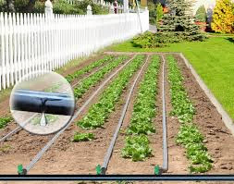
WELL WATER, RAIN BARREL, POND OR STREAM
FLAT OR RAISED BEDS
TEST FOR MINERALS, IRON, MAGANESE, HARDNESS, TDS, BACTERIA, NITRATE, ARSNIC
BASED ON QUANTITY AND QUALITY WHAT METHOD WILL YOU USE
FLOOD, SPRINKLER, DRIP
WHAT IS PRESSURE FROM WEEDS FLOOD AND SPRINKLER MAY GIVE WEEDS A HEAD START
DRIP CAN BE 90% OR MORE EFFICIENT
SPRINKLER CAN BE 65% EFFICIENT

Slide 4
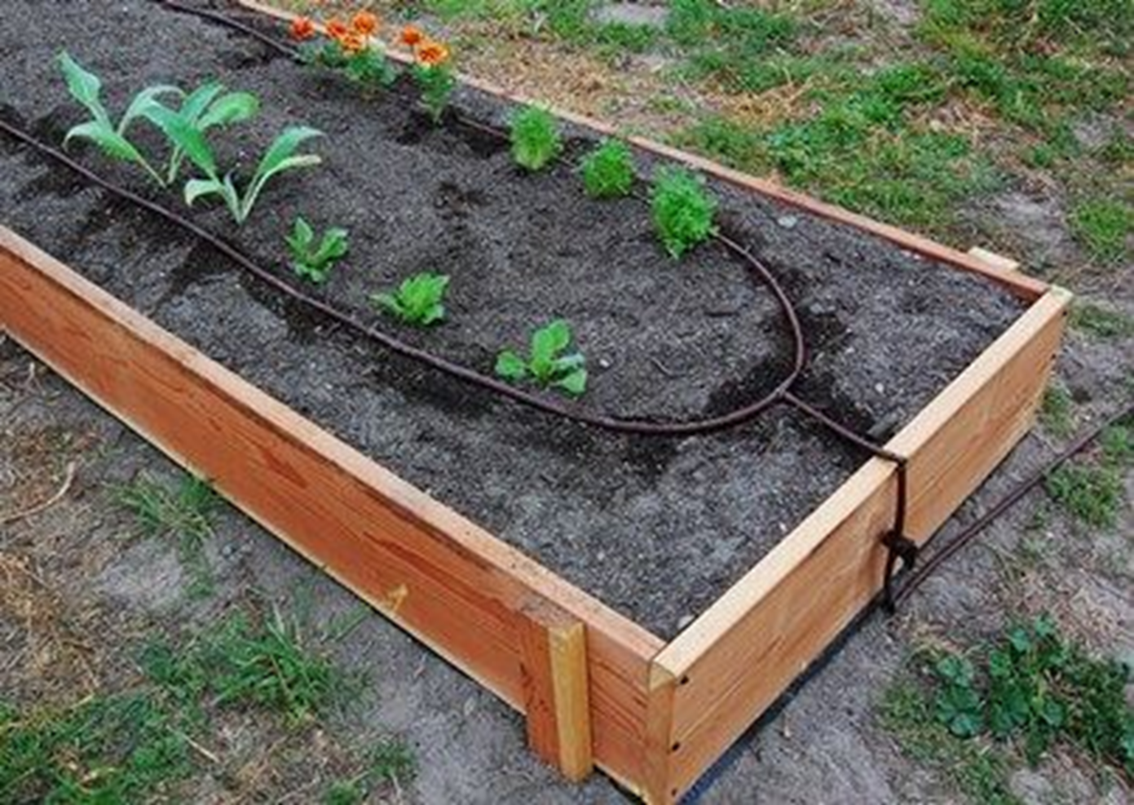

Slide 5
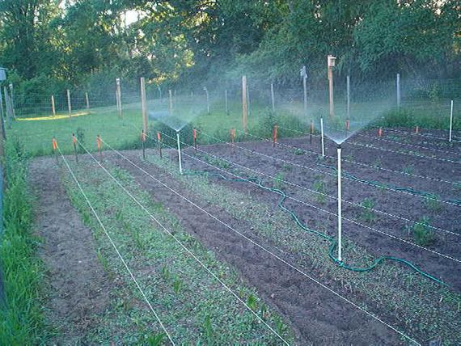

Slide 6
THINGS TO CONSIDER
DO NOT USE WHITE PVC AS SUNLIGHT WILL CAUSE IT TO YELLOW AND WILL ALLOW ALGEA TO GROW IN PIPING
GRAY ELECTRICAL CONDUIT WILL BLOCK UV RAYS TO AVOID THAT ISSUE
A LOT OF GARDNERS CHOOSE POLY PIPE BECAUSE THE THINK PVC IS LEACHING CEMICALS INTO WATER
CHOOSE SPACING AND ROW WIDTH AND LENGTH TO ALLOW FOR ROTATION
SET IT UP RIGHT AND IT WILL WORK FOR YEARS
STUB UP TO EDGE OF EACH BED OR ROW TO ALLOW WORKING BEDS BETWEEN CROPS WITHOUT HAVING UNDERGROUND PART IN WAY

Slide 7
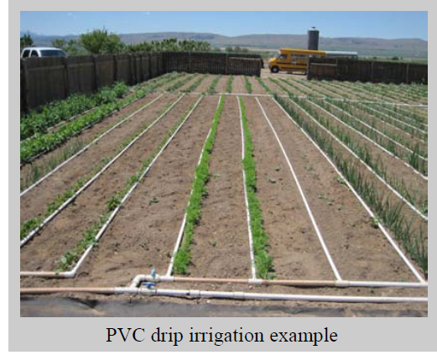
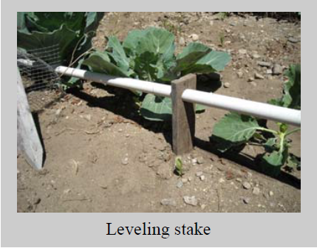
WHAT IS WRONG WITH THIS PICTURE?

Slide 8
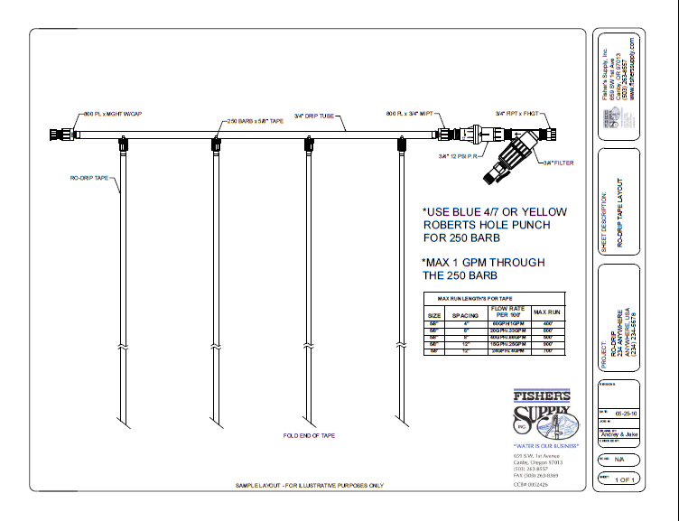

Slide 9
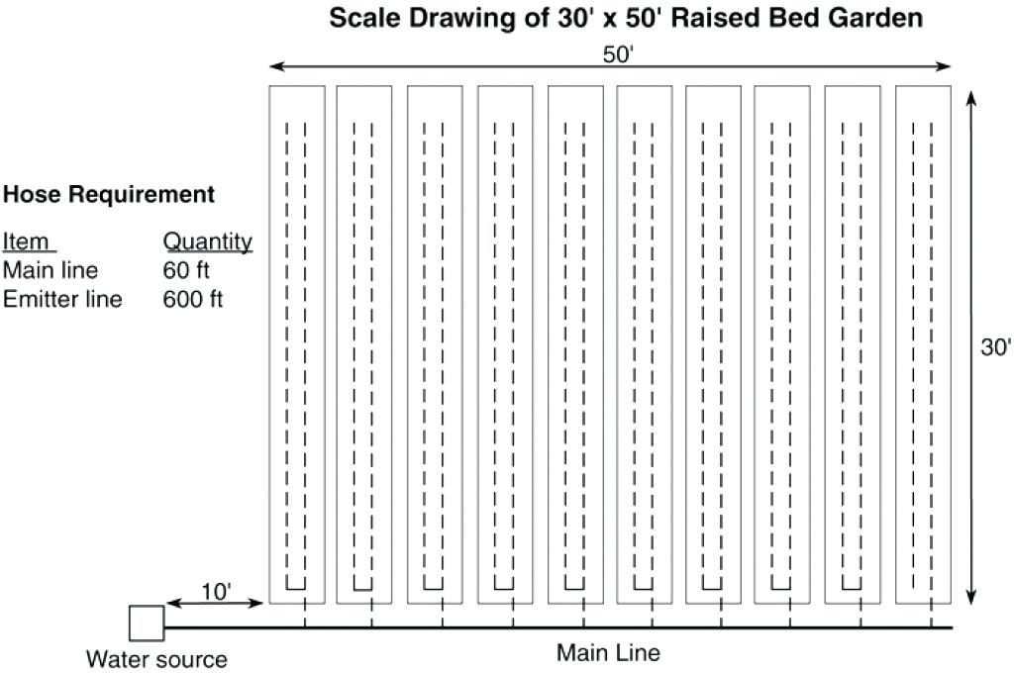

Slide 10
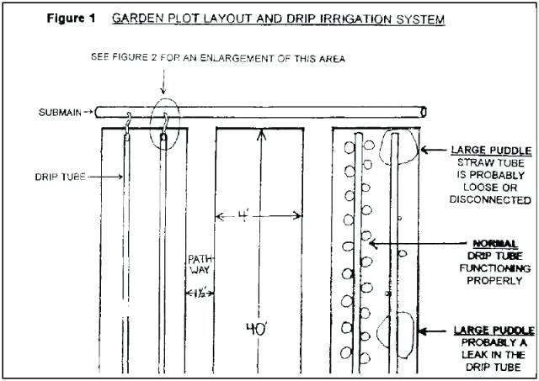

Slide 11
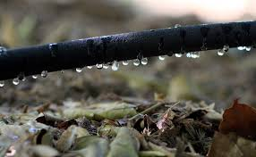
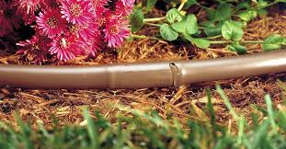

Slide 12
NON PC EMITTERS FOR GRAVITY FLOW

Slide 13
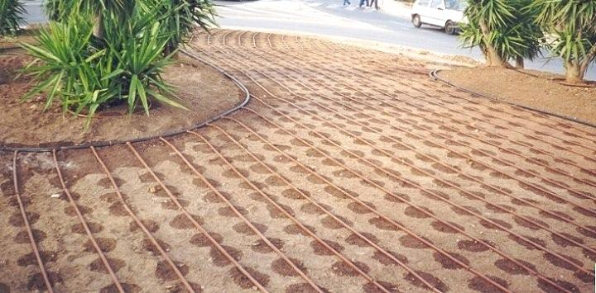

Slide 14
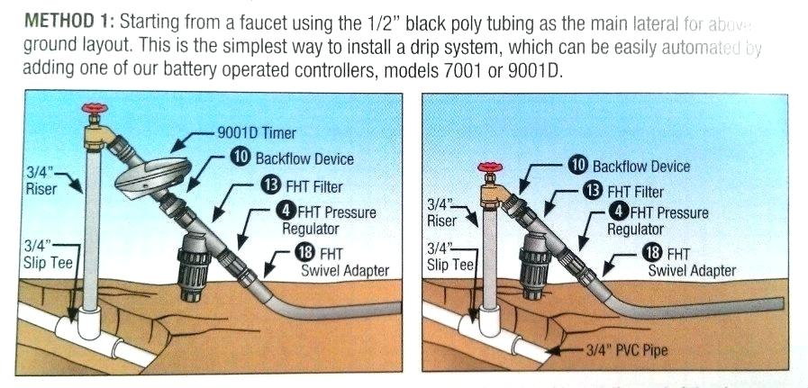

Slide 15
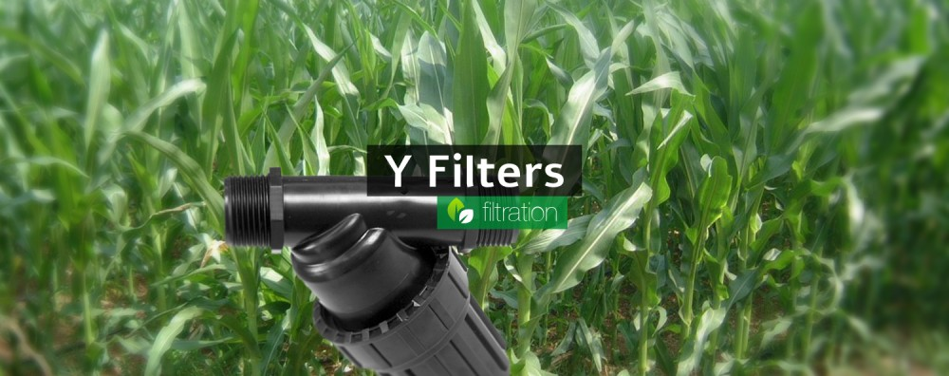
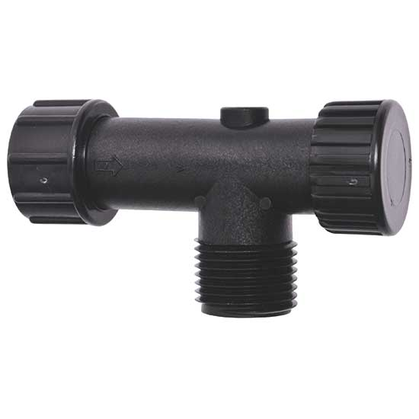

Slide 16
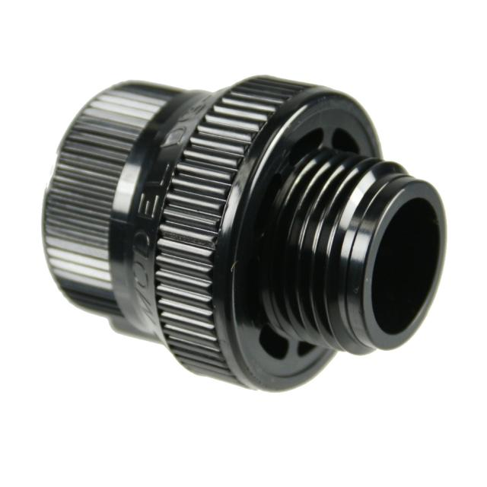
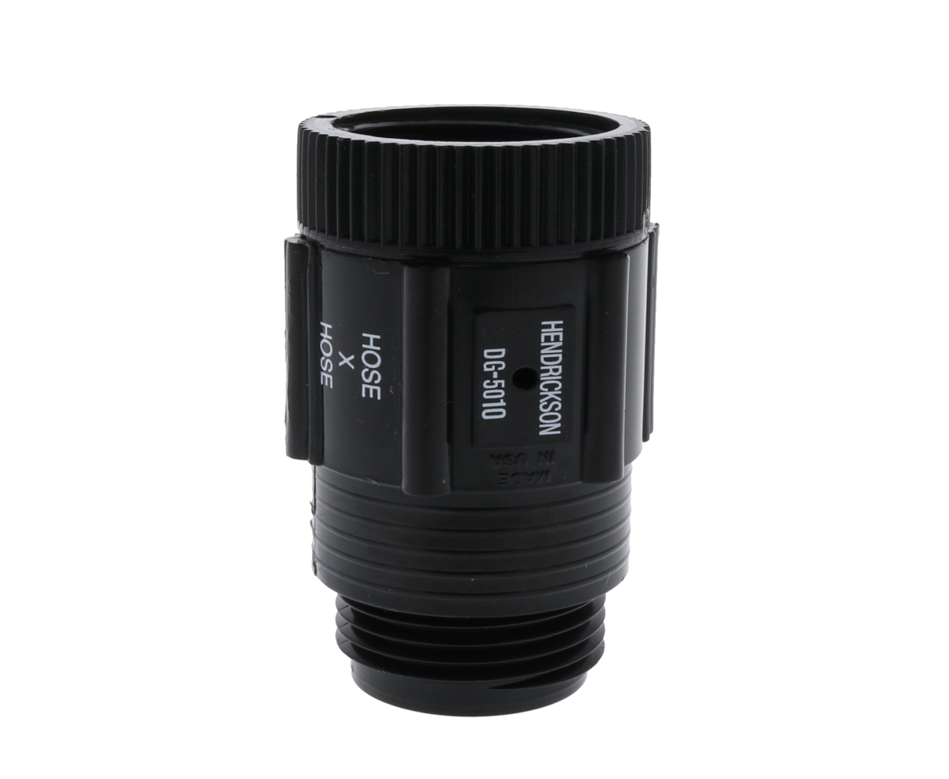
WHEN TO USE A PRESSURE REGULATOR AND OR ANTISIPHON DEVICE

Slide 17
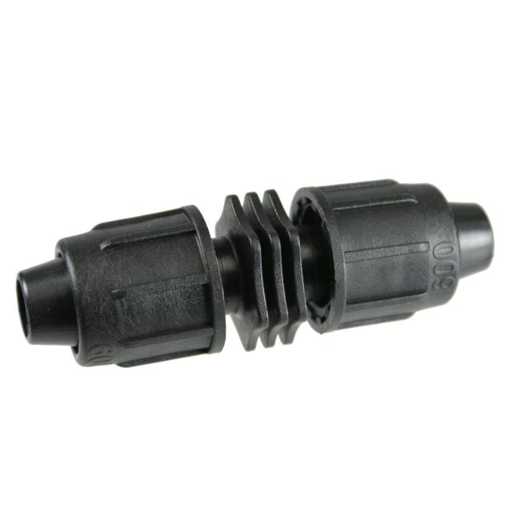
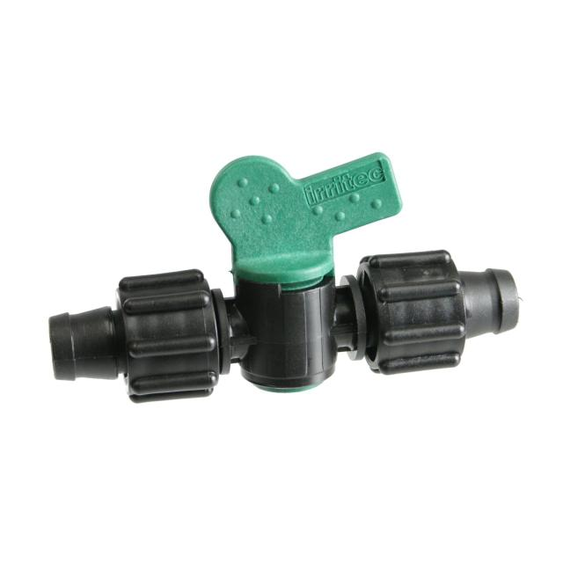
CAN YOU TELL TAPE FITTINGS FROM DRIP FITTINGS?

Slide 18
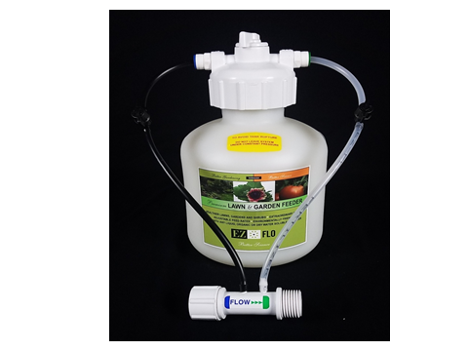
DO YOU NEED A INJECTOR

Slide 19
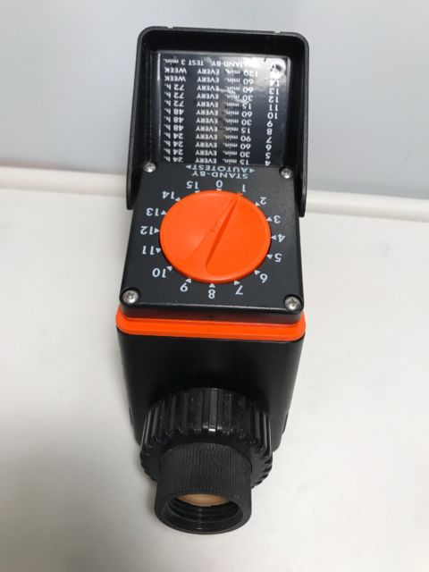
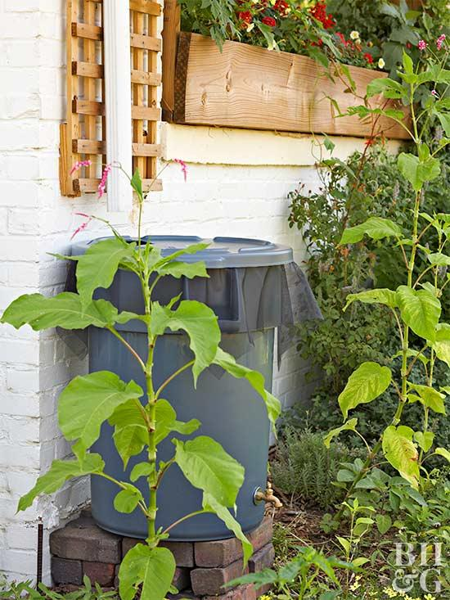
RAIN BARREL THOUGHTS
CONTROL VALVE
EMITTER
MUST BE BALL VALVE TYPE TO OPEN WITH LOW PRESSURE
PC EMITTERS START OPENING AT 5 PSE

Slide 20
QUESTIONS?

